Slide 1
Dr. Niels Raes
NLBIF node manager a.i.
GBIF EU-nodes meeting, Oslo, 21-24 May 2019 - https://biodiversitynext.org/

Slide 3
Biodiversity_Next is a joint conference by:
GBIF - Global Biodiversity Information Facility
DiSSCo - a new pan-European Research Infrastructure initiative
iDigBio - the national resource for digitized information about vouchered natural history collections
CETAF - Consortium of European Taxonomic Facilities
TDWG - Biodiversity Information Standards.
Biodiversity_Next is a conference that brings together, for the first time at this scale, major international organisations, research scientists, and policy makers to jointly identify socio-technical bottlenecks and horizon-scan opportunities around data-intensive biodiversity and geodiversity research.
GBIF EU-nodes meeting, Oslo, 21-24 May 2019 - https://biodiversitynext.org/

Slide 4
Biodiversity_Next aims at:
Promoting innovation in biodiversity & geodiversity information science and applications;
Sharing and enhancing community data standards and information management practices;
Improving domain reach to new audiences (incl. scientific, policy and industry);
Inspiring new generations to more enthusiastically embark on data-intensive science around bio- and geo-diversity;
Building community consensus on pivotal technical and sociocultural aspects of the community practices.
GBIF EU-nodes meeting, Oslo, 21-24 May 2019 - https://biodiversitynext.org/

Slide 5
Four tracks:
Science
Infrastructure
Standards
Policy & International Coordination
GBIF EU-nodes meeting, Oslo, 21-24 May 2019 - https://biodiversitynext.org/programme-tracks/

Slide 6
Symposia:
Received valid proposals: 89
Accepted proposals: 72 (78%)
Symposia: 46
Task groups and interest group meetings: 7
Workshops: 19
90-minute sessions:
Requested: 127
Granted 91.5 (72%)
Breakouts: 8 parallel sessions
Plenary speakers & plenary events: 8 sessions
GBIF EU-nodes meeting, Oslo - https://biodiversitynext.org/list-of-symposia-and-workshops/

Slide 7
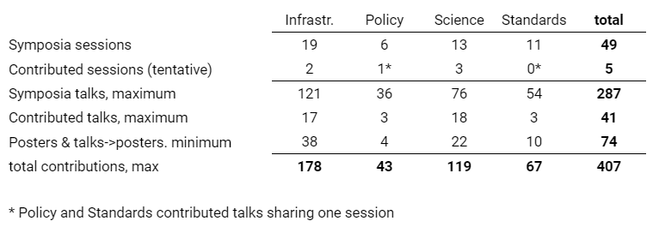
Abstracts (Work in progress--data as of 2019.05.10):

Slide 8
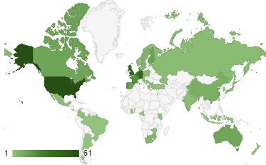
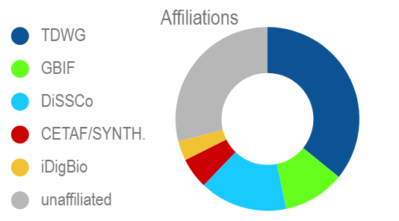
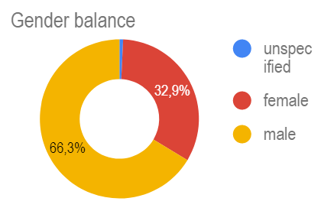

Slide 9
