Slide 1
GBIF: global biodiversity information facility
Nidelva in Trondheim by Alexander Shchukin
Dag Endresen | GBIF Node Manager for Norway
Based on slides for the GBIF - Open Biodiversity Ambassadors
Living Norway colloquium | Trondheim, Norway | 12 October 2020
Notes:
Background image: Nidelva in Trondheim by Alexander Shchukin. CC BY NC ND 2.0
GBIF: global biodiversity information facility – presented by Dag Endresen, GBIF Node Manager for Norway; University of Oslo; Living Norway colloquium in Trondheim 12 October 2020
Slides credit: Based on a slide-set by GBIF Scientific Officer Dmitry Schigel <dschigel@gbif.org>; Biodiversity Open Data Ambassadors, https://www.gbif.org/article/6dNF1d0tgcI4cmqeoS2sQ4/biodiversity-open-data-ambassadors

Slide 2
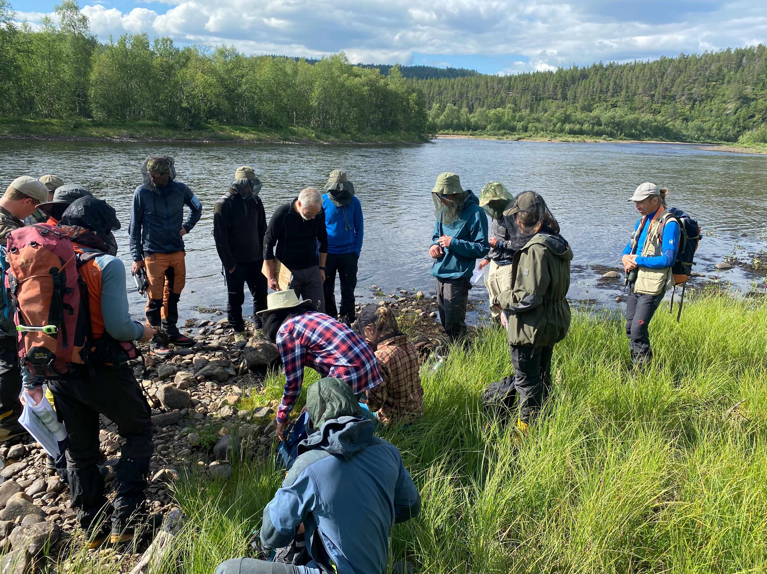
Why approach open Science in ecology?
Notes:
Photo CC0 Dag Endresen, University of Oslo Geo-ecology research group field trip to Karasjok Finmark in August 2020; https://www.inaturalist.org/projects/geco2020karasjok

Slide 3
Why approach open Science in Ecology?
We are in the middle of an ongoing paradigm shift in scientific practice (and impact metrics).
The open science wave is moving fast!
Ecology researchers will need to develop different approaches, than they needed in the past – to remain relevant.
Society is quickly gaining Big Data maturity and will expect new services from biodiversity information and research.

Slide 4
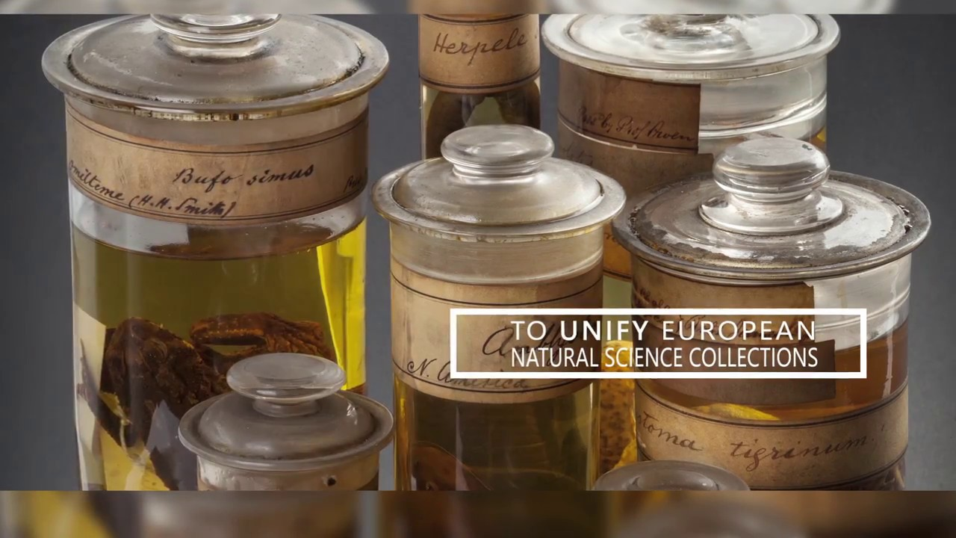
Data Citation as a new currency of Science
Peer-reviewed scholarly papers in high impact journals maintain considerable weight for impact metrics.
A movement is under way to build similar status for open data, open metadata, open material samples, and other open scientific research products…

Slide 5
Data citation principles
Data to be legitimate citable products of research.
Data citations giving scholarly credit and attribution.
In scholarly literature, whenever claims are based on data, data should always be cited.
Persistent method for identification of data, that is machine actionable, globally unique, universal.
Data citation facilitate access to data or at least to metadata.
Unique identifiers that persist even beyond the lifespan of the data.
Data citation identify and access the specific data that support verification of the claim (provenance, time-slice, version).
Flexible, but attention to interoperability of practices across communities.
Data Citation Synthesis Group: Joint Declaration of Data Citation Principles. Martone M. (ed.) San Diego CA: FORCE11; 2014; https://doi.org/10.25490/a97f-egyk
Notes:
Joint Declaration of Data Citation Principles - FINAL
When citing please use: Data Citation Synthesis Group: Joint Declaration of Data Citation Principles. Martone M. (ed.) San Diego CA: FORCE11; 2014 https://doi.org/10.25490/a97f-egyk
https://www.force11.org/datacitationprinciples | https://www.force11.org/group/joint-declaration-data-citation-principles-final
Endorsement List
Preamble
Sound, reproducible scholarship rests upon a foundation of robust, accessible data. For this to be so in practice as well as theory, data must be accorded due importance in the practice of scholarship and in the enduring scholarly record. In other words, data should be considered legitimate, citable products of research. Data citation, like the citation of other evidence and sources, is good research practice and is part of the scholarly ecosystem supporting data reuse.
In support of this assertion, and to encourage good practice, we offer a set of guiding principles for data within scholarly literature, another dataset, or any other research object.
These principles are the synthesis of work by a number of groups. As we move into the next phase, we welcome your participation and endorsement of these principles.
--
Principles
The Data Citation Principles cover purpose, function and attributes of citations. These principles recognize the dual necessity of creating citation practices that are both human understandable and machine-actionable.
These citation principles are not comprehensive recommendations for data stewardship. And, as practices vary across communities and technologies will evolve over time, we do not include recommendations for specific implementations, but encourage communities to develop practices and tools that embody these principles.
The principles are grouped so as to facilitate understanding, rather than according to any perceived criteria of importance.
1. Importance
Data should be considered legitimate, citable products of research. Data citations should be accorded the same importance in the scholarly record as citations of other research objects, such as publications[1].
2. Credit and Attribution
Data citations should facilitate giving scholarly credit and normative and legal attribution to all contributors to the data, recognizing that a single style or mechanism of attribution may not be applicable to all data[2].
3. Evidence
In scholarly literature, whenever and wherever a claim relies upon data, the corresponding data should be cited[3].
4. Unique Identification
A data citation should include a persistent method for identification that is machine actionable, globally unique, and widely used by a community[4].
5. Access
Data citations should facilitate access to the data themselves and to such associated metadata, documentation, code, and other materials, as are necessary for both humans and machines to make informed use of the referenced data[5].
6. Persistence
Unique identifiers, and metadata describing the data, and its disposition, should persist -- even beyond the lifespan of the data they describe[6].
7. Specificity and Verifiability
Data citations should facilitate identification of, access to, and verification of the specific data that support a claim. Citations or citation metadata should include information about provenance and fixity sufficient to facilitate verfiying that the specific timeslice, version and/or granular portion of data retrieved subsequently is the same as was originally cited[7].
8. Interoperability and Flexibility
Data citation methods should be sufficiently flexible to accommodate the variant practices among communities, but should not differ so much that they compromise interoperability of data citation practices across communities[8].

Slide 6
What is gbif?
Intergovernmental network and research infrastructure
Provides anyone, anywhere, free and open access to data about all types of life on Earth
Voluntary collaboration through Memorandum of Understanding
Participant nodes, Secretariat in Copenhagen, Denmark
https://www.gbif.org
Notes:
https://www.gbif.org/

Slide 7
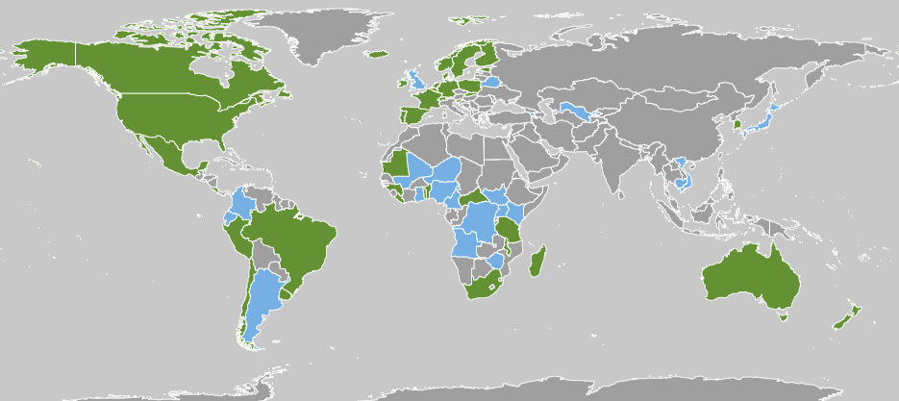
GBIF Participant countries
41 | Voting Participants
21 | Associate Countries
38 | Other Associate
1652 | Data publishers
Notes:
Participation

Slide 8
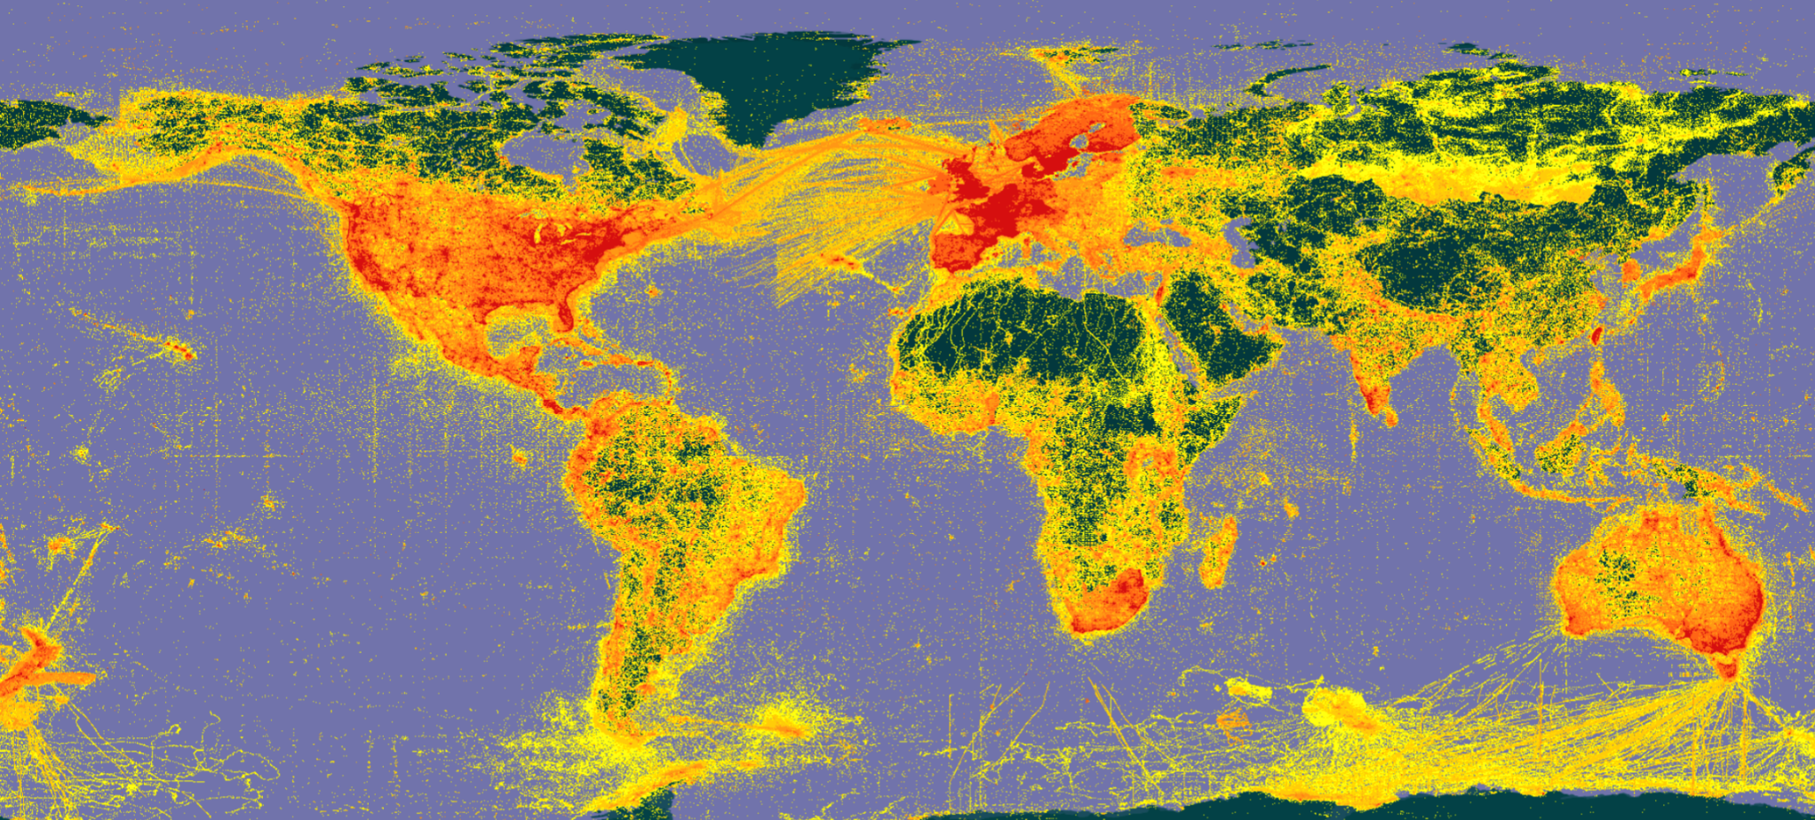
A window on evidence about where species HAVE lived, and when
Observations
Digitized specimens
Data publishing and indexing
Literature
Common standards (DwC)
Data discovery and use
Remote-sensing
Environmental DNA

Slide 9
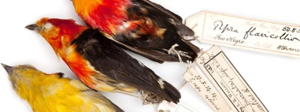
GBIF: Multiple-purpose data publishing services
EU Directive reporting
(proposed workflow)
Darwin Core
Bio-Collections
& ecology datasets
Norwegian Red List
Research data portals
portal
Notes:
One-stop data publishing for data-flow into multiple information systems

Slide 10
BY THE NUMBERS | 7 October 2020
1 603 395 882
54 583
Datasets
Species occurrence records
1 652
5 042
Peer-review papers
using data
62
38
Country Participants
Organizational Participants
23.6 billion
Average records downloaded per month (2020 ytd)
Publishers
Notes:
A window on biodiversity
An informatics infrastructure focused on tools and standards in service to science and society
A global network on bioinformatics

Slide 11
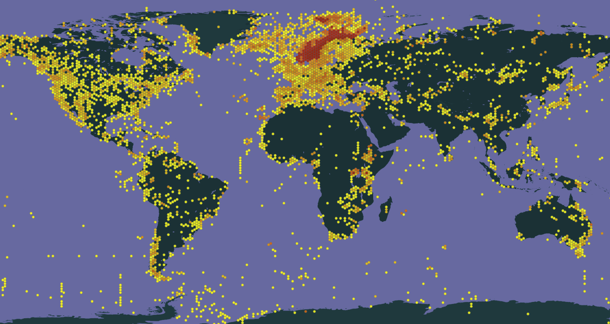
BY THE NUMBERS | 7 October 2020 -- Norway
40 142 211
287
Datasets (published from)
Species occurrence records (published from)
38
119
Peer-review papers
using data (co-author from Norway
62
38
Country Participants
Organizational Participants
Publishers
(from Norway)
23.6 billion
Average records downloaded per month (2020 ytd)
Notes:
A window on biodiversity
An informatics infrastructure focused on tools and standards in service to science and society
A global network on bioinformatics

Slide 12
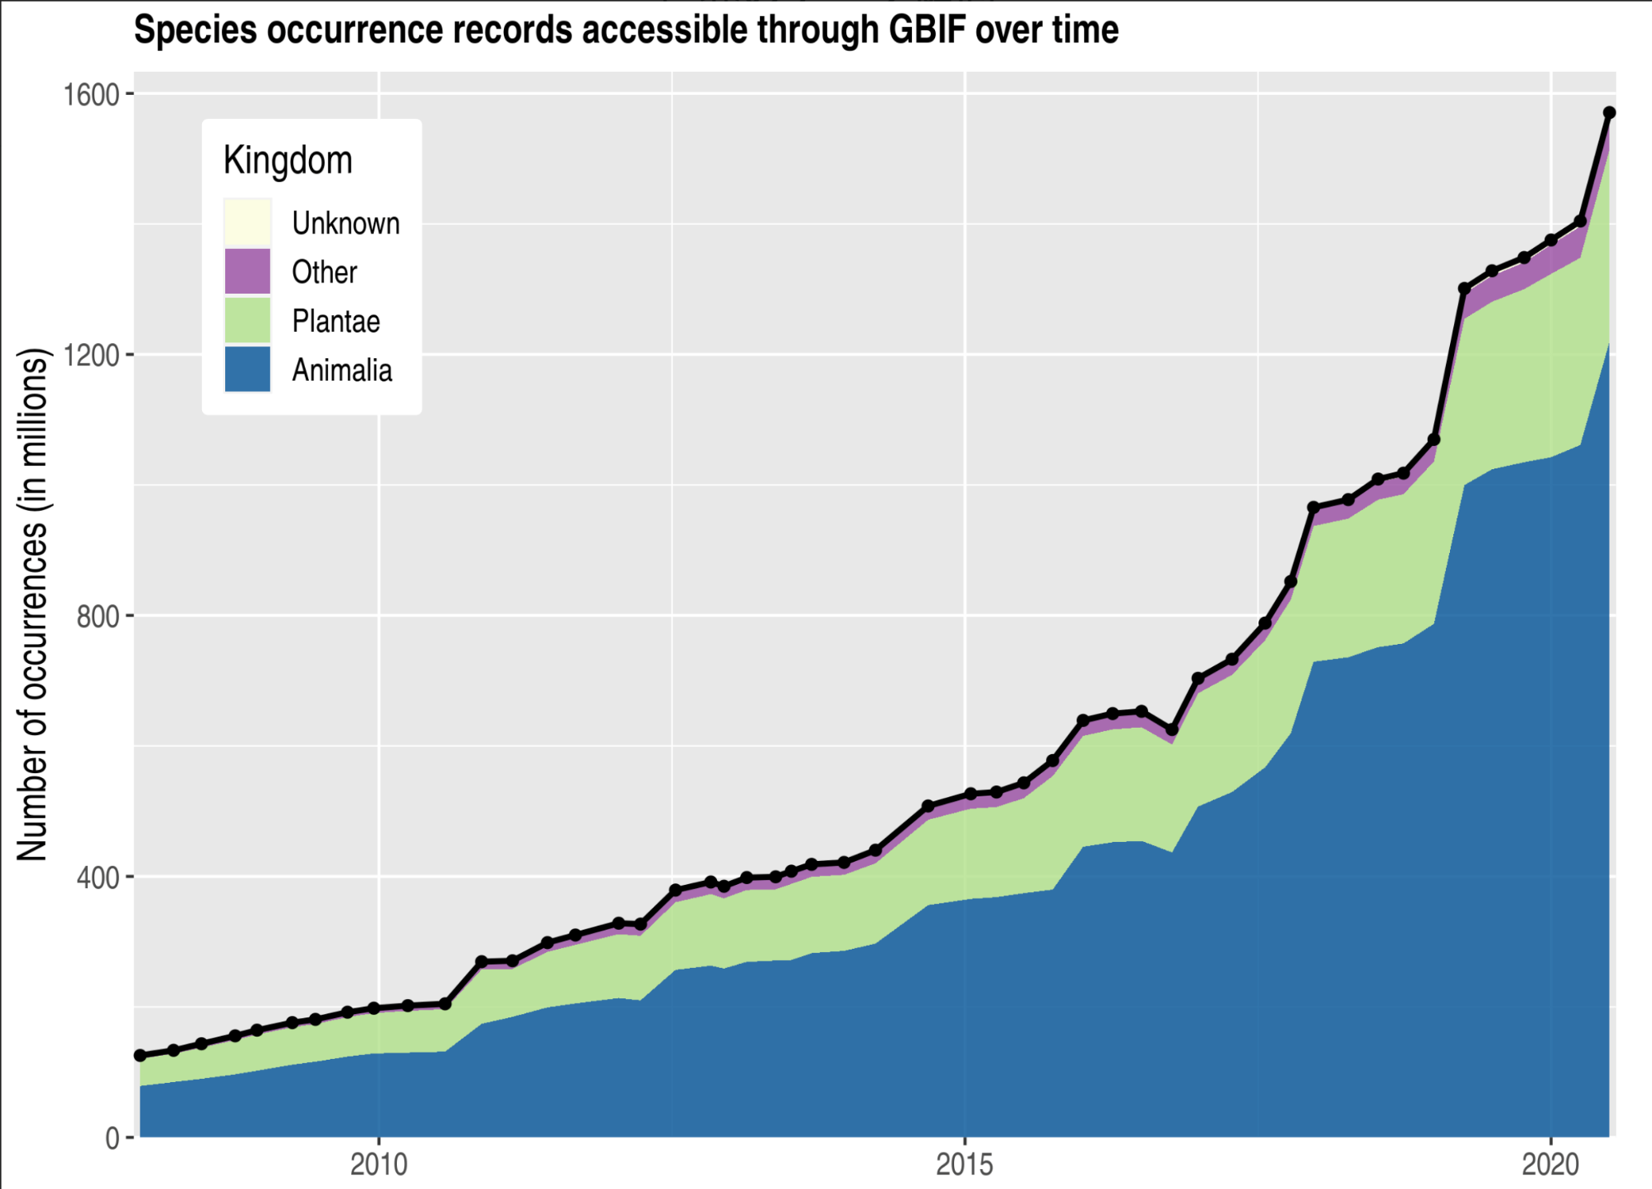
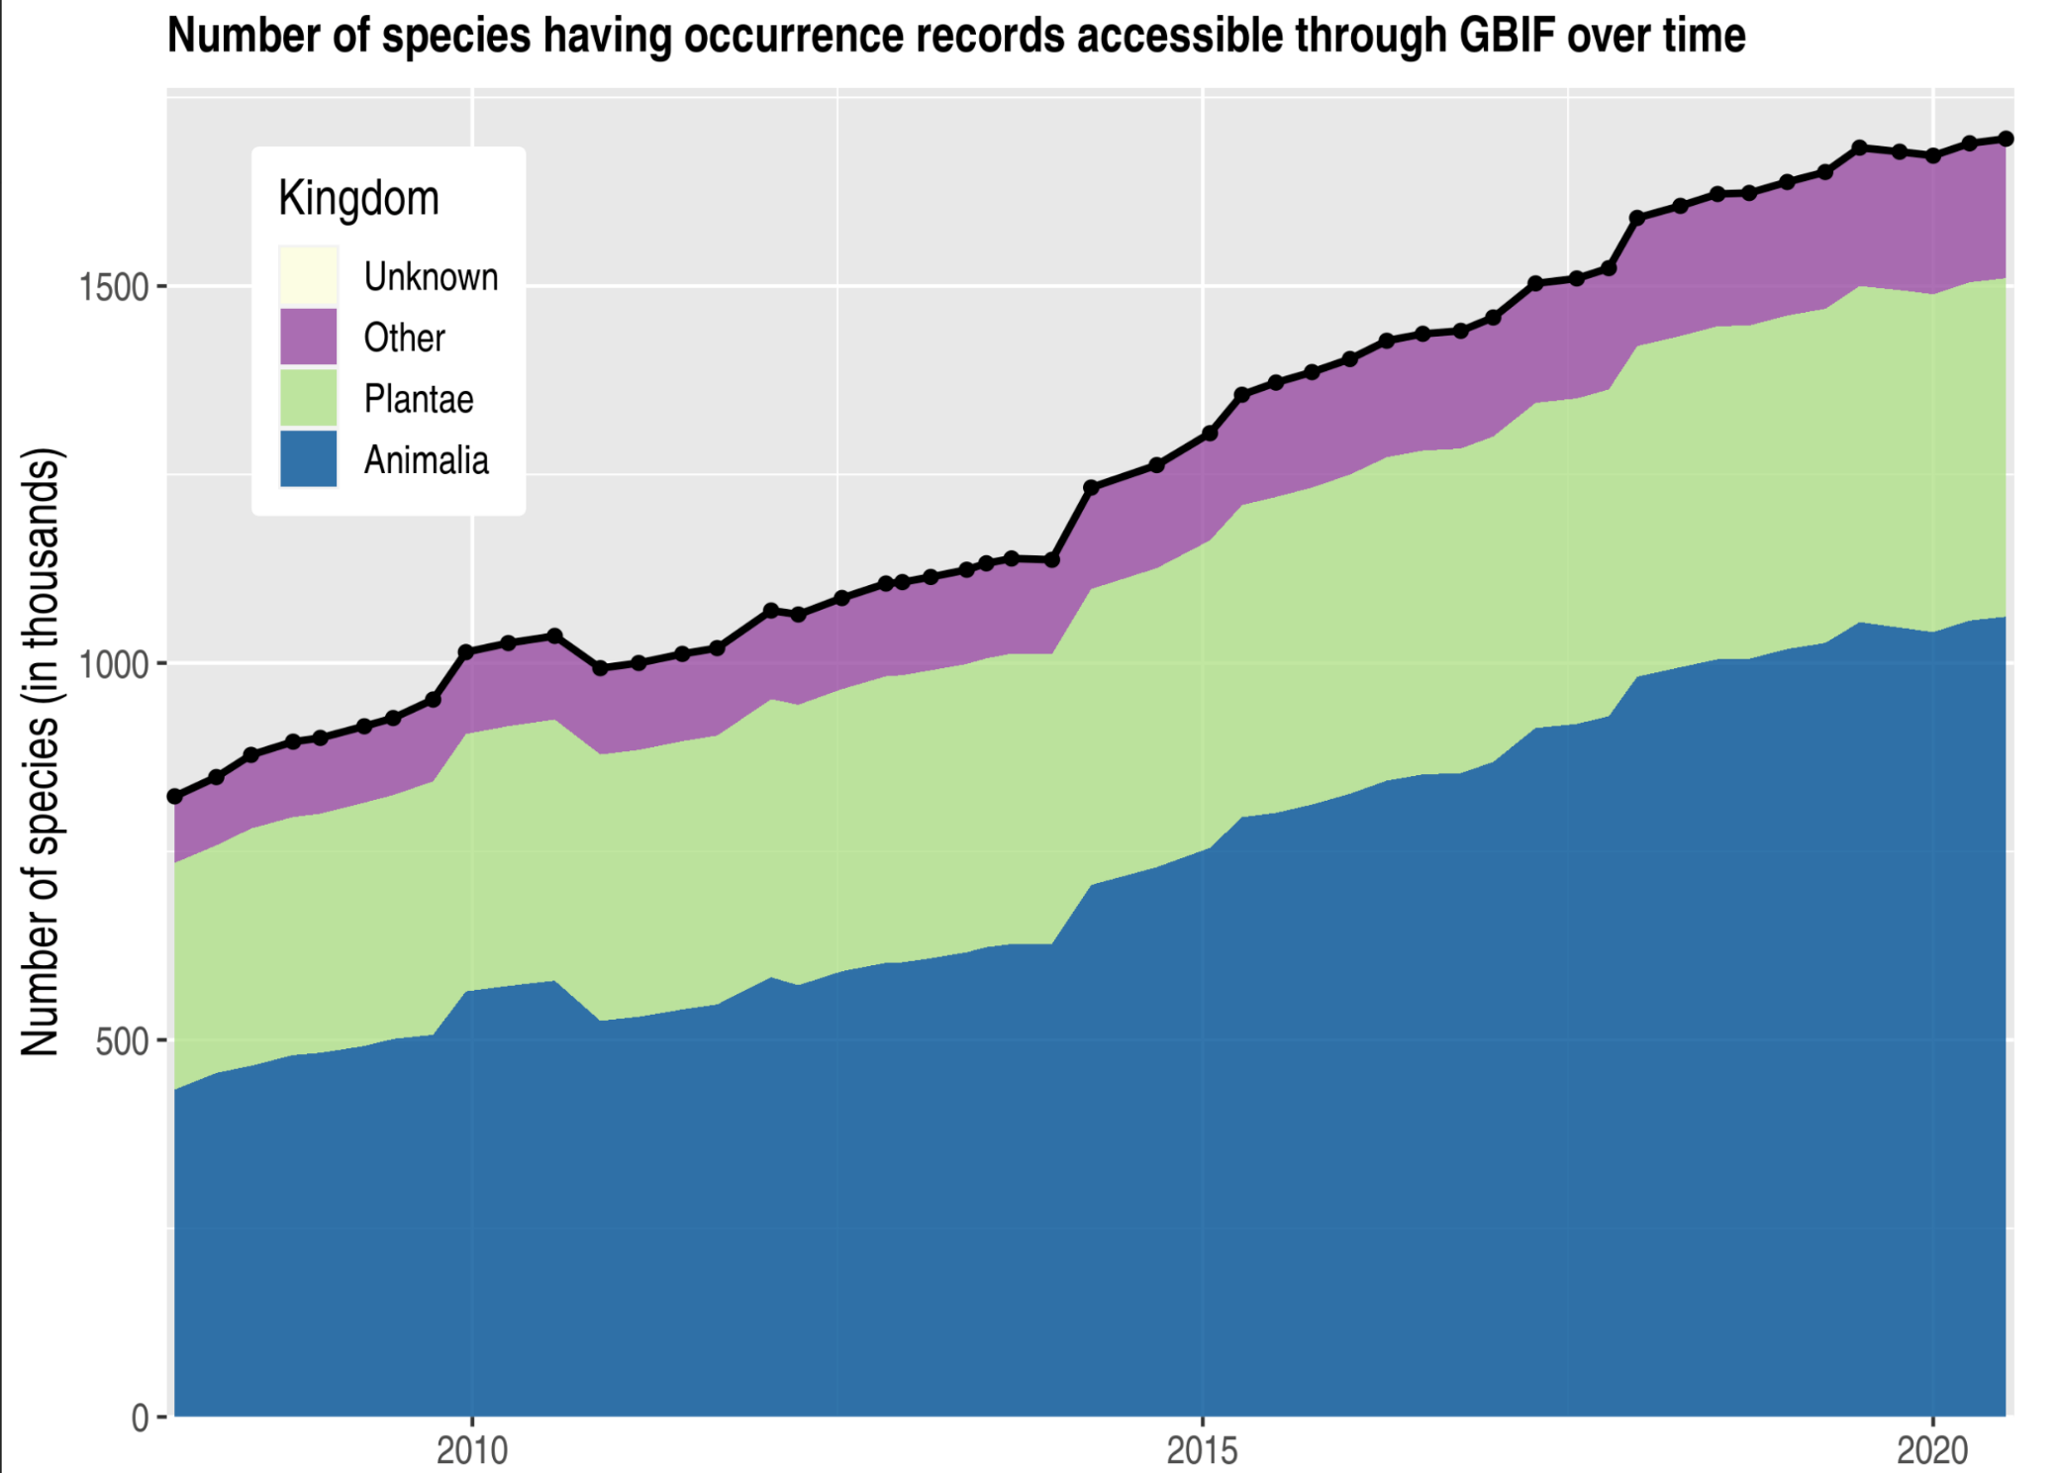
Data trends on GBIF.org
% specimens
Notes:
Data growth and evolution of evidence

Slide 13
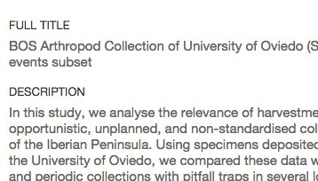
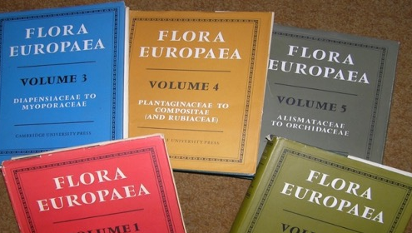
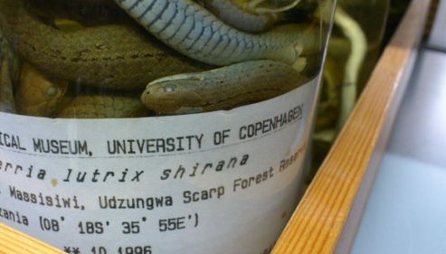
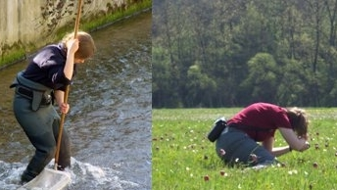
Data richness levels supported by Gbif
Dataset description, taxonomic/geographic/temporal scope
List of taxa
regional or thematic (e.g. invasive, medicinal)
M
C
Dataset metadata
Species checklists
Species occurrences dates, coordinates, basis of record
Species occurrences and sampling events dates, coordinates, sampling effort / protocol, abundance
O
SE
Occurrence-only data
Sampling-event data
Notes:
Four richness levels -- https://www.gbif.org/dataset-classes

Slide 14
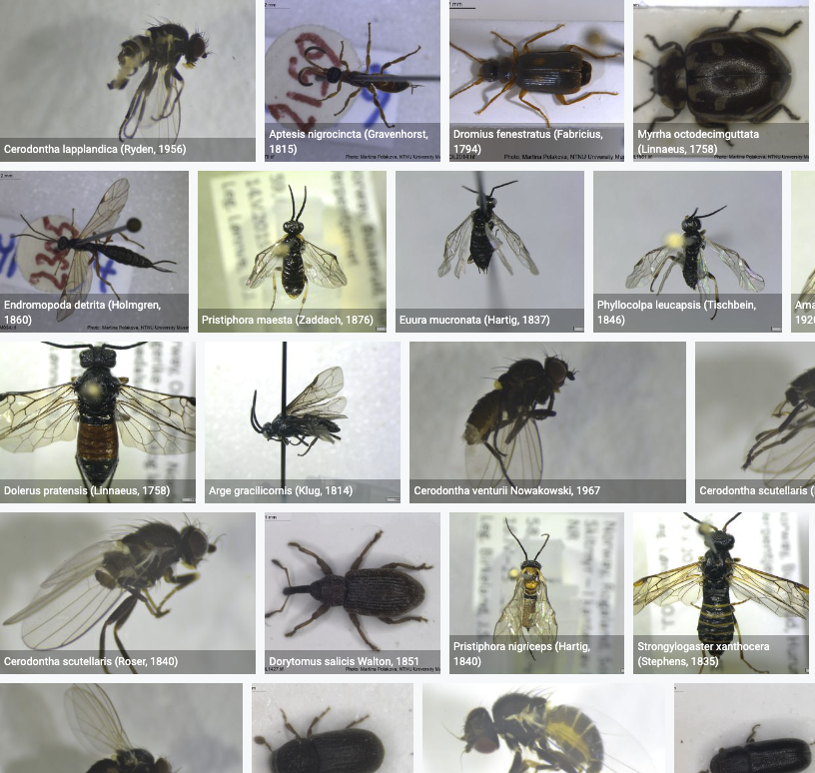
Species occurrence records with Multimedia evidence 7th October 2020
66.3 million records with taxonomically identified images (1.7 million from Norway)
35.7 million specimens (Norway: 775 051)
28.2 million human observations (Norway: 884 969)
1.3 million material samples (Norway: 36 919)
644 066 audio files (Norway: 3 193)
2 480 videos (Norway: 4)
https://www.gbif.org/occurrence/gallery
Notes:
Multimedia

Slide 15
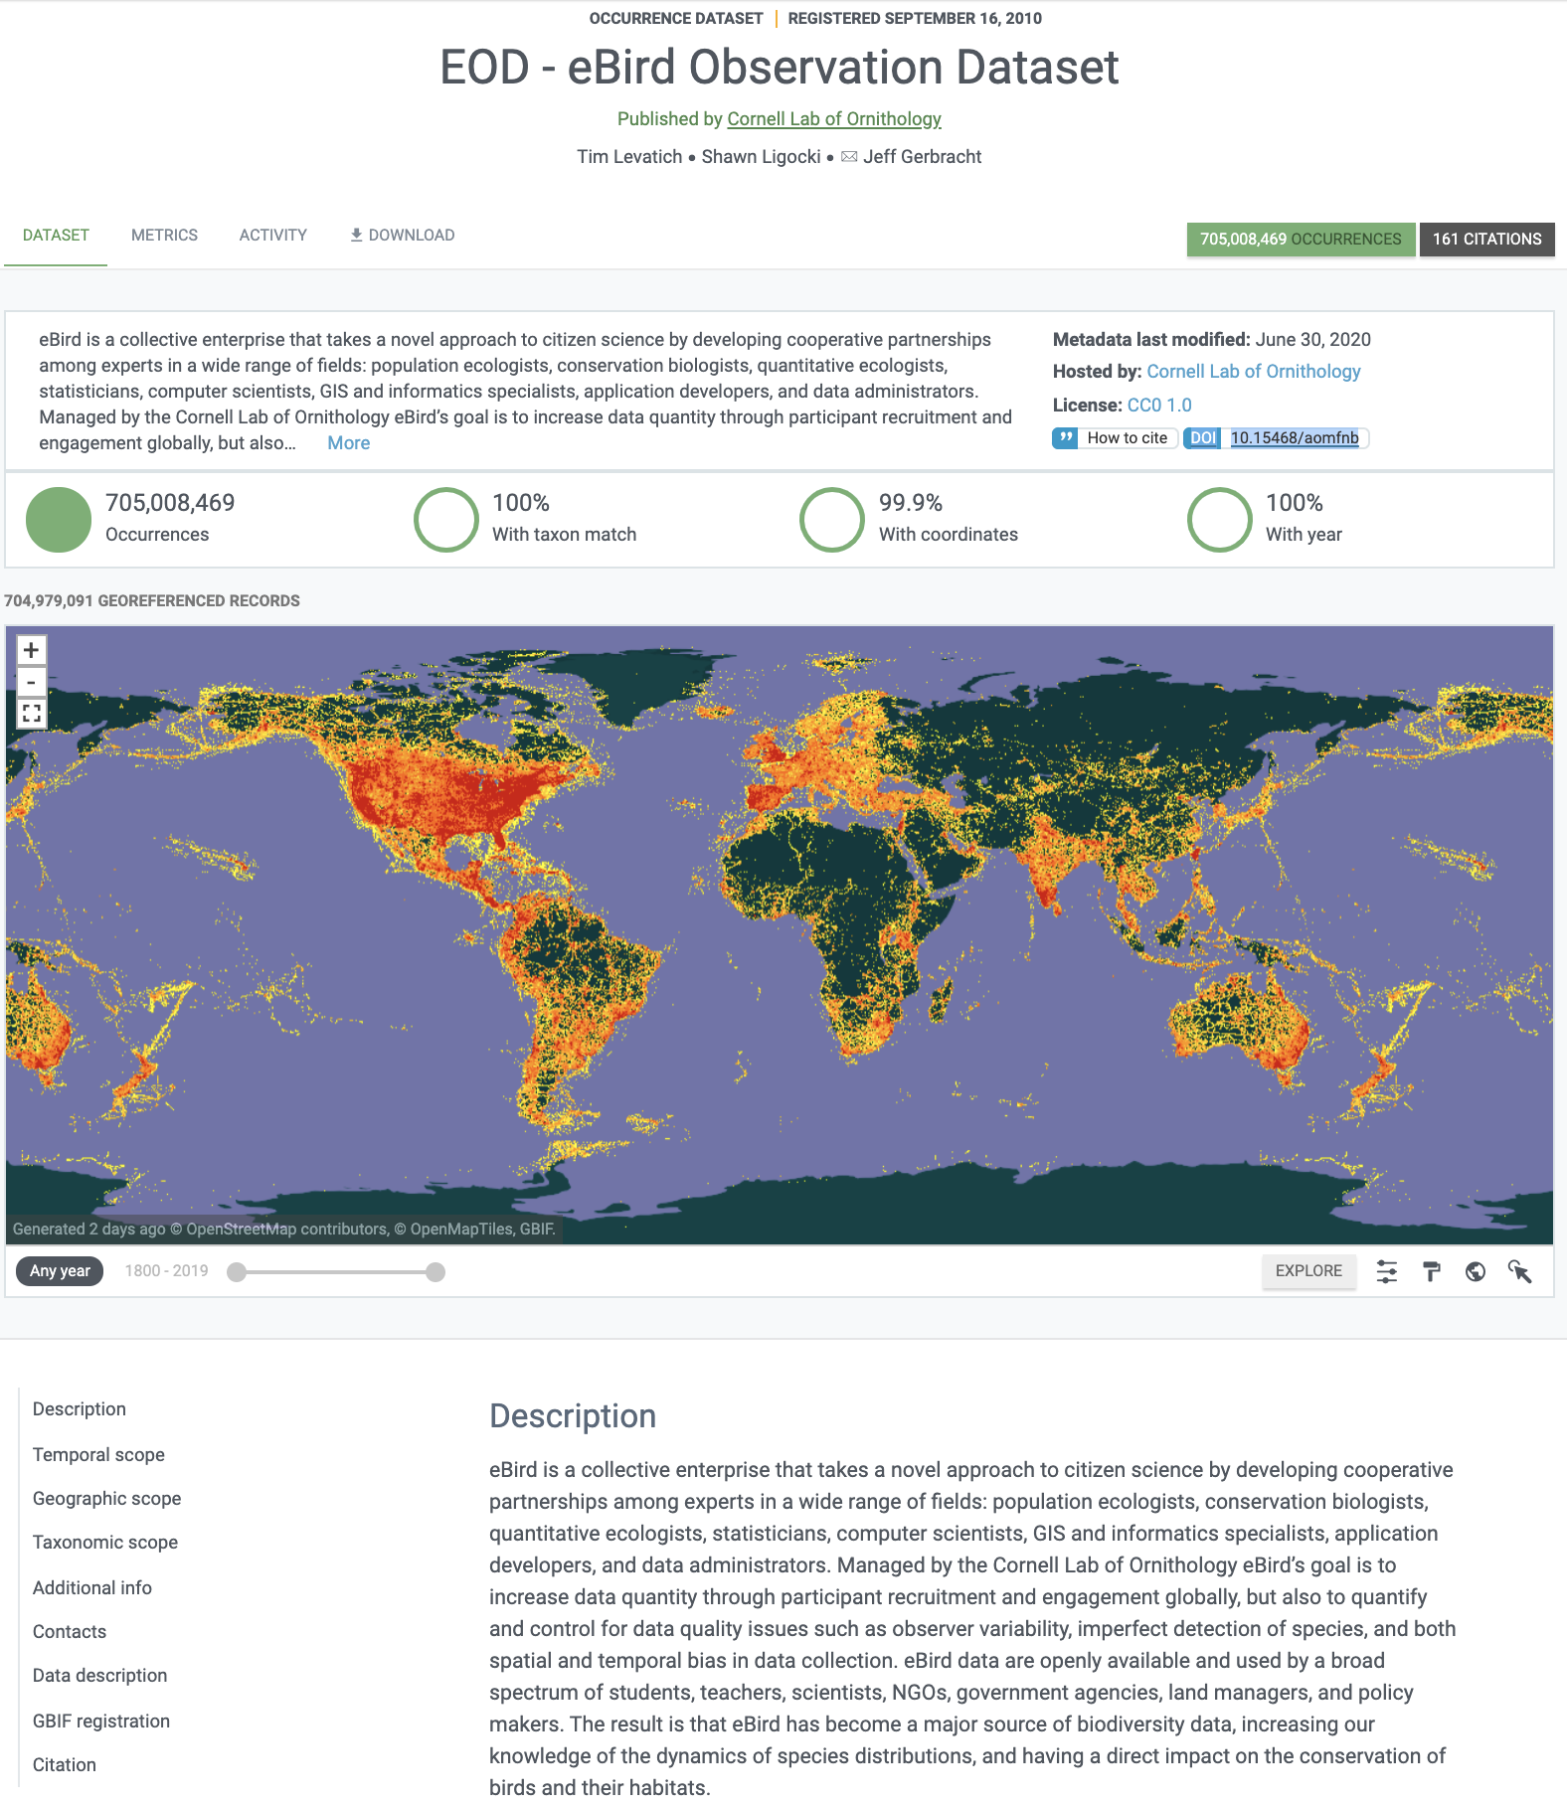
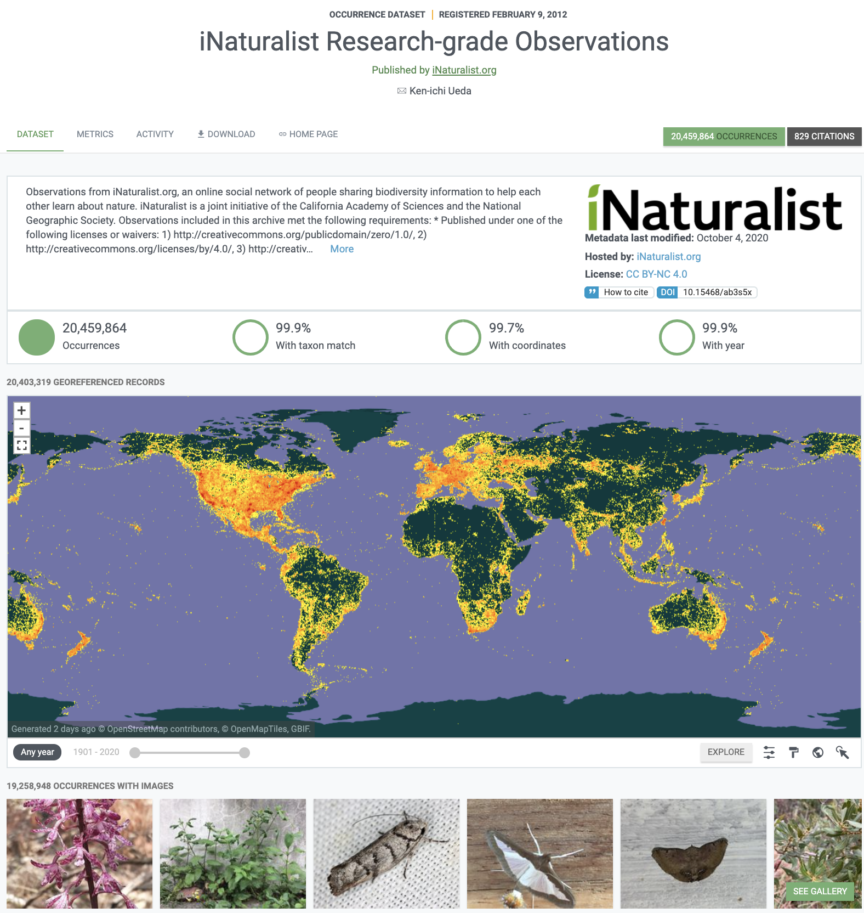
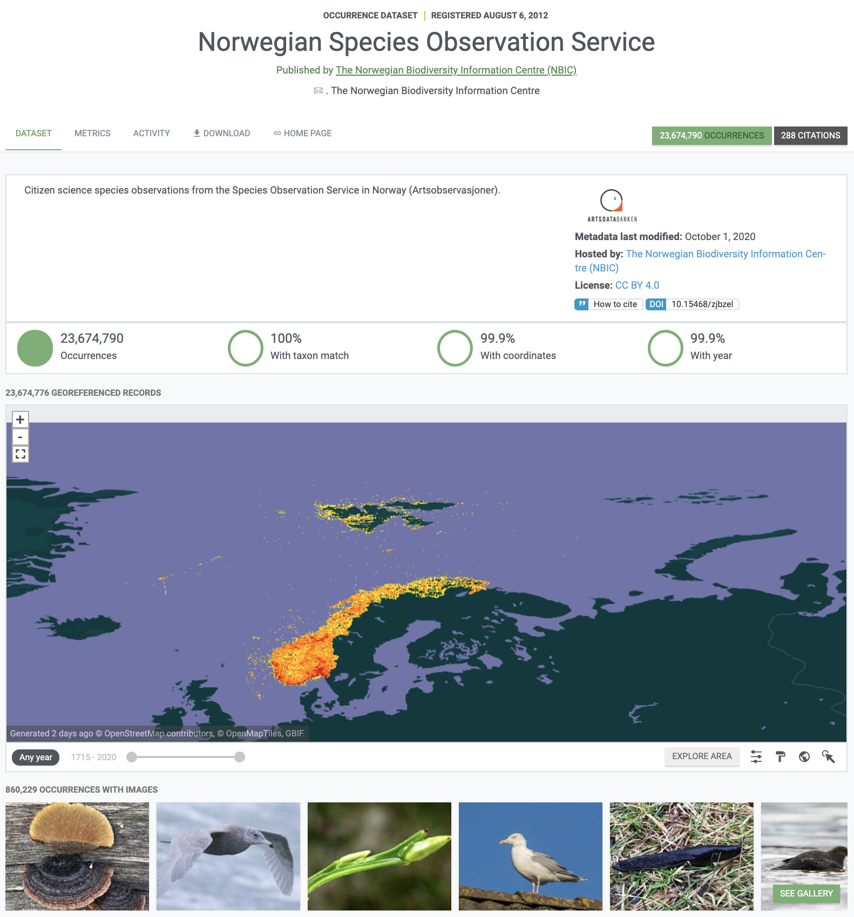
Sources of data in gbiF: citizen science observations
Notes:
Citizen science
eBird: https://doi.org/10.15468/aomfnb
iNaturalist: https://doi.org/10.15468/ab3s5x
NBIC Artsobservasjoner: https://doi.org/10.15468/zjbzel

Slide 16
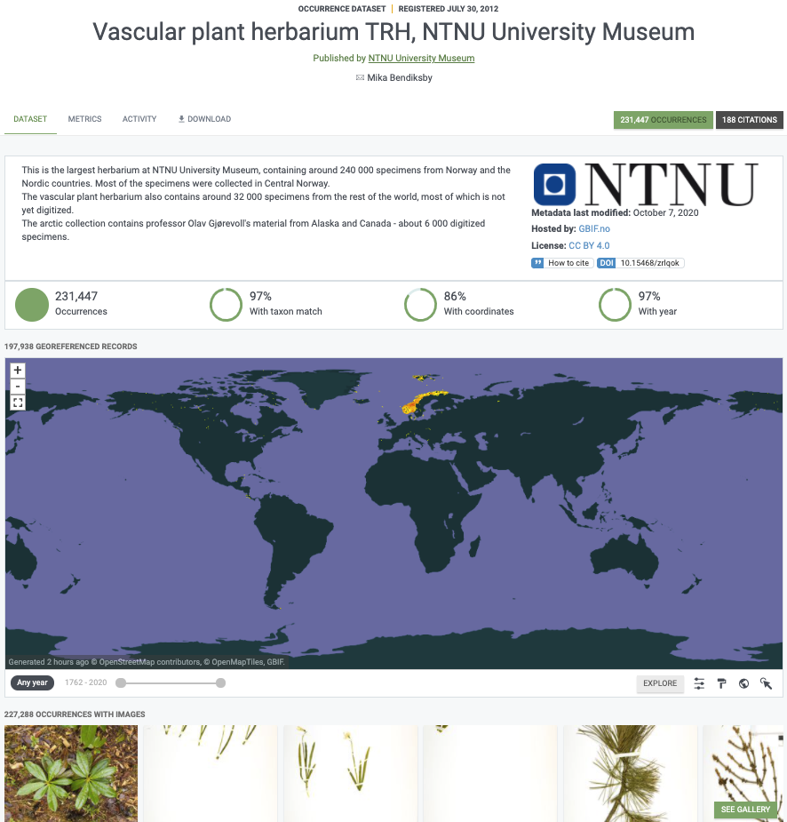
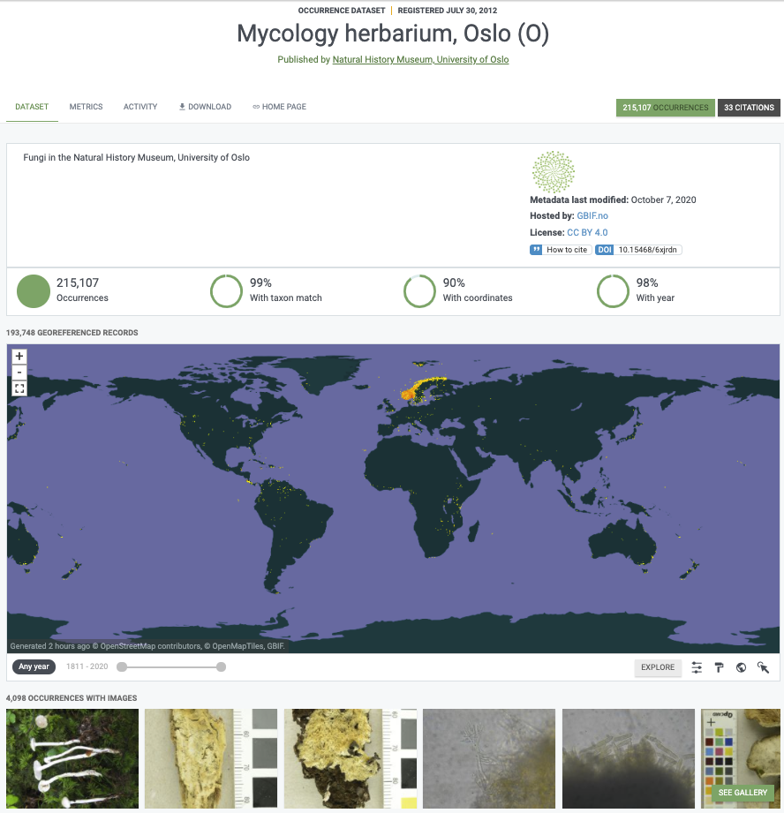
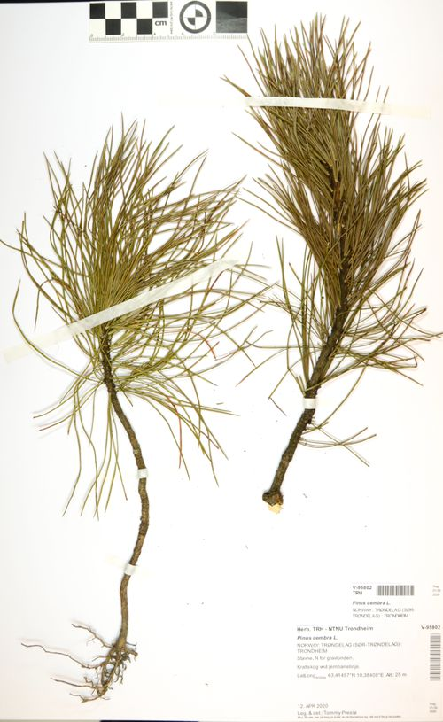
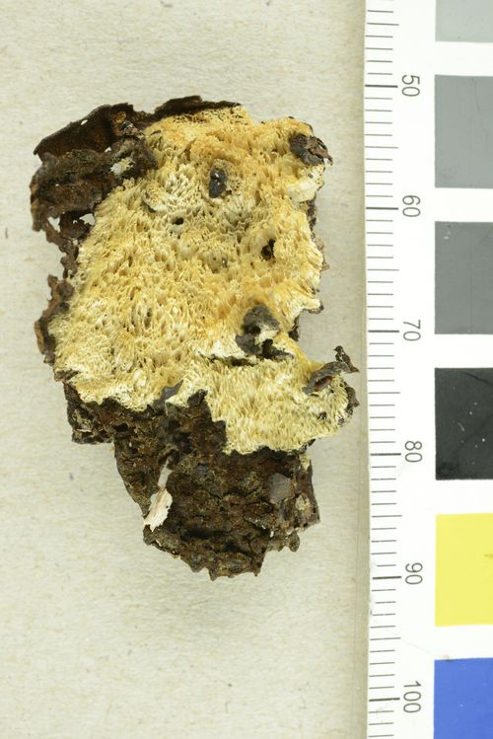
Sources of data in gbiF: digitized specimens from Museum collections
Notes:
Museums and other collections
NTNU Vascular plants: https://doi.org/10.15468/zrlqok

Slide 17
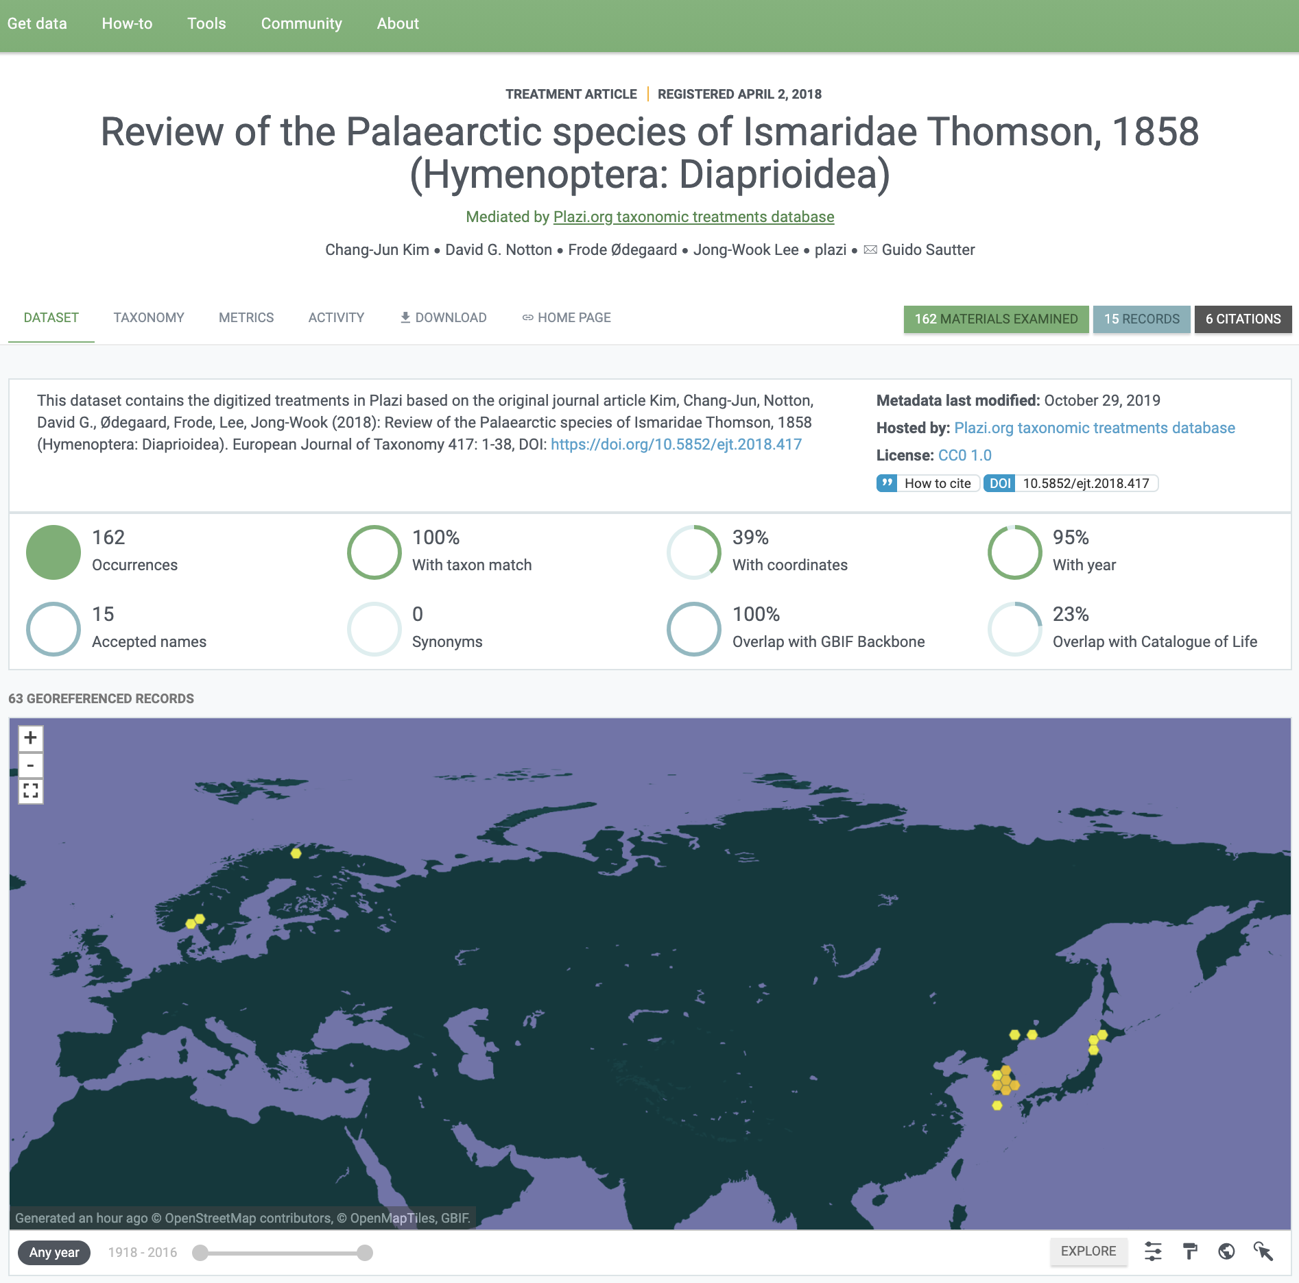
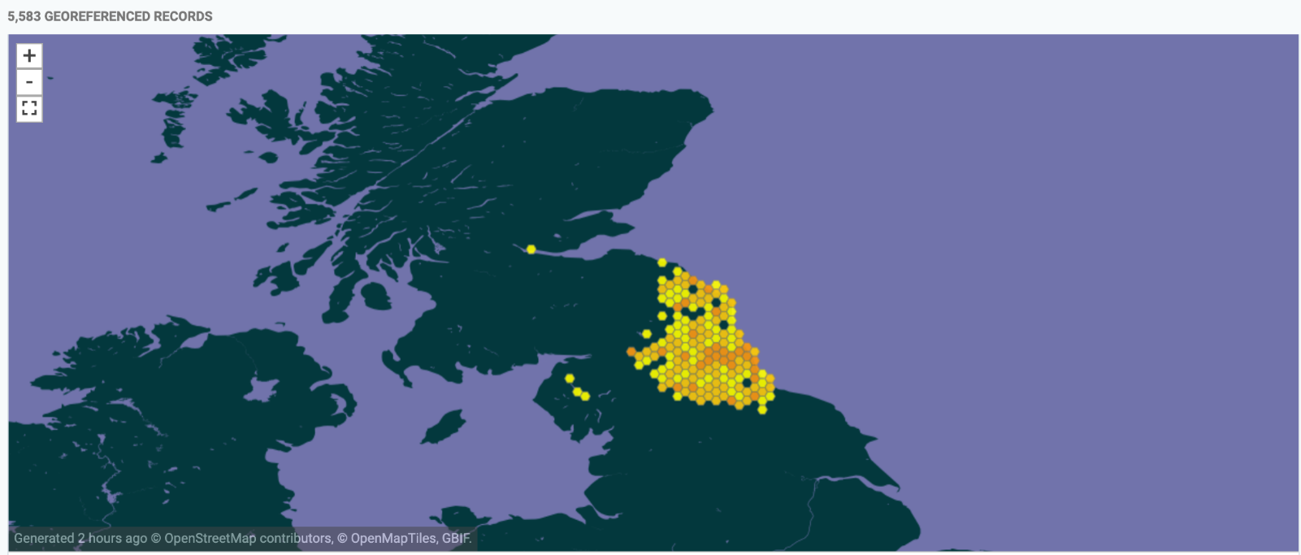
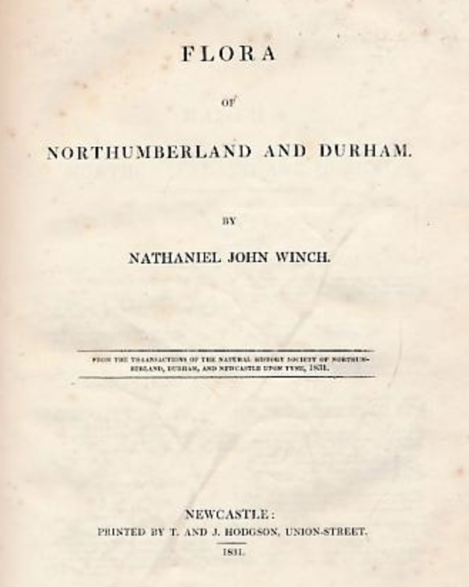
Sources of data in gbiF: taxonomic literature, old and new
Data liberation
Notes:
Taxonomic literature and data liberation
Palaearctic Dataset: https://doi.org/10.5852/ejt.2018.417

Slide 18
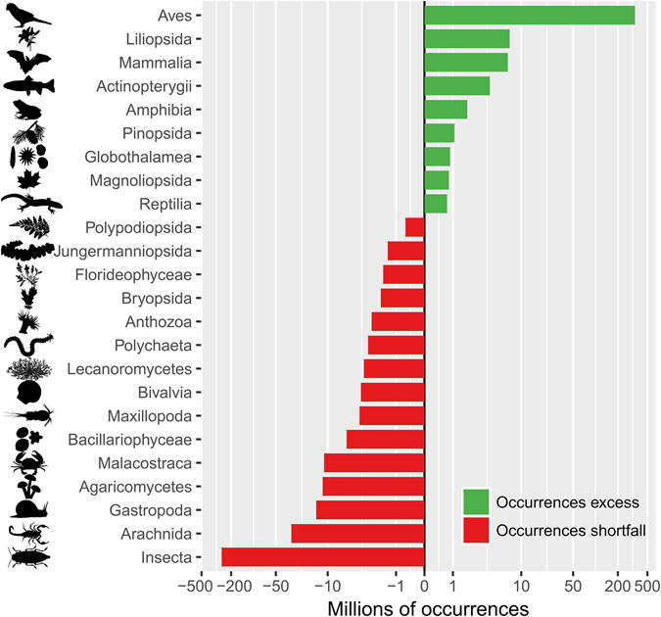
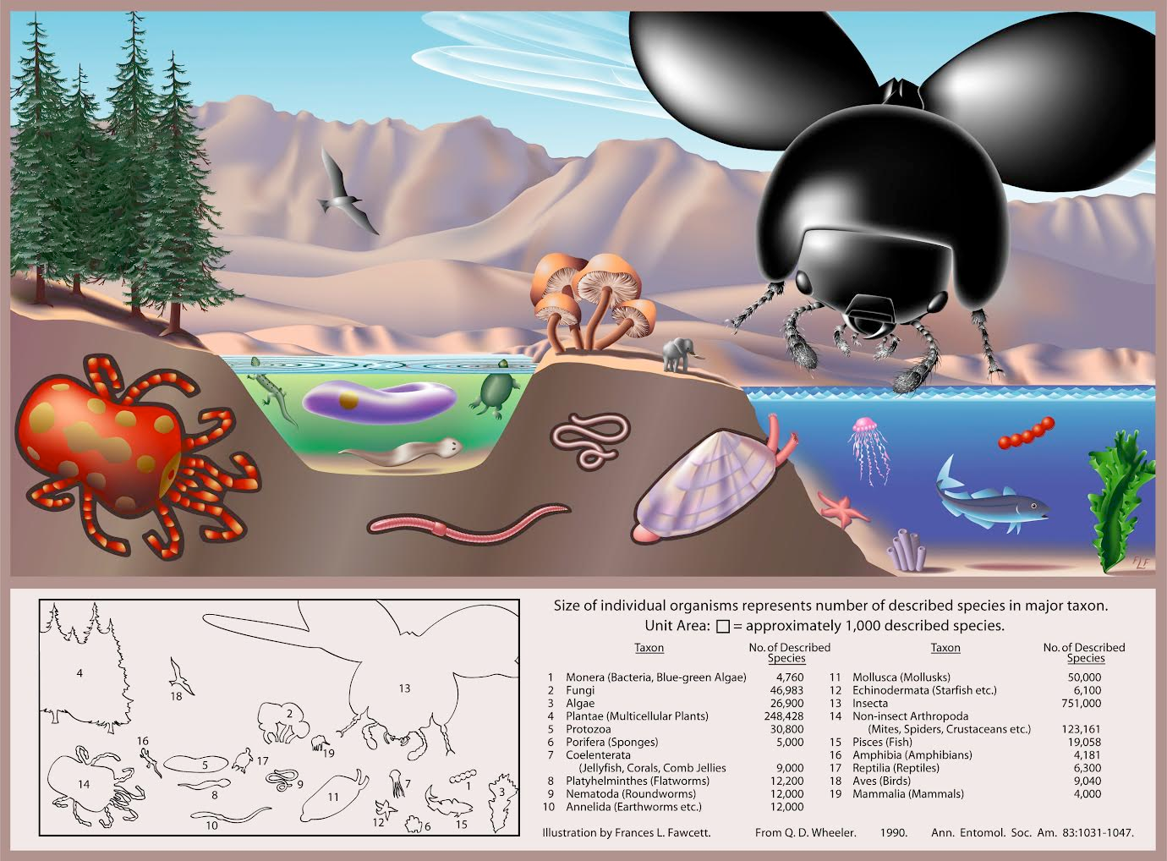
Global biodiversity vs. digitally available data
1200 mill.
occurrences
300 m
20 m
16 m
0,04 m
Troudet et al. Nature Scientific Reports 2017
Image: FL Fawcett in Wheller Ann. Entomol. Soc. Am. 1990
Notes:
Taxon equality

Slide 19
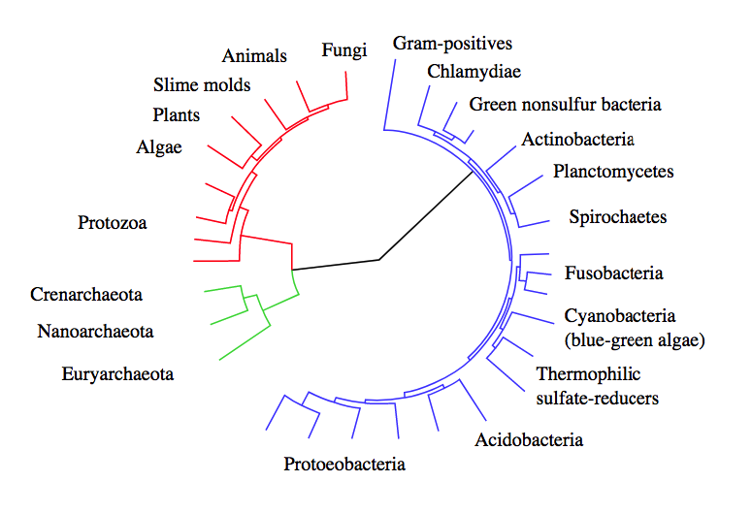
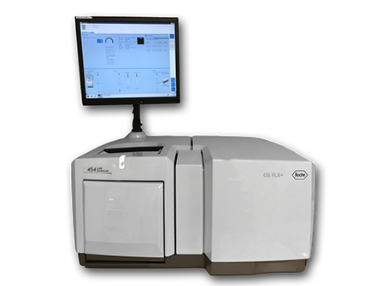
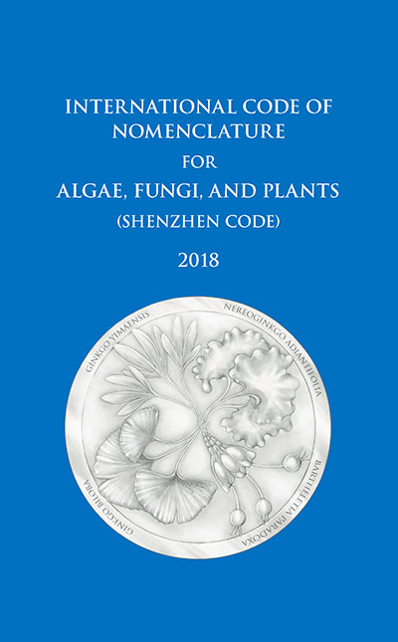
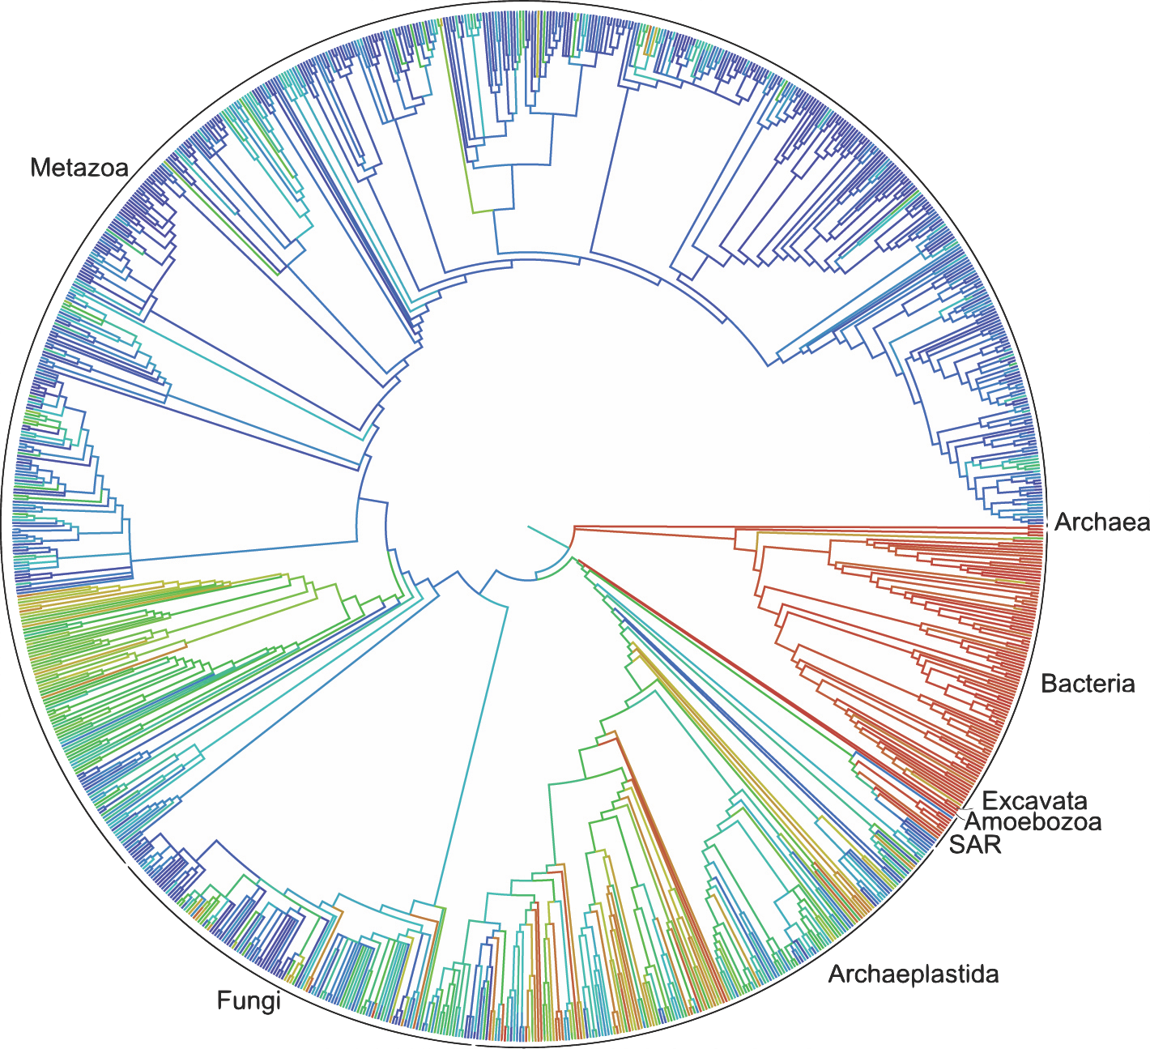
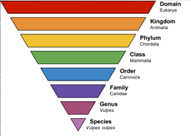
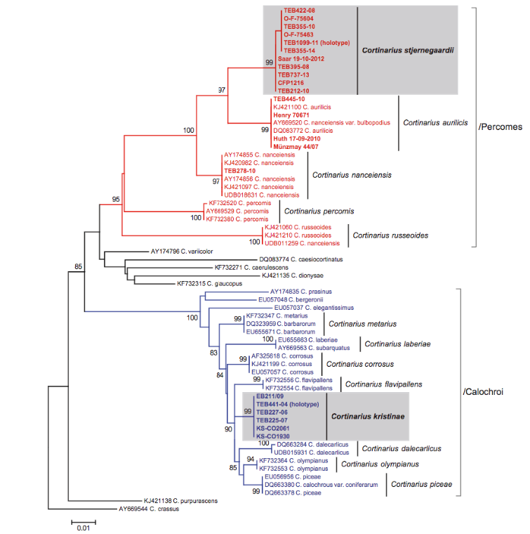
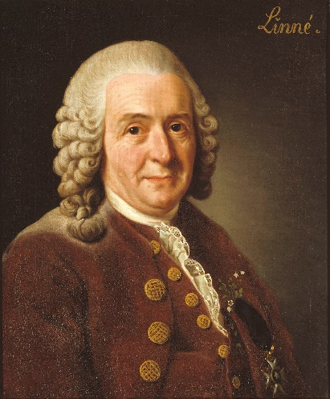
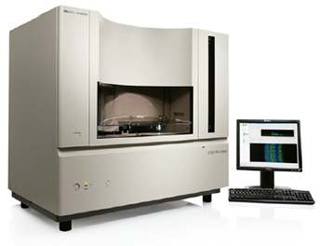
Latin names are ruled by the Codes
1200 mill.
occurrences
300 m
20 m
16 m
0,04 m
Notes:
From Codes to OTUs
Algae, Fungi and Plants – International Code of Nomenclature for algae, fungi, and plants (ICN), which in July 2011 replaced the International Code of Botanical Nomenclature (ICBN) and the earlier International Rules of Botanical Nomenclature.
Animals – International Code of Zoological Nomenclature (ICZN)
Bacteria and Archaea – International Code of Nomenclature of Prokaryotes (ICNP), which in 2008 replaced the International Code of Nomenclature of Bacteria (ICNB)
Cultivated plants – International Code of Nomenclature for Cultivated Plants (ICNCP)
Plant associations – International Code of Phytosociological Nomenclature (ICPN)
Viruses – The International Code of Virus Classification and Nomenclature (ICVCN); see also virus classification

Slide 20
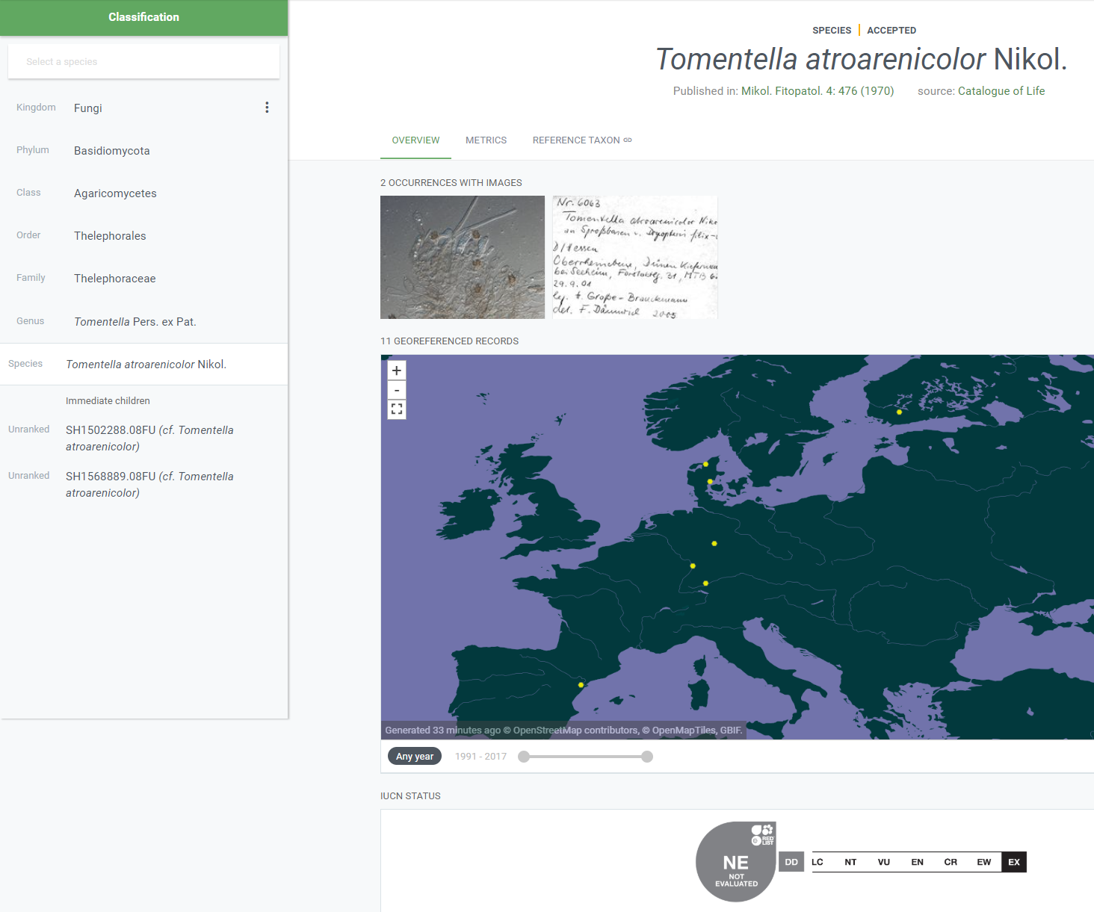
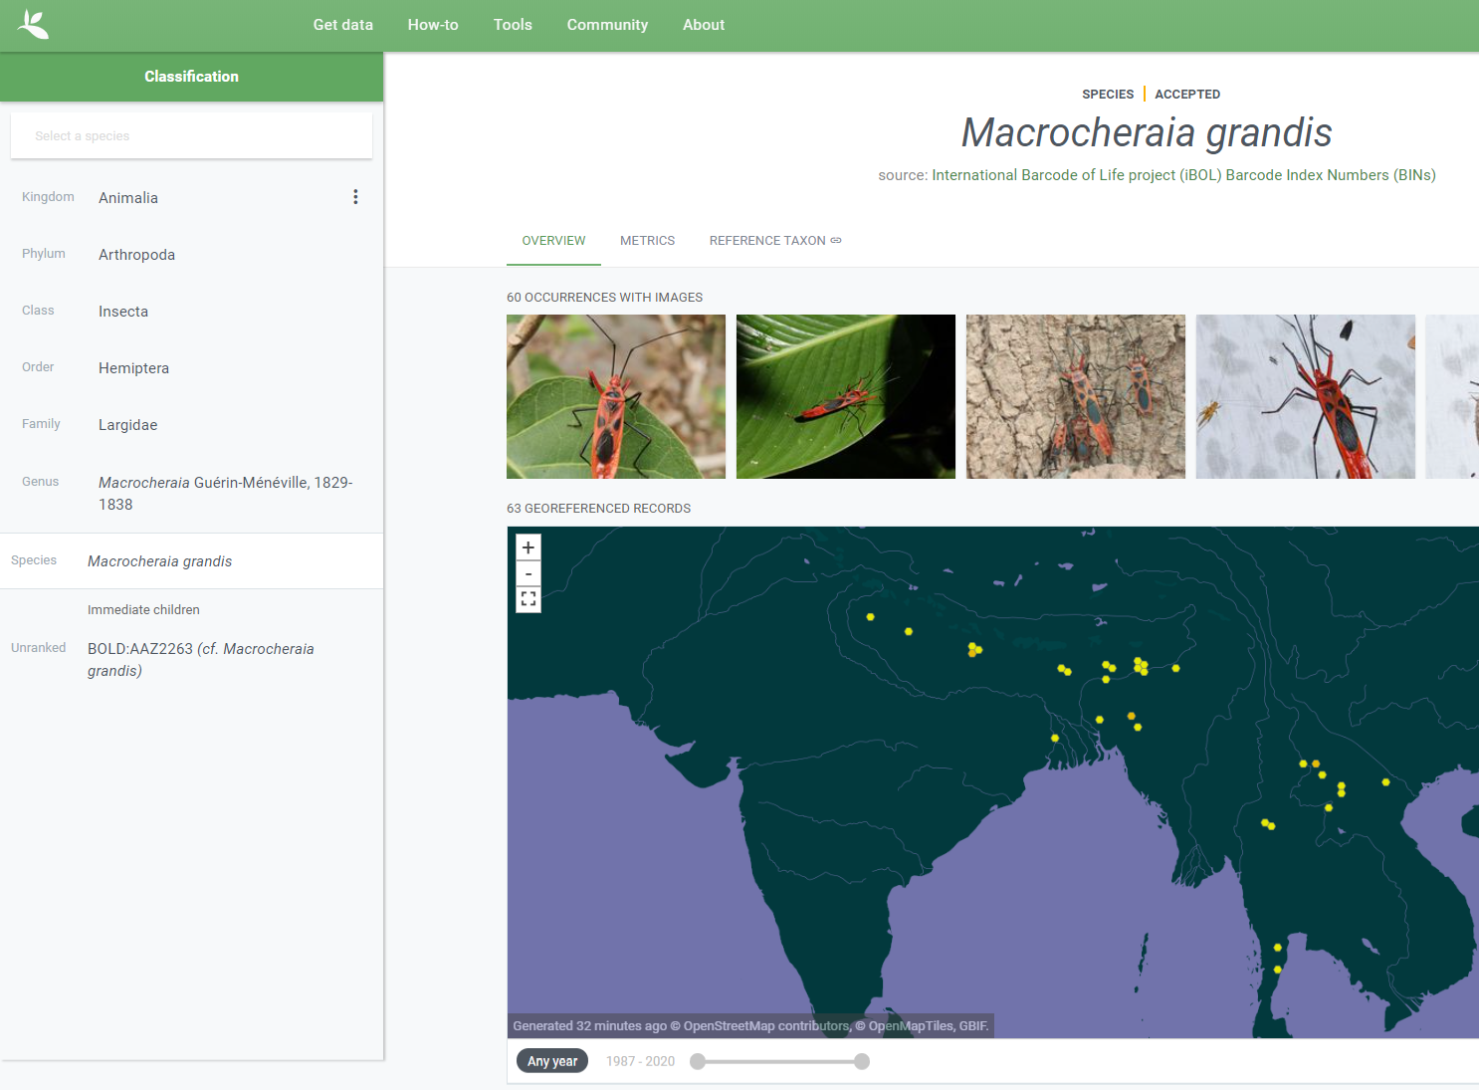
OTU = Operational Taxonomic Unit
OTU = SH,
Species hypothesis numbers [DOI]
SH ABC0001
GBIF backbone taxonomy
OTU = BIN,
Barcode identification number
BIN DEF0002
Notes:
GBIF is integrating OTUs to the taxonomic backbone. OTU = Operational Taxonomic Unit
https://www.gbif.org/news/2UfGq1L6iXbSu0ElamvVlH/gbif-introduces-new-version-of-the-backbone-taxonomy (News item 2019-09-25)
https://www.gbif.org/news/2LrgV5t3ZuGeU2WIymSEuk/adding-sequence-based-identifiers-to-backbone-taxonomy-reveals-dark-taxa-fungi (News item 2018-08-29)
https://data-blog.gbif.org/post/gbif-molecular-data/ (Blog post 2019-04-24)
https://data-blog.gbif.org/post/gbif-molecular-data-quality/ (Blog post 2019-04-26)
UNITE OTU SH checklist: https://doi.org/10.15468/mkpcy3 (2018)
iBOL BIN checklist: https://doi.org/10.15468/wvfqoi (2019)

Slide 21
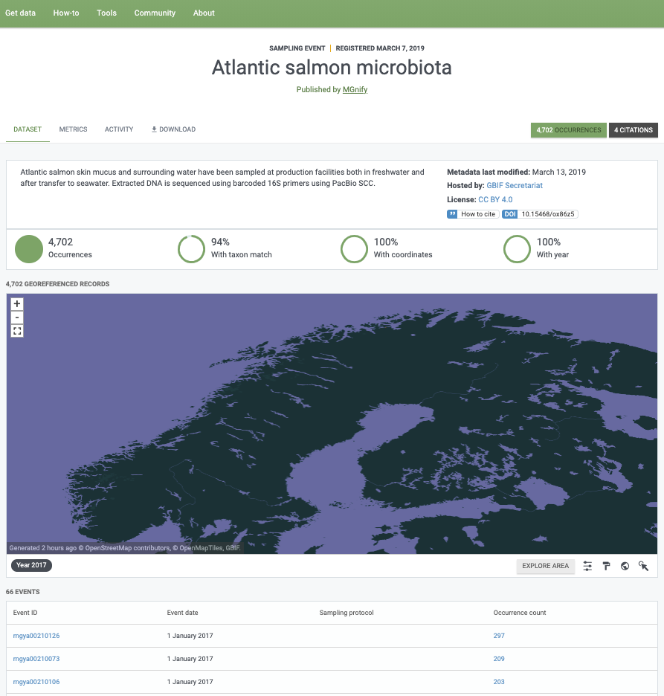
Sources of data in gbiF: DNA sequence-derived occurrence data
Notes:
eDNA, a promise of speed and coverage
MGnify -- Atlantic salmon microbiota: https://doi.org/10.15468/ox86z5
MGnify data publisher: https://www.gbif.org/publisher/ab733144-7043-4e88-bd4f-fca7bf858880

Slide 22
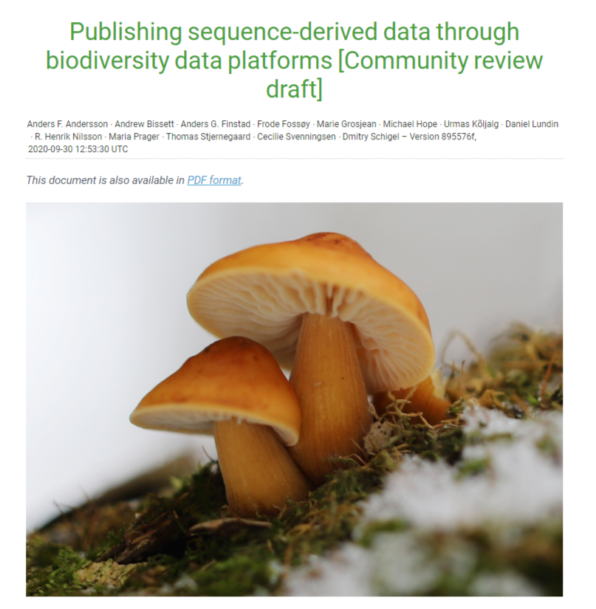
NEW GBIF GUIDE: Publishing sequence-derived data through biodiversity discovery platforms
Authors from Australia, Norway, Sweden, Denmark, UNITE, and GBIF
Based on practical mapping and data publishing experiences
Cross-platform
About 40 pages long ”cookbook”
Introduction – refresh your ”data culinary” knowledge
Categorization – what ”data ingredients” you got to publish?
Mapping – choose and follow the ”recipe”
Visuals – clarity and guidelines
Future prospects
Resources: glossary, links, references
Based on Darwin Core and MIxS data standards
Notes:
New guide https://docs.gbif-uat.org/publishing-sequence-derived-data/1.0/en
Andersson AF, Bissett A, Finstad AG, Fossøy F, Grosjean M, Hope M, Jeppesen TS, Kõljalg U, Lundin D, Nilsson RN, Prager M, Svenningsen C & Schigel D (2020) Publishing sequence-derived data through biodiversity data platforms [Community review draft]. Copenhagen: GBIF Secretariat. https://doi.org/10.35035/doc-vf1a-nr22.

Slide 23
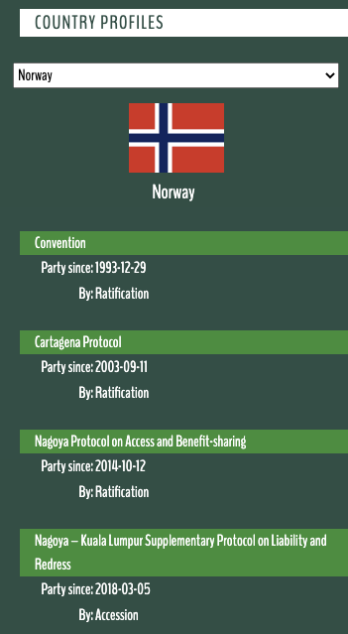
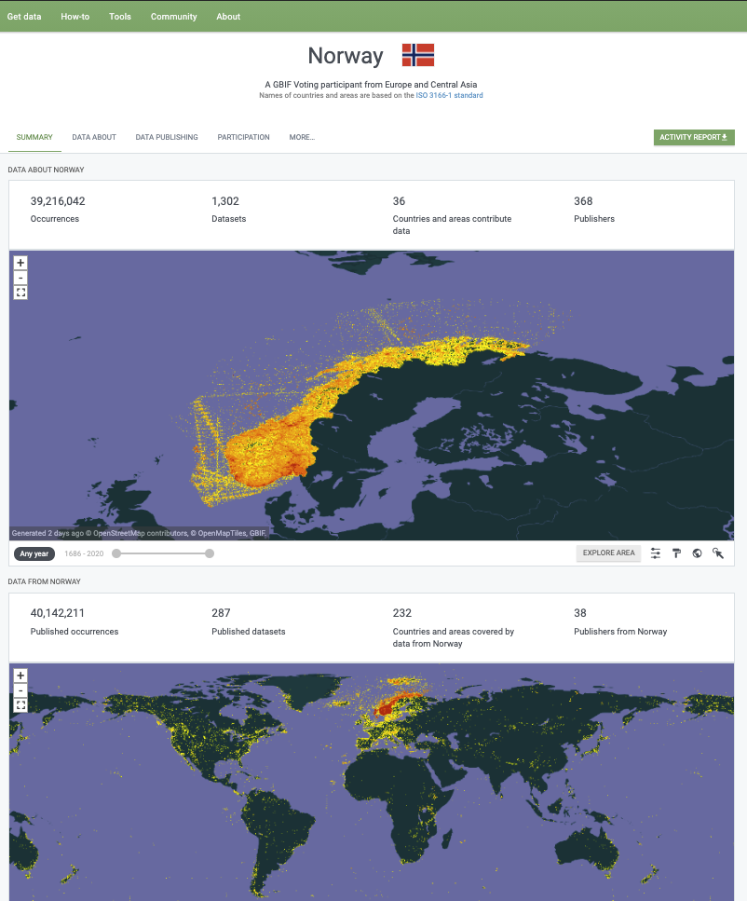
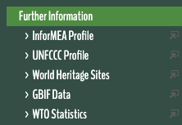
POLICY LINKS
Notes:
CBD: https://www.cbd.int/countries/?country=no
GBIF: https://www.gbif.org/country/NO/summary

Slide 24
Policy Links: Aichi targetsupporting biodiversity indicators
- Trend in invasive alien species introductions (through Global Register of Introduced and Invasive Species)
Species Protection Index
Protected Area Representativeness Index
Comprehensiveness of conservation of socioeconomically/culturally valuable species
Agrobiodiversity Index
Crop Wild Relative Index
Growth in species occurrence records accessible through GBIF
Species Status Information Index
Notes:
Aichi and post-2020
https://www.cbd.int/cooperation/csp/gbif.shtml
https://www.cbd.int/csp/survey/GBIF.pdf

Slide 25
A data resource to support research and sustainable development
Conservation
Protected areas
Threatened species
Invasive species risk
Food Security
Crop wild relatives
In situ, ex situ conservation of genetic diversity
Fisheries planning
Climate change
Modelling impacts on species ranges
Adaptation strategies
Mitigation benefits, risks
Human health
Disease risk based on occurrence of vectors, hosts, reservoirs
Medicinal plants
Hazards e.g. snakebite
Notes:
So we've brought all of this data together, but for what purpose? Through tracking the citations of GBIF in research, and its onward relevance to policy and decisions, we can build up a picture of how all of those involved in sharing standardized data, from the volunteer wildlife observer to researchers and museum curators, are contributing to the knowledge that supports better decisions for our planet and our societies. Just some examples:
- Data shared through GBIF supports CONSERVATION, by helping to identify the most important sites for protected areas; by underpinning assessment of species extinction risk through the Red Listing process; and by tracking the actual and predicted spread of invasive alien species.
- Data shared through GBIF supports FOOD SECURITY, by mapping the distribution of the wild relatives of the most important food crops, and therefore the location of the genetic resources that need to be conserved for future plant breeding; and by providing information on both marine and freshwater fish species - along with other wild species important for nutrition.
- Data shared through GBIF supports action on CLIMATE CHANGE, through helping to model how species ranges will change under different climate change scenarios, informing strategies to adapt to climate change, and assessing the impacts of measures to mitigate climate change, for example increased production of biofuels and hydropower.
- And finally, data shared through GBIF supports HUMAN HEALTH, by tracking the distribution of species that act as vectors, hosts and reservoirs of human diseases; by helping to map medicinal plant species, and by assessing risks posted by significant public health hazards such as snakebite.

Slide 26
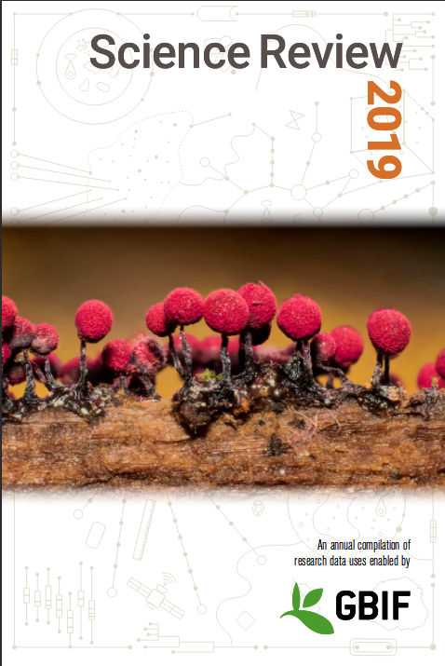
Peer-reviewed publications using GBIF-mediated data September 2020
~ 2-3 papers a day
#CiteTheDOI
Notes:
Use in research litterature

Slide 27
Data Use in peer-reviewed journals October 2020
Peer-reviewed uses by country
Year-to-date October 2020 |  |  | 2019 rank
1 | United States | 169 | 1
2 | China | 139 | 2
3 | Brazil | 81 | 3
4 | United Kingdom | 77 | 4
5 | Mexico | 58 | 5
5 | Spain | 57 | 8
7 | Germany | 56 | 6
8 | Canada | 41 | 10
9 | Australia | 36 | 7
10 | France | 33 | 9
-- | Norway | 15 | --
Notes:
Use by country
https://www.gbif.org/resource/search?contentType=literature&literatureType=journal&relevance=GBIF_USED&peerReview=true
https://www.gbif.org/resource/search?contentType=literature&year=2020&literatureType=journal&relevance=GBIF_USED&countriesOfResearcher=NO&peerReview=true

Slide 28
How to cite Data mediated by GBIF ata citation
Download data from GBIF.org
and receive recommended citation with a download DOI
Cite the DOI in published research or other work
Example: GBIF.org (12 October 2020) GBIF Occurrence Download https//doi.org/10.15468/dl.xxxxxx
#CiteTheDOI
Notes:
How to cite data

Slide 29
Why cite data?ata citation
Good academic practice for transparent and reproducible research
Credit institutions who shared data and supported your research
Help data publishing institutions to demonstrate value of digitization and data publication through research
Correct citation encourages data sharing
Data accessed through GBIF is free for all – but not free of obligations: see the user agreement
#CiteTheDOI
Notes:
Why cite data?

Slide 30
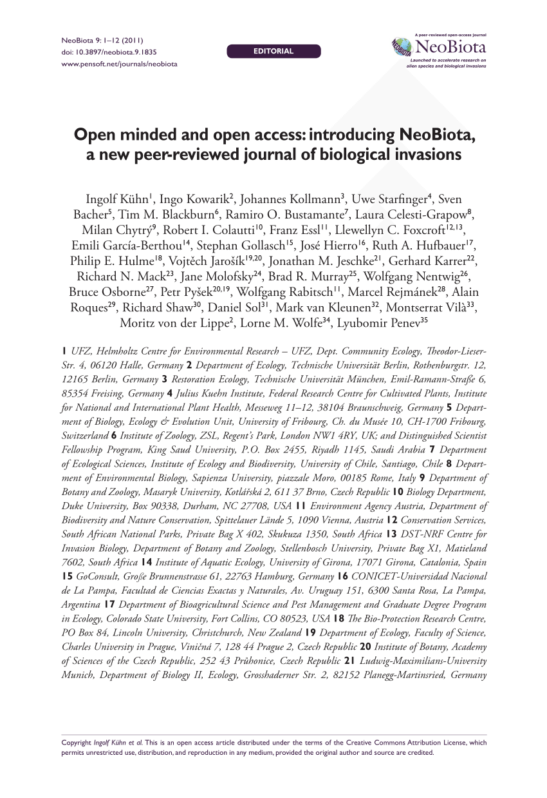
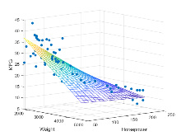
Dataset DOIs
Download DOI
Archive DOI
Bibliographic DOI
Source dataset #1
Source dataset #2
GBIF download
Final state of data
Filter
Process
Analyze & publish
Source dataset #3
Archive
Notes:
DOI explained 1 of 3

Slide 31
Dataset DOIs
Download DOI
Archive DOI
Bibliographic DOI
Source dataset #1
Source dataset #2
GBIF download
Final state of data
Filter
Process
Analyze & publish
Source dataset #3
Archive
Notes:
DOI explained 2 of 3

Slide 32
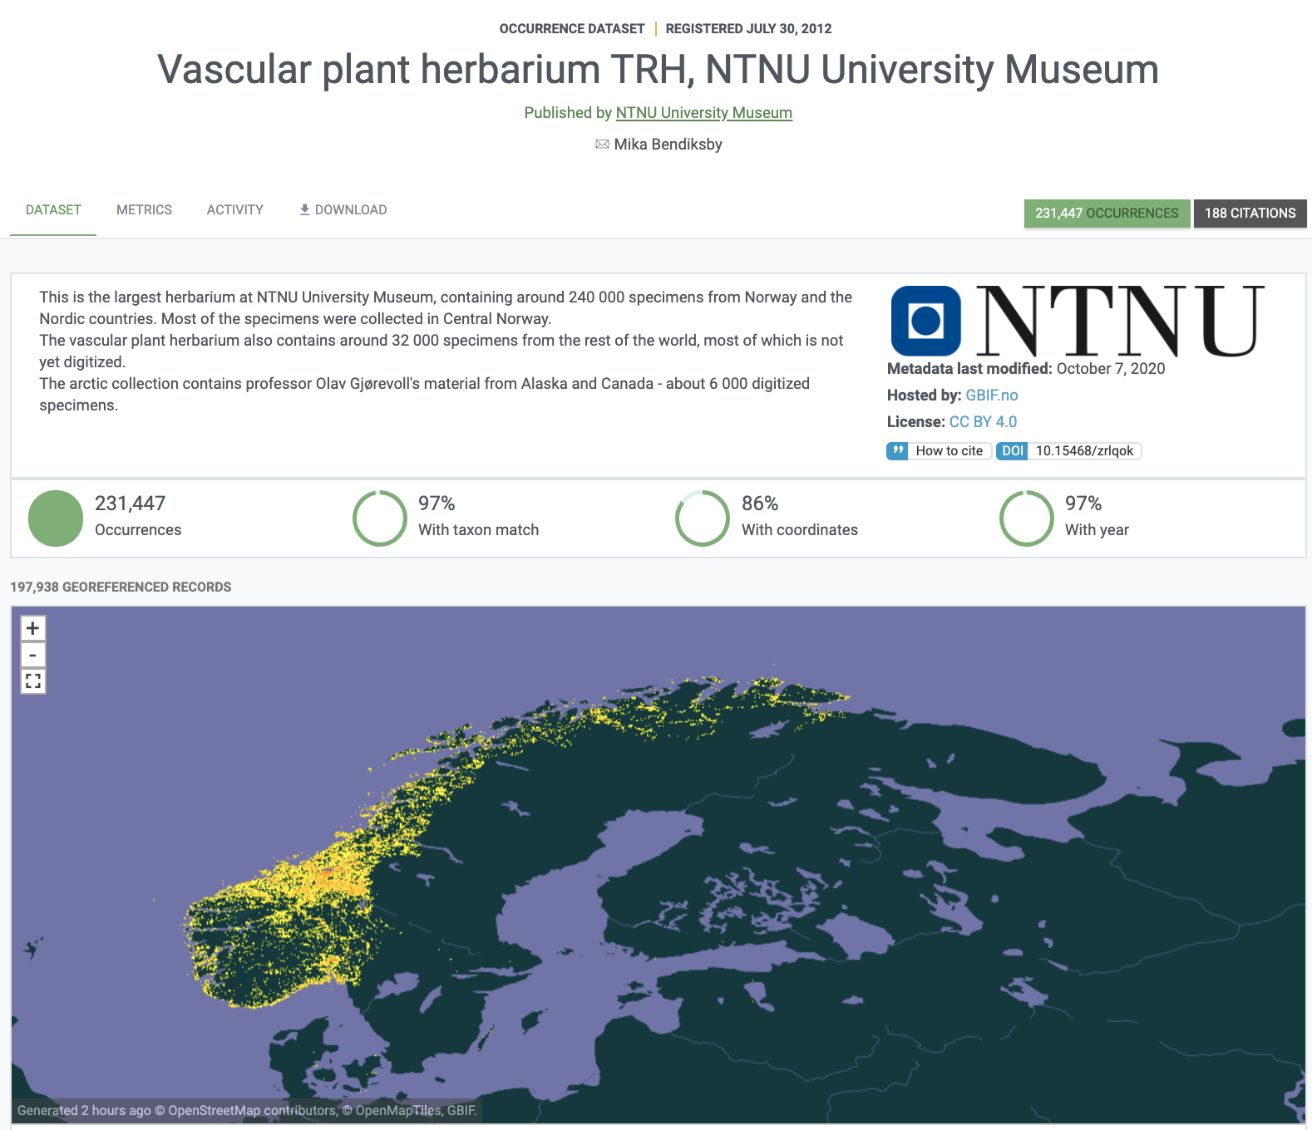
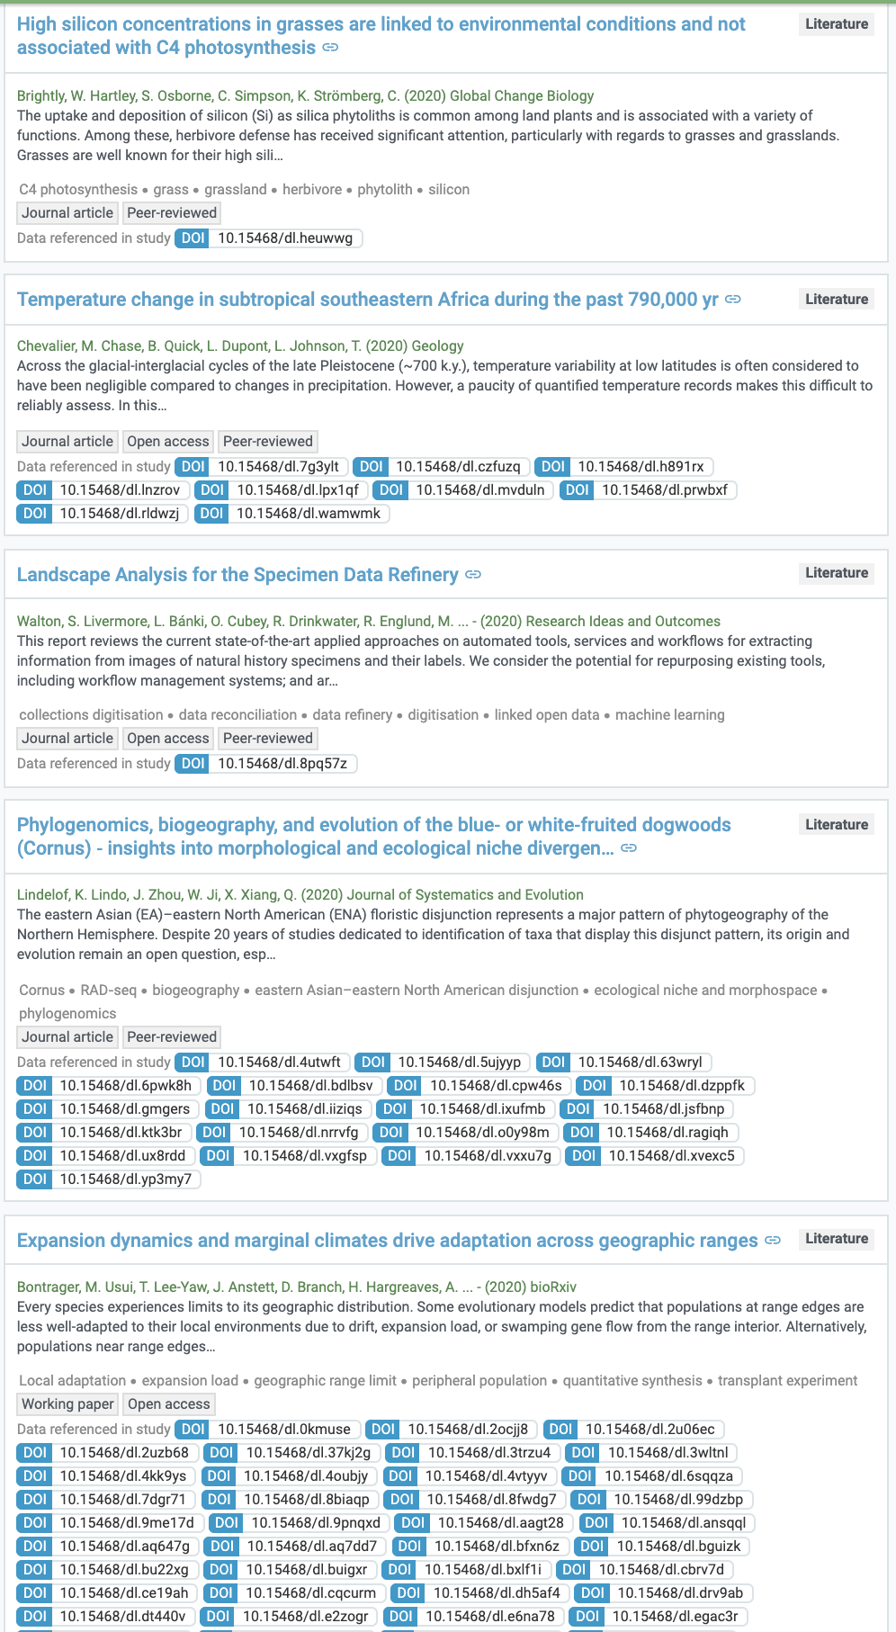
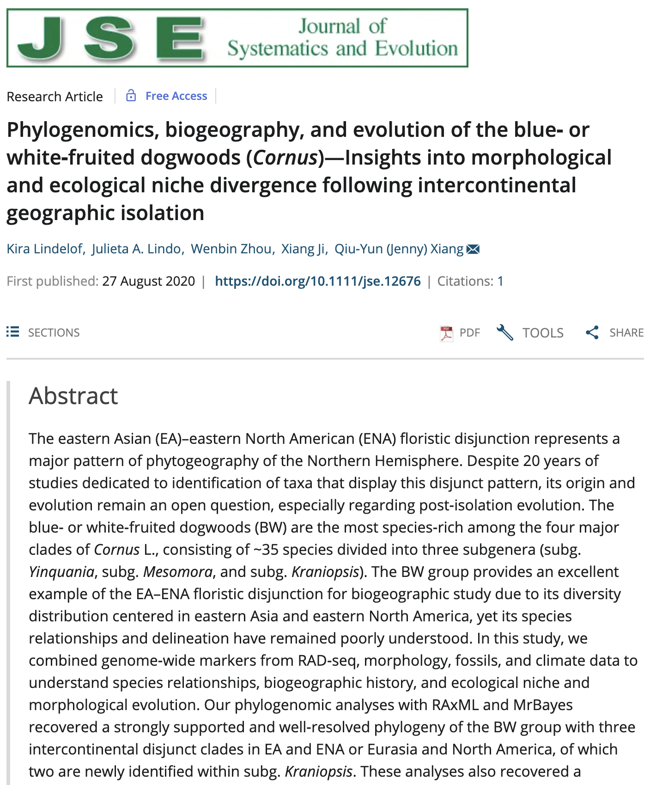
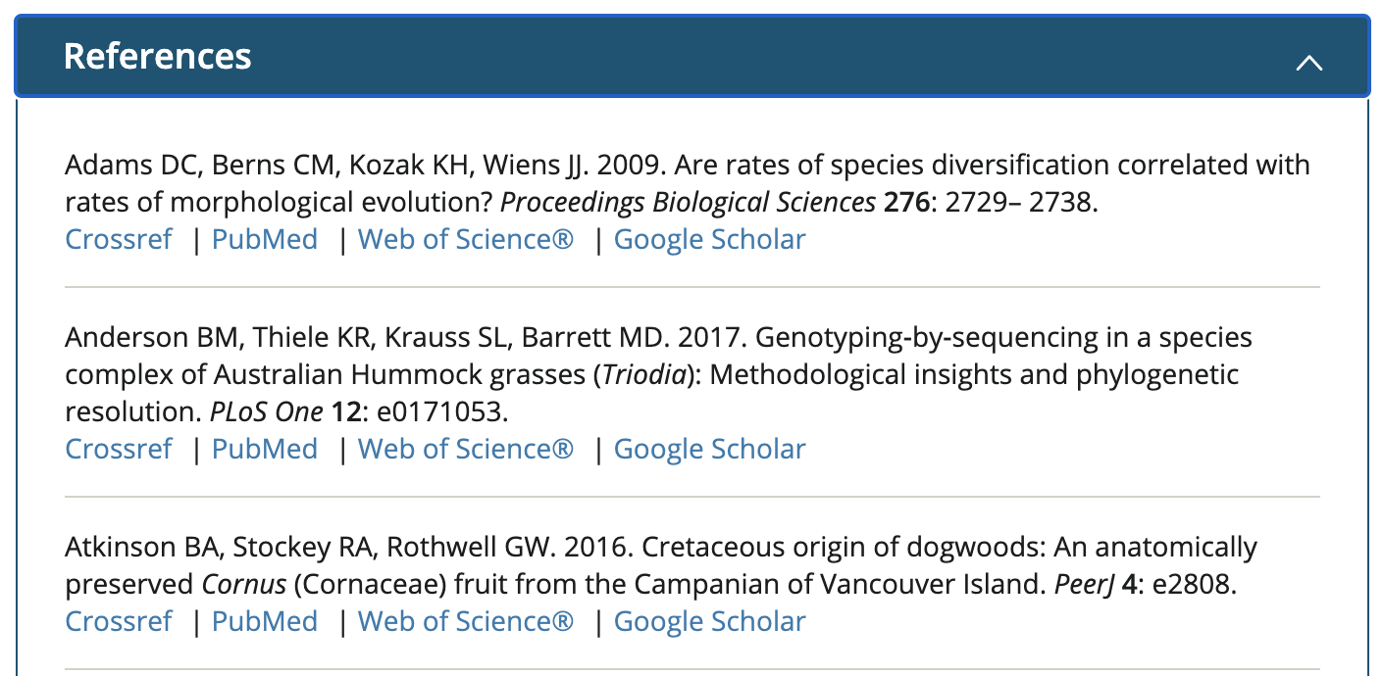
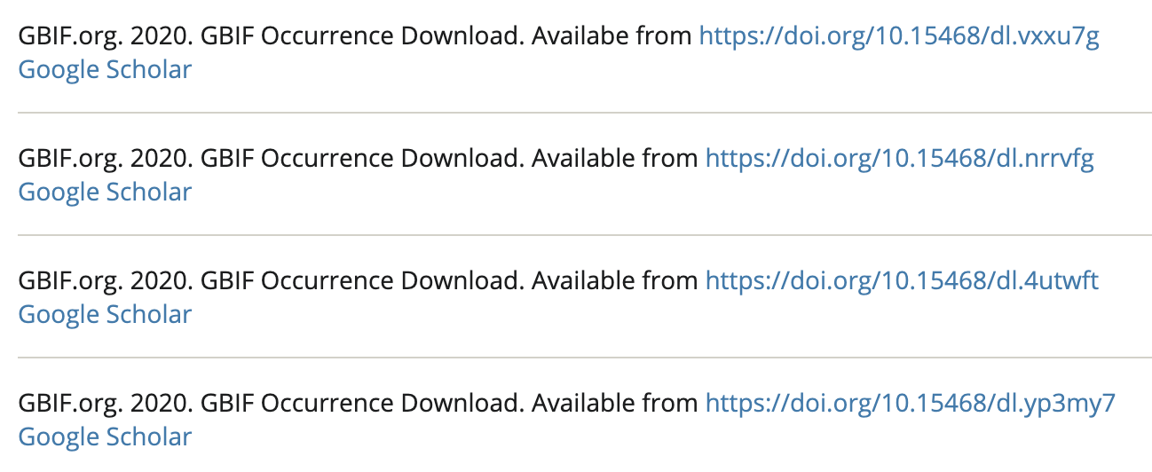
DOI BASED DATA CITATION AT GBIF.org
Notes:
DOI explained 3 of 3
NTNU Vascular plants: https://doi.org/10.15468/zrlqok

Slide 33
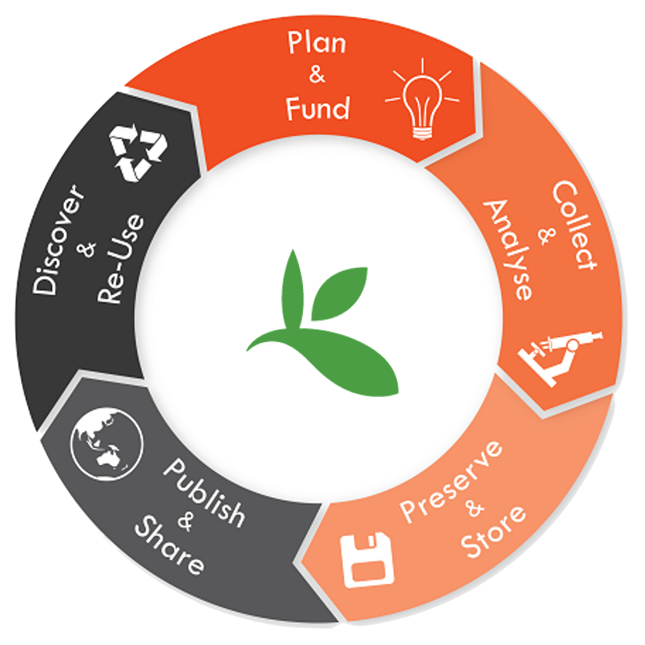
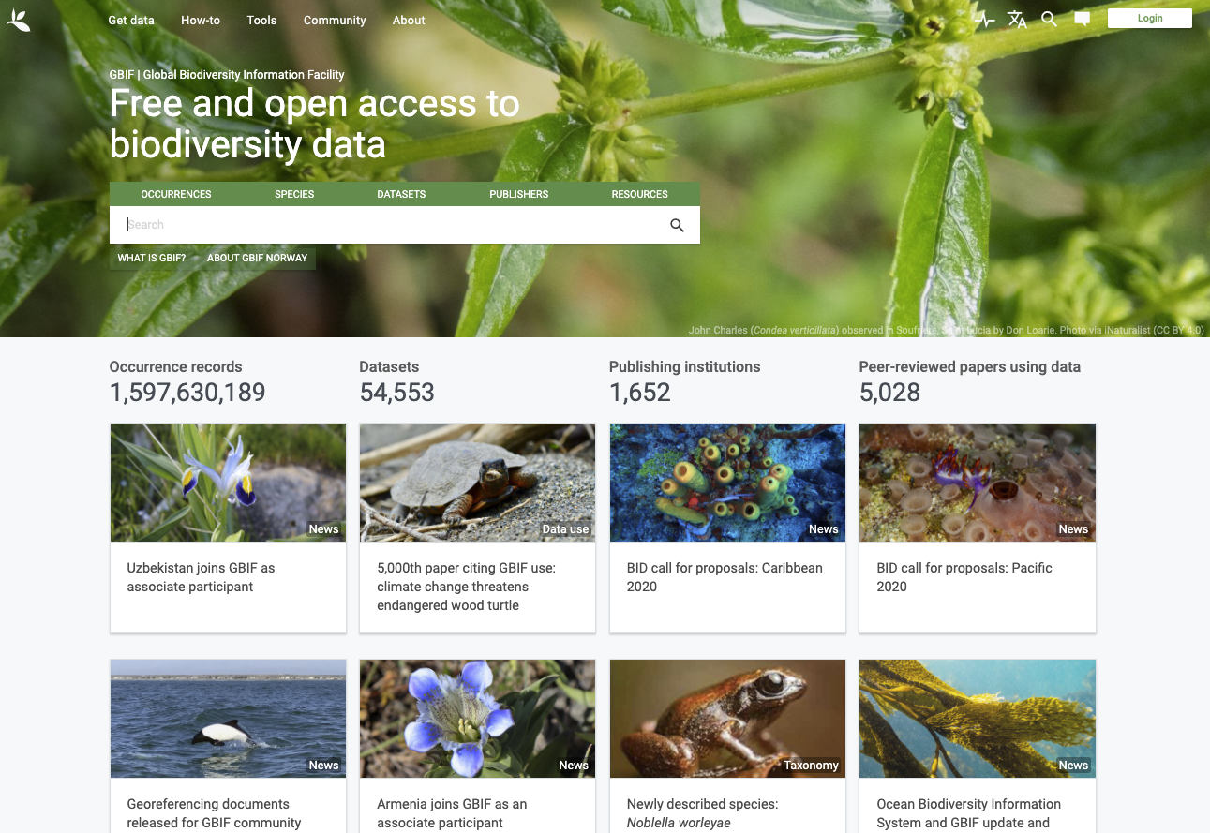
The research data lifecycle
GBIF.org
Notes:
Lifecycle

Slide 34
Dag Endresen | GBIF Norway
helpdesk@gbif.no

