Slide 1
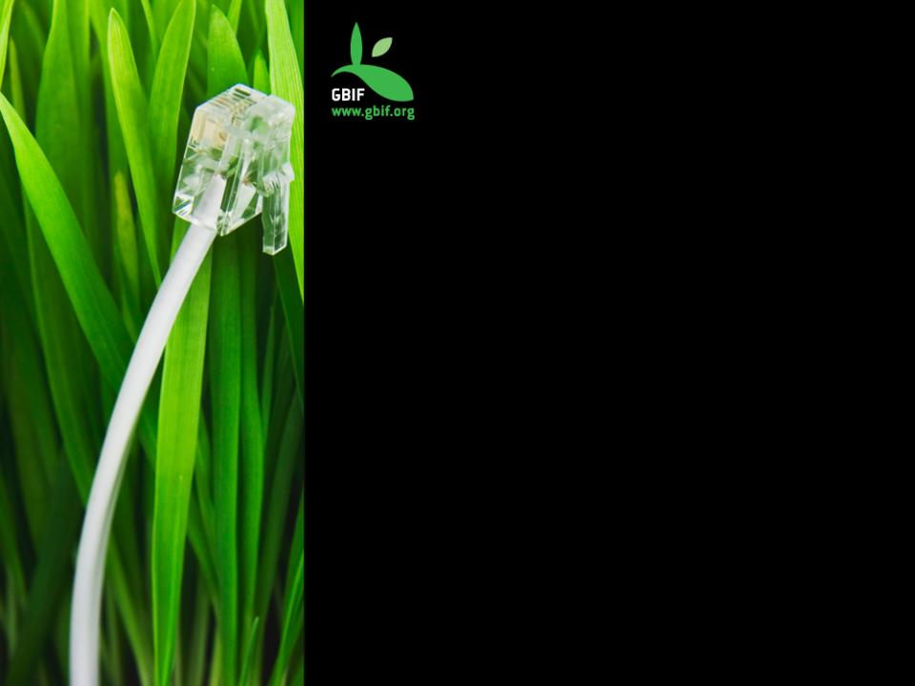
Workshop on Open Publishing for Research Data
organized by the Research Council of Norway (RCN)
GBIF data publication
Dag Endresen
GBIF Norway
UiO Natural History Museum in Oslo
University of Oslo
Lysaker, Oslo, November 1st 2016
Slides: CC-BY-4.0, GBIF.no

Slide 2
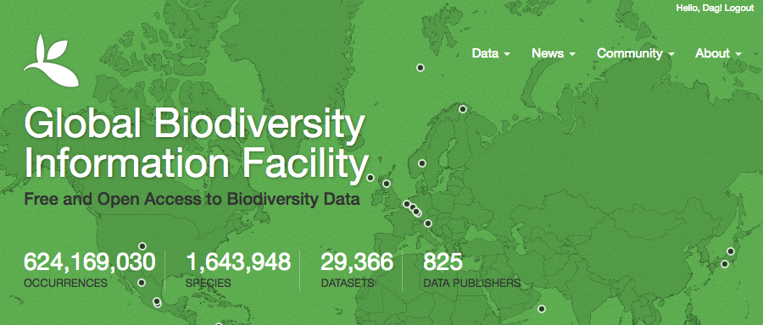
Status
26st October 2016
GBIF enables free and open access to biodiversity data online.
We are an international government-initiated and -funded initiative focused on making biodiversity data available to all and anyone, for scientific research, conservation and sustainable development.
Notes:
GBIF: http://www.gbif.org/
what is the Global Biodiversity Information Facility? GBIF enables free and open access to biodiversity data online. We are an international government-initiated and funded initiative focused on making biodiversity data available to all and anyone, for scientific research, conservation and sustainable development.
Hva er Global Biodiversity Information Facility (GBIF)? GBIF arbeider for fri og åpen tilgang til biodiversitetsdata online. Vi er et internasjonalt og statlig initiert og finansiert nettverk med fokus på å bidra til at biodiversitetsdata er tilgjengelig for alle og enhver, for vitenskapelig forskning, bevaring og bærekraftig utvikling.

Slide 3
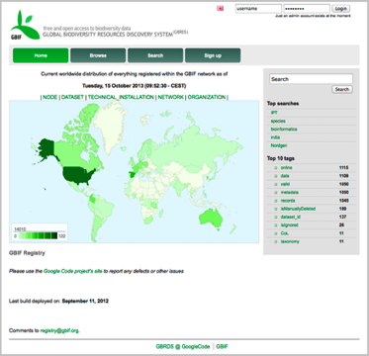
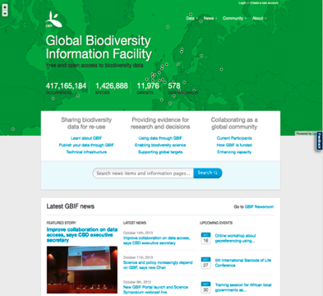
GBIF provides a data discovery system
that is dependent on resolvable stable identifiers for efficient functionality
global registry
data portal
Notes:
GBIF is dependent on resolvable and stable identifiers for efficient functionality. Identifiers for occurrences and for datasets etc.

Slide 4
Data published through GBIf.org
data mobilization
Occurrence records (millions)
http://www.gbif.org | 6 JUN 2016

Slide 5
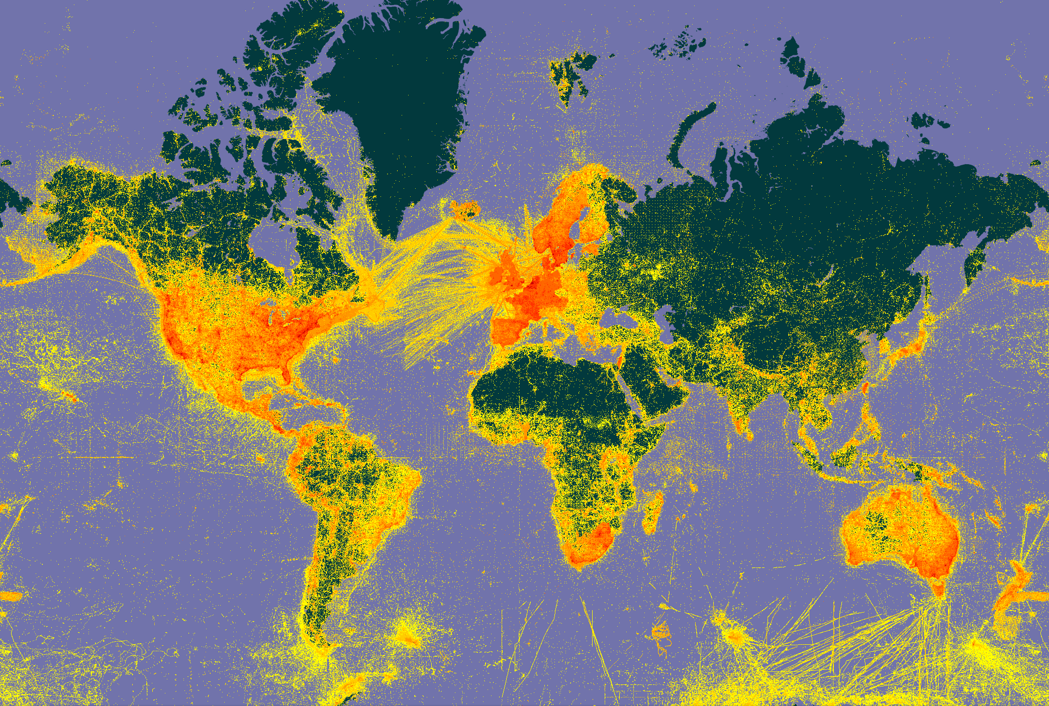
Asia (lack of data)
Africa (lack of data)

Slide 6
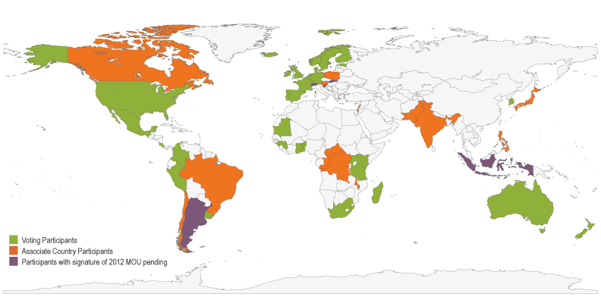
Map of GBIF Country Participants
participation
Asia (lack of data)
Africa (lack of data)
37 country members
18 associate countries
3 affiliate networks
39 organizations
Norway became a (voting) GBIF member in February 2004. (Map last updated August 2016)

Slide 7
Licensing for data published through GBIF
GBIF Governing Board decision in 2014 - three CC licenses
Status: set for all datasets published in GBIF since August 2016
CC0 CC0 is recommended whenever possible
CC BY with use guidelines specified by the owner
CC BY-NC use is not for commercial purposes
http://www.gbif.org/newsroom/news/data-licensing-milestone & http://www.gbif.org/terms/licences
Notes:
http://www.gbif.org/terms/licences
https://en.wikipedia.org/wiki/Creative_Commons_license
https://en.wikipedia.org/wiki/CC0
https://en.wikipedia.org/wiki/CC_BY
https://en.wikipedia.org/wiki/Non-commercial
--
http://www.gbif.org/newsroom/news/data-licensing-milestone – August 18th 2016
http://www.gbif.org/newsroom/news/data-licensing-and-endorsement – September 22nd 2014, updated October 23rd 2015
http://www.gbif.org/newsroom/consultations#licensing
http://www.gbif.org/resources?search_api_views_fulltext=licensing&sort_by=gr_date_of_publication&sort_order=DESC&items_per_page=20
7

Slide 8
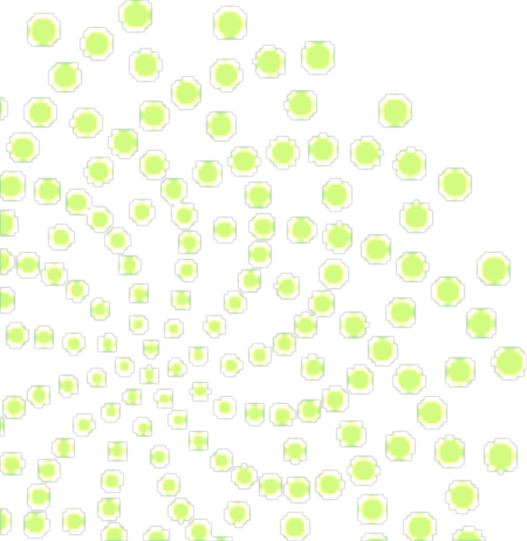
GBIF Data portal

Slide 9
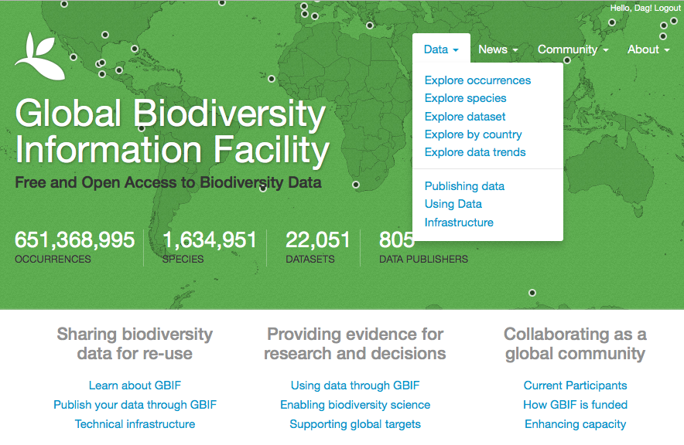
GBIF DATA PORTAL
Notes:
This is the GBIF 2013 Data Portal

Slide 10
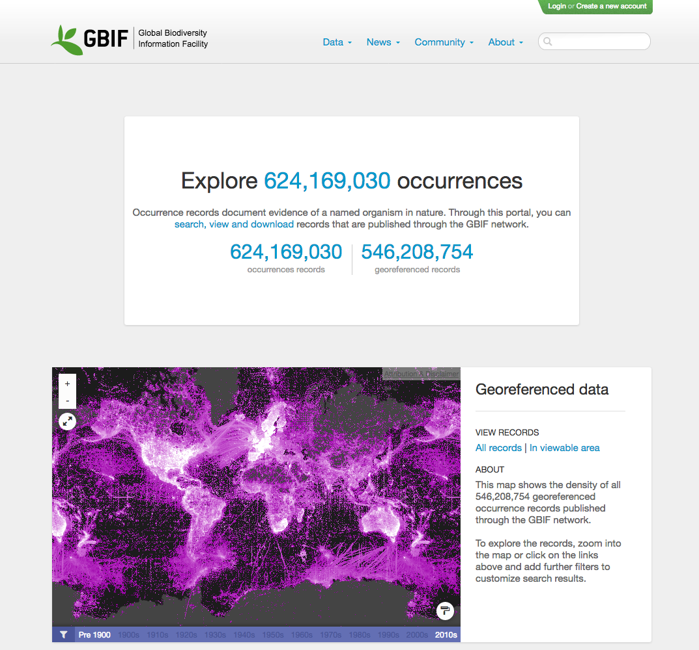

Slide 11
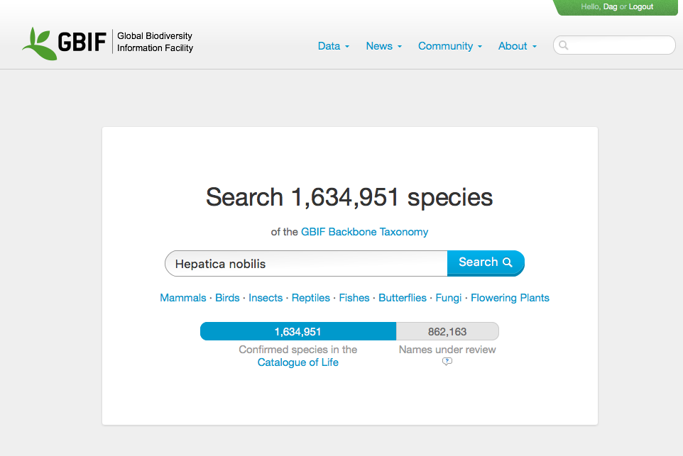
Notes:
http://www.gbif.org/occurrence/search

Slide 12
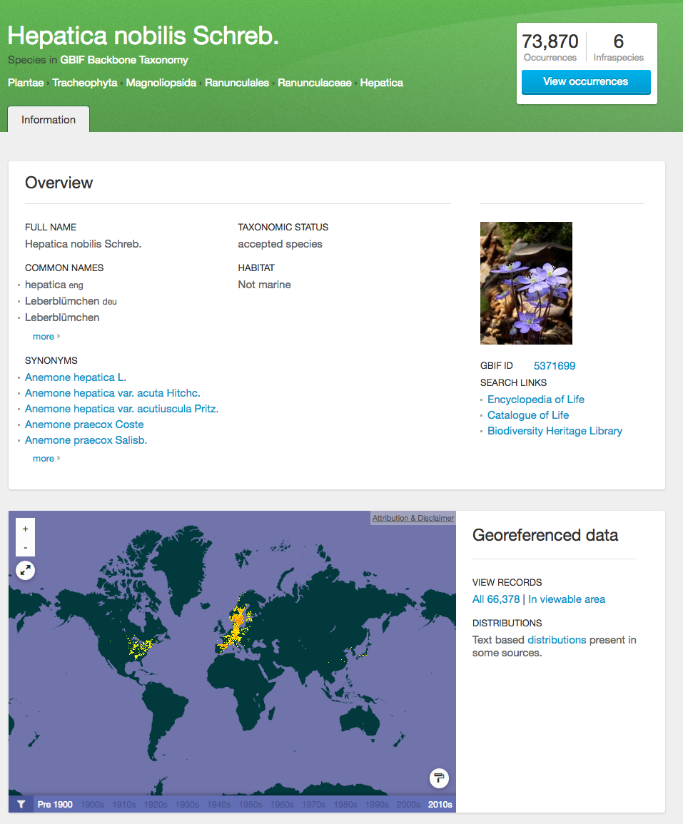
Notes:
Navigating though an specie search, show the results related with the search and also there is the capability to filter the results.

Slide 13
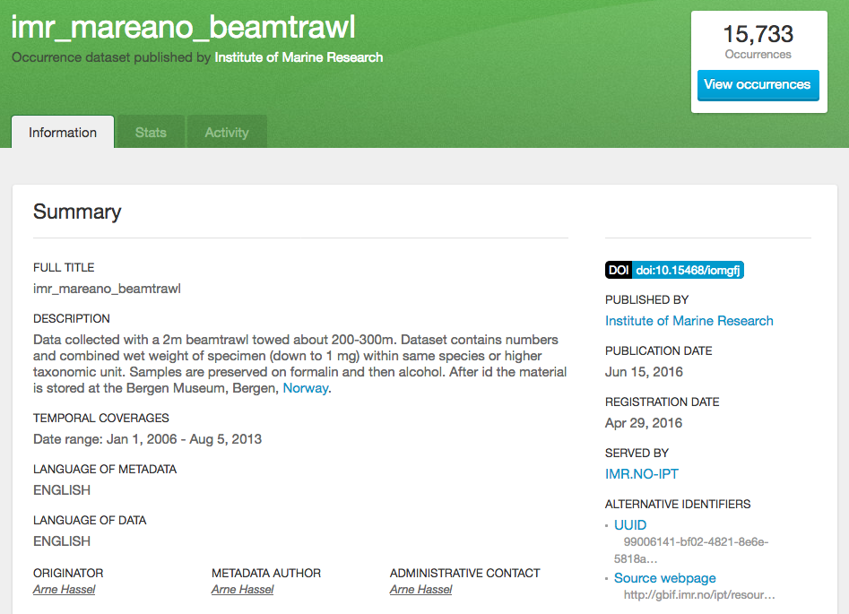
All datasets in GBIF are assigned a dataset DOI
Notes:
http://www.gbif.org/dataset/99006141-bf02-4821-8e6e-5818a1cbf70a
http://doi.org/10.15468/iomgfj
Institute of Marine Research: imr_mareano_beamtrawl. doi:10.15468/iomgfj Accessed via http://www.gbif.org/dataset/99006141-bf02-4821-8e6e-5818a1cbf70a on 2016-10-27

Slide 14
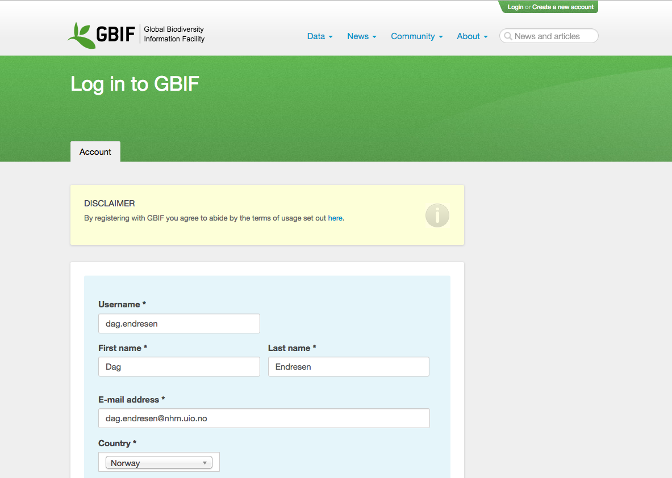
Login is required to download data
Notes:
http://www.gbif.org/terms/data-user

Slide 15
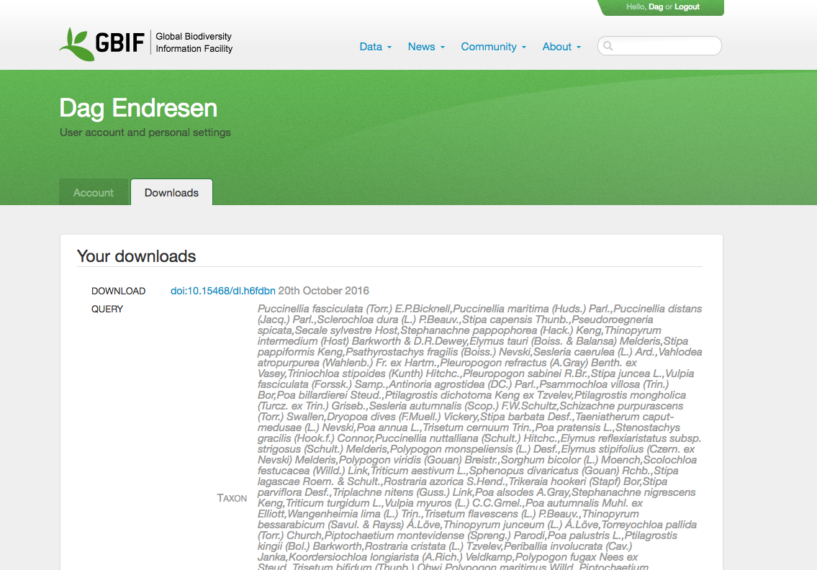
Previous data downloads are listed from the user profile
Notes:
http://doi.org/10.15468/dl.h6fdbn

Slide 16
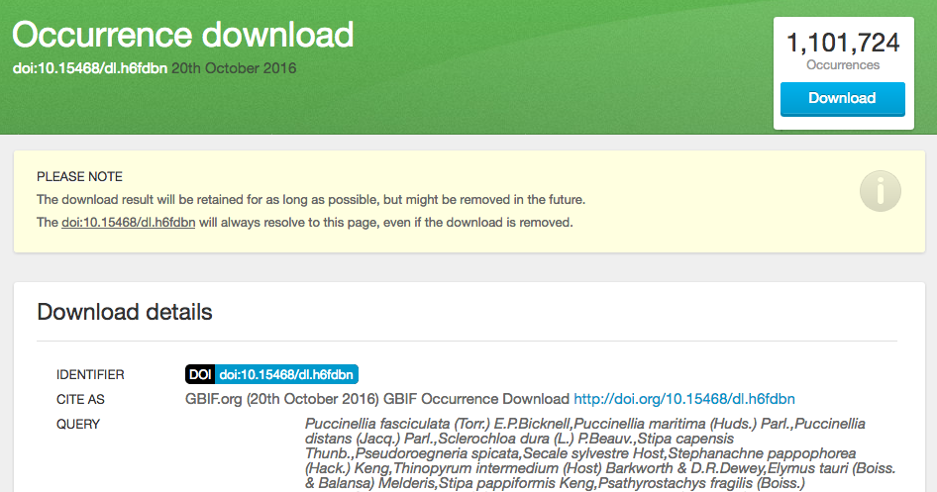
All downloads are assigned a DOI for citation
(...)
Notes:
http://doi.org/10.15468/dl.h6fdbn

Slide 17
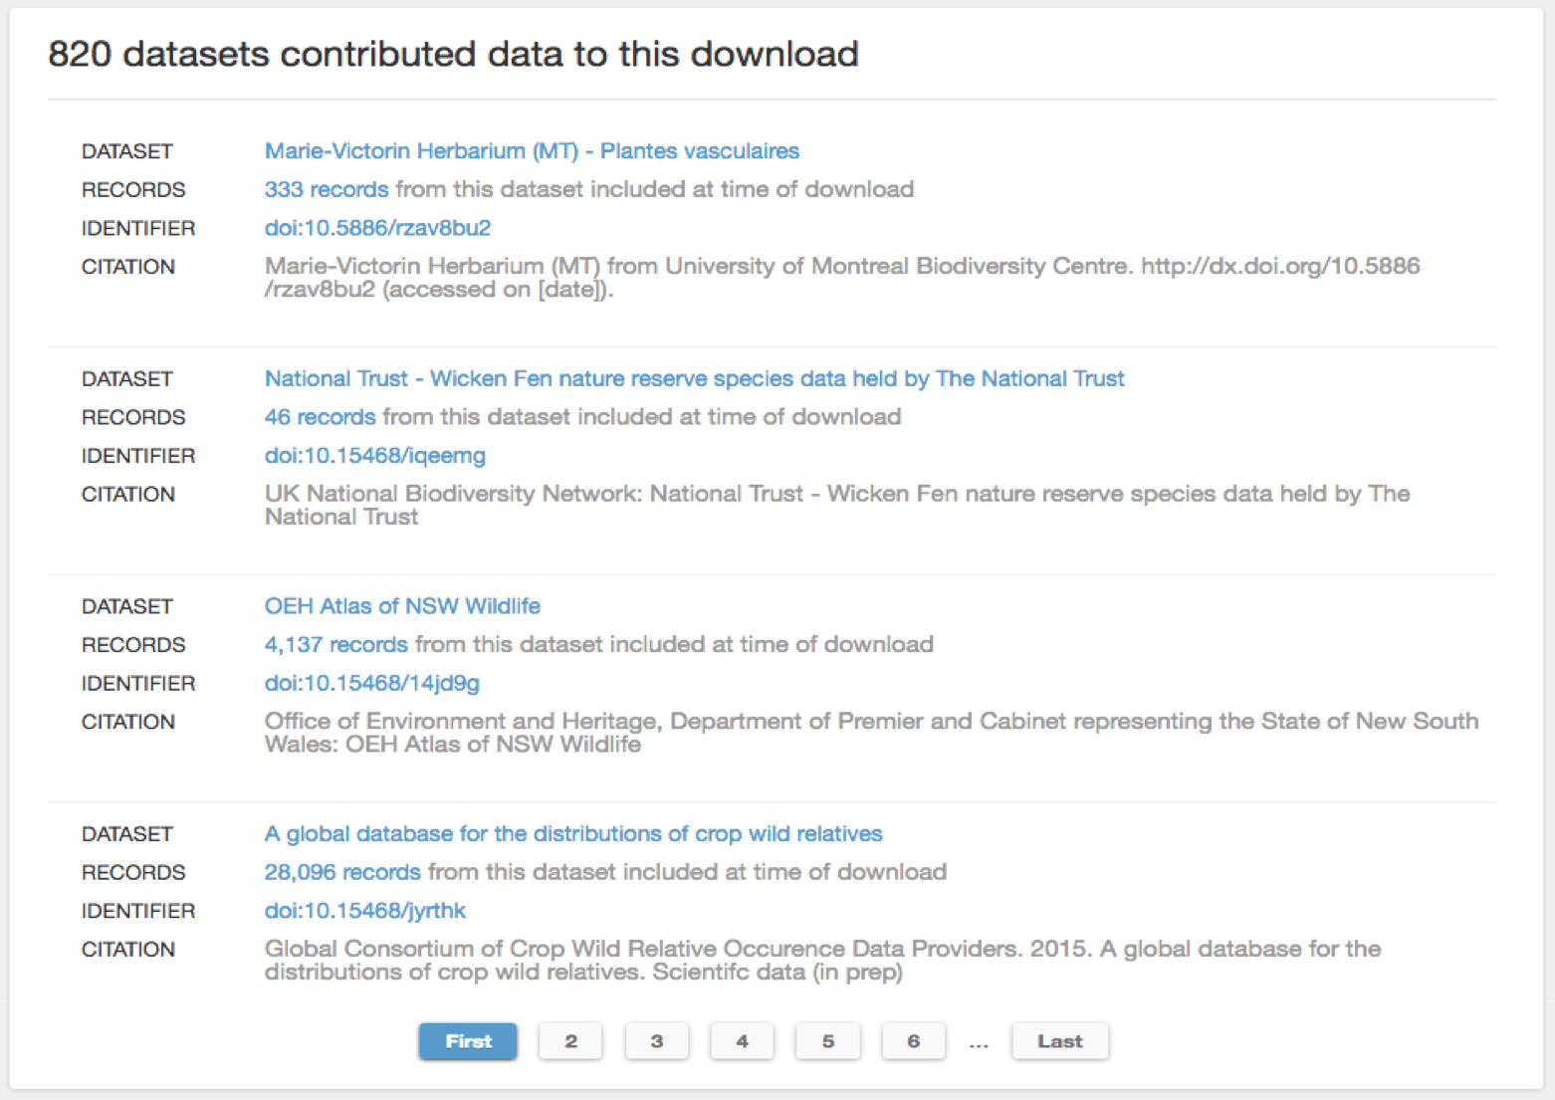
(...)
Notes:
http://doi.org/10.15468/dl.h6fdbn

Slide 18
Data citation
with DOI

Slide 19
Scholarly Data citation is good research practice
Data citation integrated part of the scholarly system
Supporting research validation and reproducibility
Enable reuse of research output and results
Tracking impact of published data
Scholarly structure to reward and credit people involved in producing research data

Slide 20
DOI – Digital Object Identifier
Persistent resolvable identifiers
Standard for scholarly journal papers
Simplify citation of references
Used for measuring impact

Slide 21
Who has cited your data resource?
CrossRef services link citations between scientific journal articles
With CrossRef you can discover who has cited your research paper!
Services to link dataset citations (DataCite DOI) with CrossRef systems
Towards services in CrossRef to discover who cited your research data …
http://blog.crossref.org/?s=DataCite
Notes:
http://blog.crossref.org/?s=DataCite
http://blog.crossref.org/2016/08/the-article-nexus.html
http://blog.crossref.org/2016/09/linking-publications-to-data-and-software.html
http://www.stm-assoc.org/2012_06_14_STM_DataCite_Joint_Statement.pdf
http://blog.crossref.org/2015/09/det-poised-for-launch.html
http://blog.crossref.org/2014/09/linking-data-and-publications.html
--
GBIF dataset DOIs introduced at GBIF Governing Board, GB21 in India, in September 2014:
http://vimeo.com/107148220#t=6m28s

Slide 22
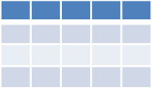
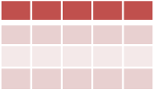
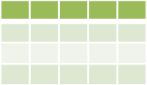
GBIF & Digital Object Identifiers (DOI)
GBIF.org
GBIF registers datasets
without existing DOIs
with DataCite Denmark
DataCite Denmark
IPT
Any tool
Any tool
National DataCite Service
Publisher uses IPT to register dataset with DataCite
Publisher establishes DOI externally
Publisher does not provide DOI
Data Publishers
GBIF dataset DOI launced in September 2014: http://vimeo.com/107148220#t=6m28s
Notes:
GBIF dataset DOIs introduced at GBIF Governing Board, GB21 in India, in September 2014: http://vimeo.com/107148220#t=6m28s

Slide 23
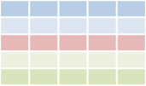
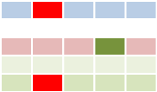
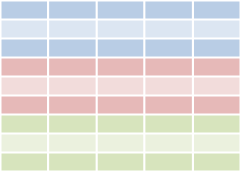
GBIF & Digital Object Identifiers (DOI)
GBIF download
Cleaned data
Paper
Download DOI
Dataset DOI
Paper DOI
Data
Data
User publishes paper
Published paper can give resolvable links to GBIF download and/or to cleaned dataset
Researcher
User cleans data
Data attribution
Data attribution
User searches for data through GBIF.org
User deposits cleaned dataset in a repository and gets DOI for dataset
GBIF.org
Download history
Download 1
DataCite Denmark
. . .
GBIF assigns DOIs to
data downloads
GBIF.org creates a download data set
GBIF dataset DOI launced in September 2014: http://vimeo.com/107148220#t=6m28s
Notes:
GBIF dataset DOIs introduced at GBIF Governing Board, GB21 in India, in September 2014: http://vimeo.com/107148220#t=6m28s

Slide 24
BIBSYS is the Norwegian member in DataCite
"As a DataCite member BIBSYS act as a national DataCite representative in Norway and thereby allow all of Norway's higher education and research institutions to use DOI on their research data".
Resource must be citation-worthy
Resource must have good metadata
Long-term archiving and accessibility for data
http://www.bibsys.no/rammeverk-for-doi/
Notes:
https://en.wikipedia.org/wiki/DataCite
https://en.wikipedia.org/wiki/Bibsys
http://www.bibsys.no/produkter-tjenester/tjenester/gjor-forskningen-din-synlig/
http://www.bibsys.no/rammeverk-for-doi/

Slide 25
Services to enable data analysis

Slide 26
LifeWatch Norway
LifeWatch Virtual Research Environment (VRE)
Proposal submitted for creating a LifeWatch Norway
LifeWatch.no proposal is based on the robust GBIF infrastructure and GBIF data publishing services/mechanisms
Creating new services and work-flows for analyzing ecological data
Contribute to international GBIF standards for new data types
A LifeWatch Norway will substantially strengthen the societal benefits and capitalization of the Norwegian investments in GBIF.
Notes:
http://www.lifewatch.eu/
http://www.lifewatch.eu/Virtual_Research_Environments
https://portal.biovel.eu/
http://www.slu.se/site/svenska-lifewatch
http://www.slu.se/site/svenska-lifewatch/guider/analysportalen/

Slide 27
GBIF DATA PORTAL API
An interface to access data published through the GBIF network using web services.
http://api.gbif.org/v1/
Notes:
What’s the Data Portal API? An interface to access the data published through the GBIF network using Web Services.

Slide 28
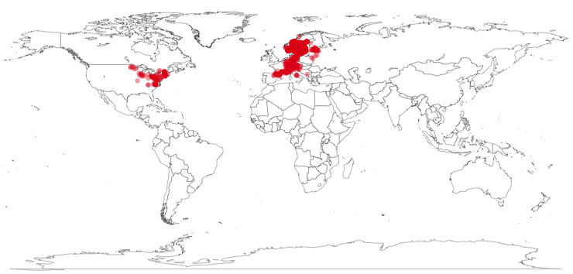
rOpenSci : rgbif
library(rgbif)
key <- name_backbone(name='Hepatica nobilis', kingdom=‘Plantae')$speciesKey
sp <- occ_search(taxonKey=key, return='data', hasCoordinate=TRUE, limit=1000)
gbifmap(sp)

Slide 29
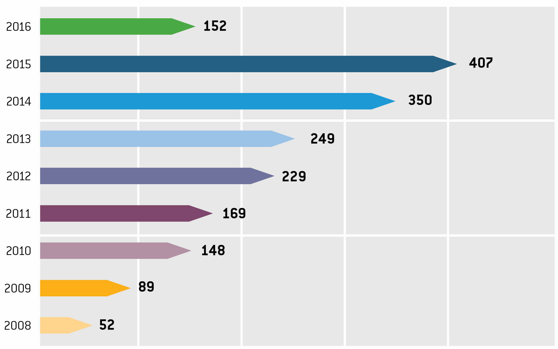
Citations in peer-reviewed research
data use
Annual number of peer-reviewed publications using GBIF-mediated data
9 JUN 2016

Slide 30
GBIF Norway
www.gbif.no

Slide 31
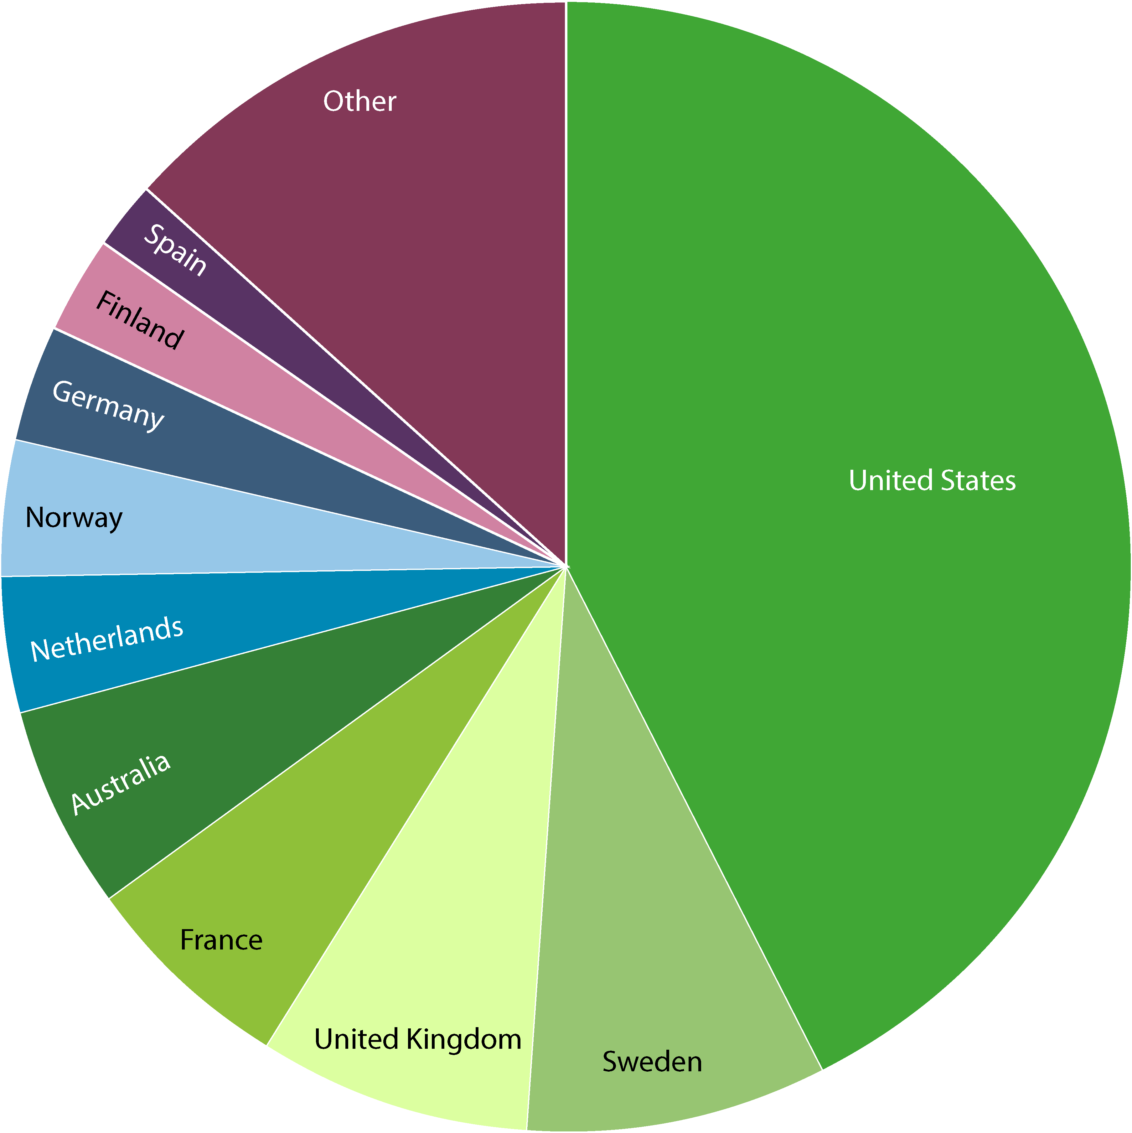
Data—by gbif participant
data publishing
Status May 2016
Norway
Norway
Number of new records published—Top 10 participant Countries (1 to 31 May 2016)
Total number of records published—Top 10 Participant Countries (as of 31 May 2016)
1. United States | 3,348,499 | 6. Belgium | 1,620423
2. Denmark | 2,972,094 | 7. Netherlands | 1,094,804
3. Germany | 2,868,240 | 8. Australia | 859,896
4. Norway | 2,322,797 | 9. Costa Rica | 810,035
5. Spain | 2,238,363 | 10. South Africa | 436,236
1. United States | 271,901,500 | 6. Netherlands | 24,241,092
2. Sweden | 53,776,182 | 7. Norway | 23,811,863
3. United Kingdom | 49,786,646 | 8. Germany | 22,151,479
4. France | 39,896,982 | 9. Finland | 16,612,735
5. Australia | 37,489,401 | 10. Spain | 13,630,866
NOTE: Datasets are assigned to countries according to the location of the publishing institution, including aggregated datasets with contributors from many other countries. http://www.gbif.org | 09 JUN 2016

Slide 32
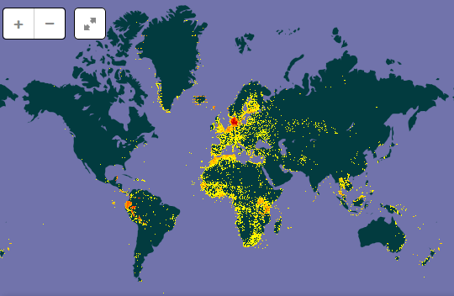
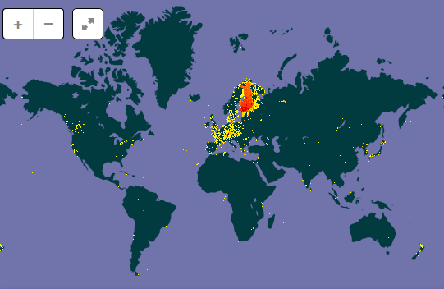
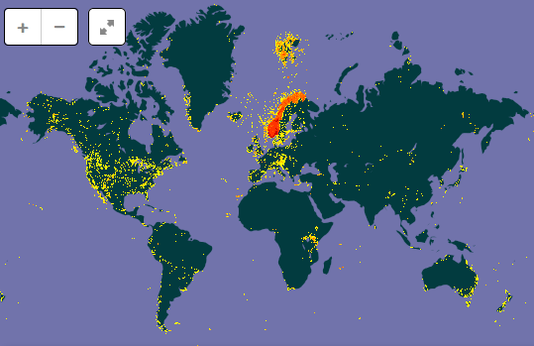
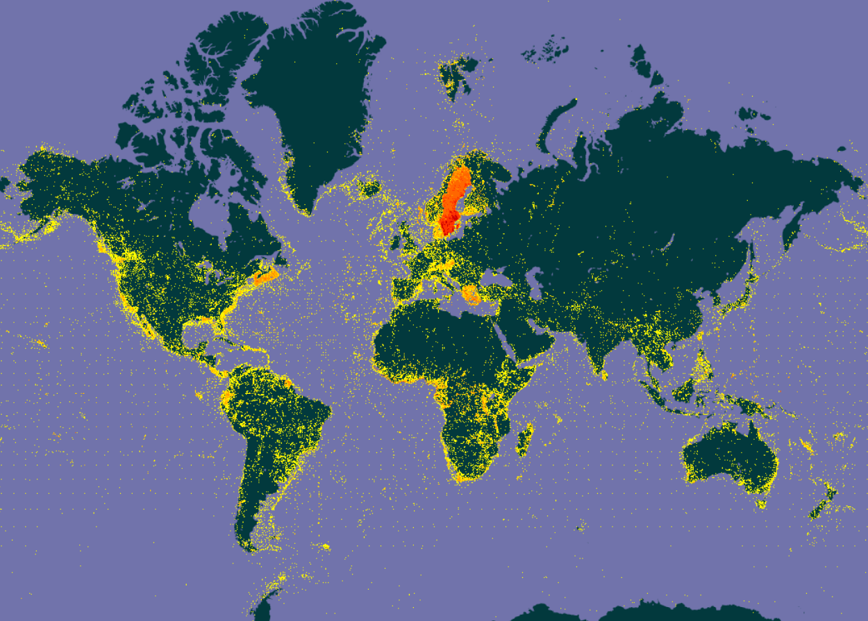
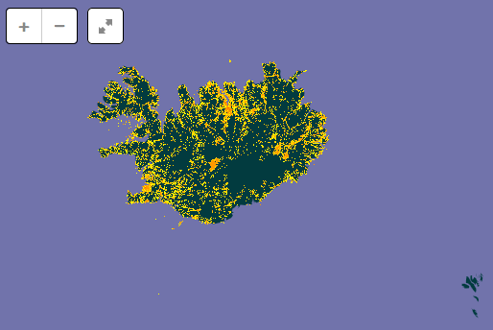
Status for Nordic GBIF nodes (data Published from country)
Danmark
Finland
http://www.gbif.org/country/NO
Norway
Sweden
Oct. 2016 | Datasets | Occurrences
Denmark | 66 + 1 | 10 905 213
Finland | 54 | 3 614 965
Iceland | 4 | 458 705
Norway | 115 + 2 | 22 431 281
Sweden | 42 + 1 | 53 791 566
Iceland
Notes:
Denmark: http://www.gbif.org/country/DK/publishing
Finland: http://www.gbif.org/country/FI/publishing
Iceland: http://www.gbif.org/country/IS/publishing
Norway: http://www.gbif.org/country/NO/publishing
Sweden: http://www.gbif.org/country/SE/publishing
Status in September 2016
Country, datasets, occurrences
Denmark, 66 + 1 datasets, 10 905 213 occurrences
Finland, 54 datasets, 3 611 729 occurrences (many data removed because of open license requirement??)
Iceland, 4 datasets, 458 705 occurrences
Norway, 112 + 2 datasets, 21 684 727 occurrences
Sweden, 42 datasets, 53 787 704 occurrences
Status in April 2015:
Country, datasets, occurrences
Denmark, 55ds, 10 250 100 occ
Finland, 58 ds, 19 626 137 occ
Iceland, 4 ds, 458 705 occ
Norway, 93 ds, 17 425 011 occ
Sweden, 34 ds, 50 997 763 occ

Slide 33
Node team at NHM, University of Oslo
Dag Endresen, Node manager
Christian Svindseth, Data manager
Fridtjof Mehlum, Research director
Einar Timdal, Associate professor
Geir Søli, Associate professor
Vidar Bakken, Consultant
Artsdatabanken, Trondheim
Wouter Koch
Nils Valland
NTNU University Museum
Anders Finstad, GBIF Science committee
Research Council of Norway
Per Backe-Hansen, Head of delegation
Contact us at: gbif-drift@nhm.uio.no
Notes:
http://www.nhm.uio.no/forskning/prosjekter/gbif/
http://www.gbif.no

