Slide 1
Global Biodiversity Information Facility
Dag Endresen - GBIF Norge, Universitetet i Oslo
Illustrasjon: GBIF data portal
UiO forskningsinfrastrukturutvalg, Oslo | 6. juni 2023
Notes:
Illustration: GBIF data portal, https://www.gbif.org

Slide 2
tema for presentasjonen (UiO Kjernefasilitet)
Fagrådet ønsker en 10 min presentasjon med fokus på følgende:
En kort sammenfatning av hvilke tjenester kjernefasiliteten planlegger å tilby (3-4 min). [allerede tilbyr]
Forklar hvorfor fasiliteten faller inn under UiOs vedtatte definisjon av en kjernefasilitet (ca 3 min).
Skisser forventet brukerbase og nedslagsfelt (2-3 min).
Hvilken gevinst ser man for seg av å få status som UiO-kjernefasilitet?
Resten av den avsatte tid vil benyttes til spørsmål og avklaringer som Fagrådet måtte ha behov for.
Notes:
Vi viser til innsendt søknad til Godkjenningsordning for kjernefasiliteter i hht. vedlegg, for GBIF Norway - Global Biodiversity Information Facility (søknad også vedlagt). Fagråd for kjernefasiliteter, som koordinerer ordningen, foretok sin første vurdering av GBIF Norway i sitt møte 14. april, og ønsker å invitere GBIF Norway til intervju:
Dato: Tirsdag 6. juni Tid: kl. 14.00-14.30 Sted: Møterom 2, Lucy Smiths hus, 10. etg.
Fasiliteten har ikke tidligere hatt status som UiO-kjernefasilitet. Fagrådet ønsker en 10 min presentasjon med fokus på følgende: • En kort sammenfatning av hvilke tjenester kjernefasiliteten planlegger å tilby (3-4 min) • Forklar hvorfor fasiliteten faller inn under UiOs vedtatte definisjon av en kjernefasilitet (ca 3 min)
• Skisser forventet brukerbase og nedslagsfelt (2-3 min) • Hvilken gevinst ser man for seg av å få status som UiO-kjernefasilitet? Resten av den avsatte tid vil benyttes til spørsmål og avklaringer som Fagrådet måtte ha behov for.
Basert på søknaden og intervjuet vil Fagrådet ta sin endelige beslutning og formidle den til miljøet før sommeren.

Slide 3
What is gbif?
Intergovernmental network and research infrastructure
Provides anyone, anywhere, free and open access to data about all types of life on Earth
Distributed research data infrastructure based on national participant NODES
Secretariat in Copenhagen, Denmark
https://www.gbif.org
Notes:
https://www.gbif.org/

Slide 4
GBIF Participant countries 5th May 2023
GBIF Norway (hosted by UiO NHMO)
GBIF member since 2005 (KD decision, RCN)
Elected representative for GBIF Europe and Central Asia in 2023 (deputy rep. since 2019)
Voting Countries (42)
Associate Countries (22)
Notes:
This map is fully editable. This map is a grouped element of all the countries in the world. All the countries are named correctly and can be accessed and selected via the Selection Pane. There are ways you can edit and make changes to the map. But please remember to always make a copy of the map on your slide and never make changes to the toolkit version. Please take a look at the next few slides to find out different ways of editing this map.

Slide 5
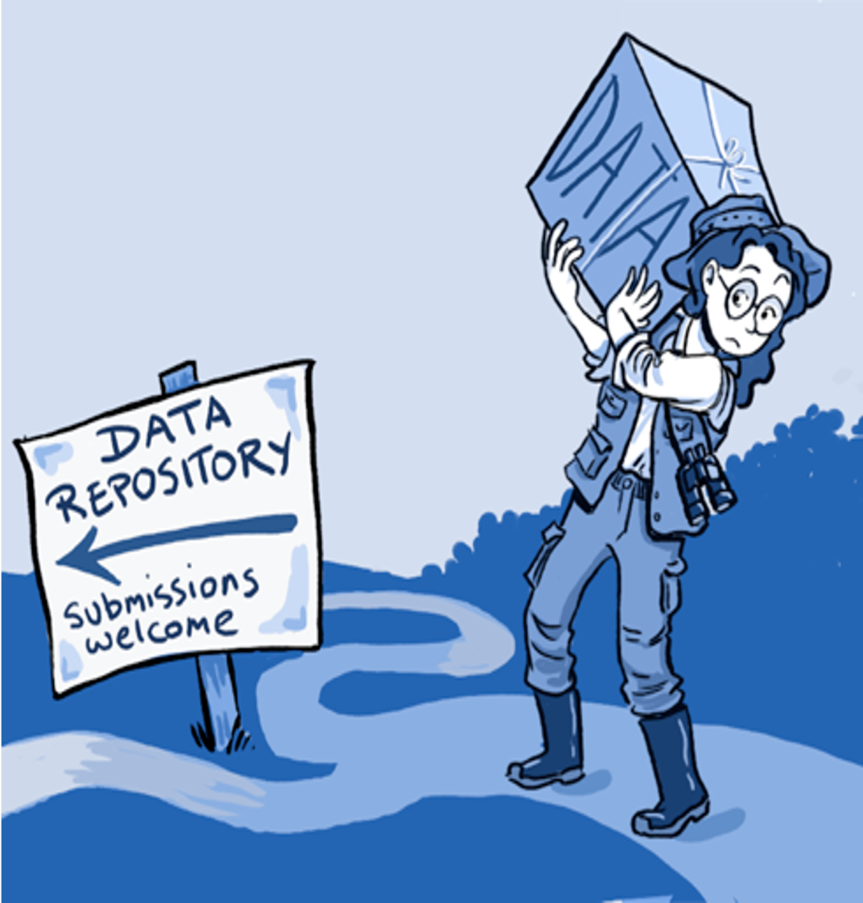
GBIF Norway services: Publish datasets with GBIF
National GBIF nodes offer support with professional data preparation and publication (data stewardship, FAIRification, data citation).
The GBIF community including the national GBIF nodes offer training and capacity building for open and FAIR data management.
GBIF support researchers and students at UiO with (FAIR) biodiversity data publishing services.
And with biodiversity data reuse (and data citation).
Notes:
http://www.gbif.org/resource/80635
http://www.gbif.org/publishing-data/summary
http://www.gbif.org/publishing-data/request-endorsement#/intro
https://www.gbif.org/publisher/f314b0b0-e3dc-11d9-8d81-b8a03c50a862/metrics

Slide 6
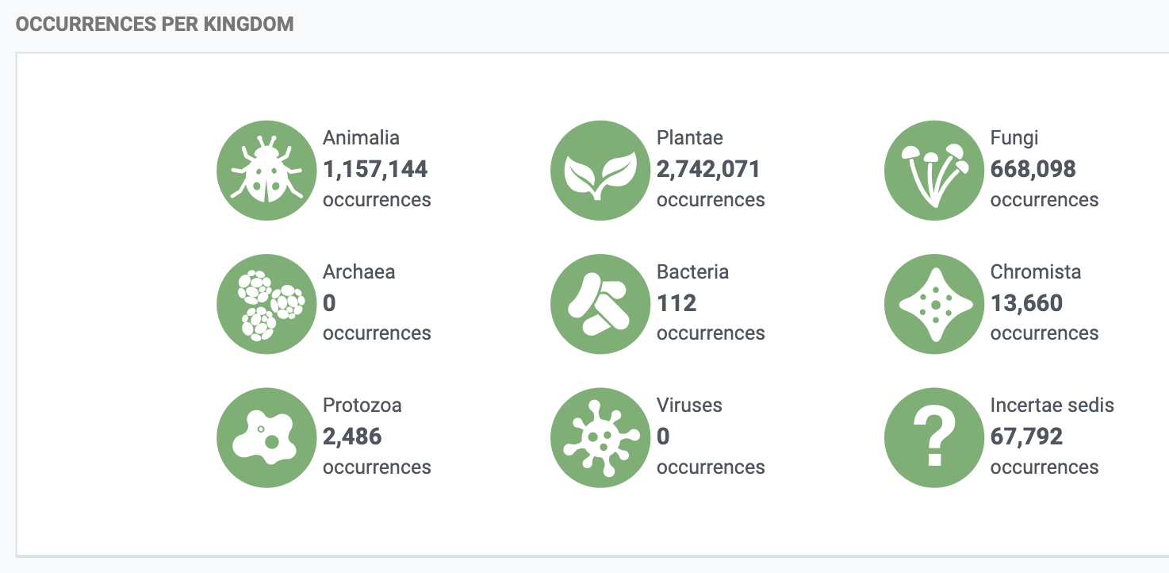
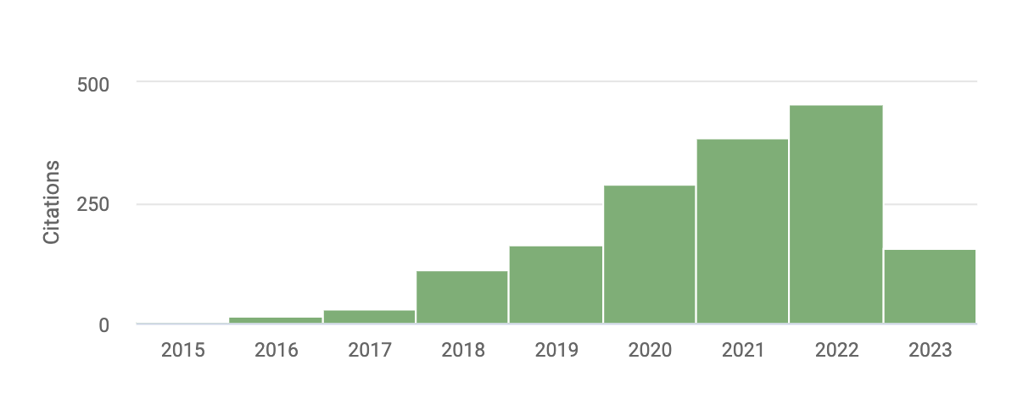
GBIF-mediated biodiversity data from researchers at UiO
Researchers and students from the University of Oslo publish 4 670 167 species occurrence data points in GBIF (updated 2023-06-04)
These data points have been reused and cited in 1 637 peer-reviewed scientific publications.
(187 so far in 2023; 455 in 2022)
In total for all datasets published from Norway
51 612 699 species occurrences published
400 datasets, 38 institutions
Data citations (biodiversity data published FROM UiO)
Notes:
https://www.gbif.org/publisher/f314b0b0-e3dc-11d9-8d81-b8a03c50a862/metrics
https://analytics-files.gbif.org/country/NO/GBIF_CountryReport_NO.pdf

Slide 7
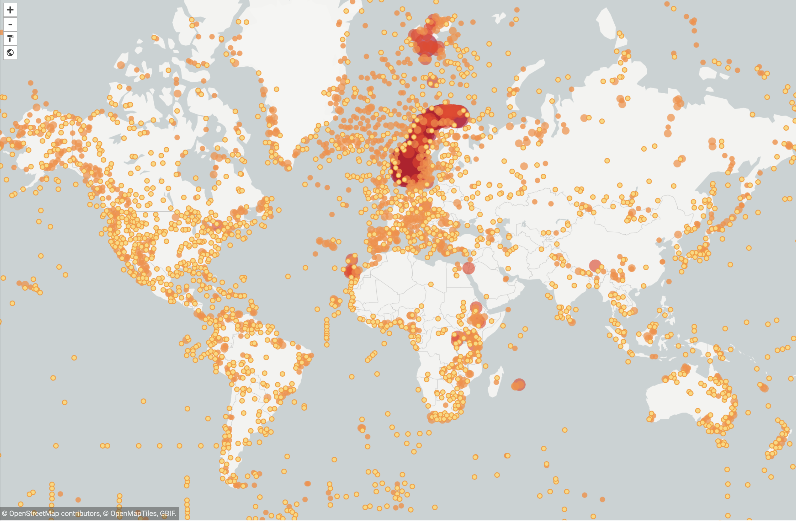
Data publishing from UiO
Researchers and students from the University of Oslo publish 4 651 363 species occurrence data in GBIF (map updated 2023-05-15)
Notes:
Researchers and students from the University of Oslo publish 4 651 363 species occurrence data in GBIF (updated 2023-05-15)
map updated 2023-05-15
https://www.gbif.org/occurrence/map?has_coordinate=true&has_geospatial_issue=false&publishing_org=f314b0b0-e3dc-11d9-8d81-b8a03c50a862
https://www.gbif.org/publisher/f314b0b0-e3dc-11d9-8d81-b8a03c50a862/metrics

Slide 8
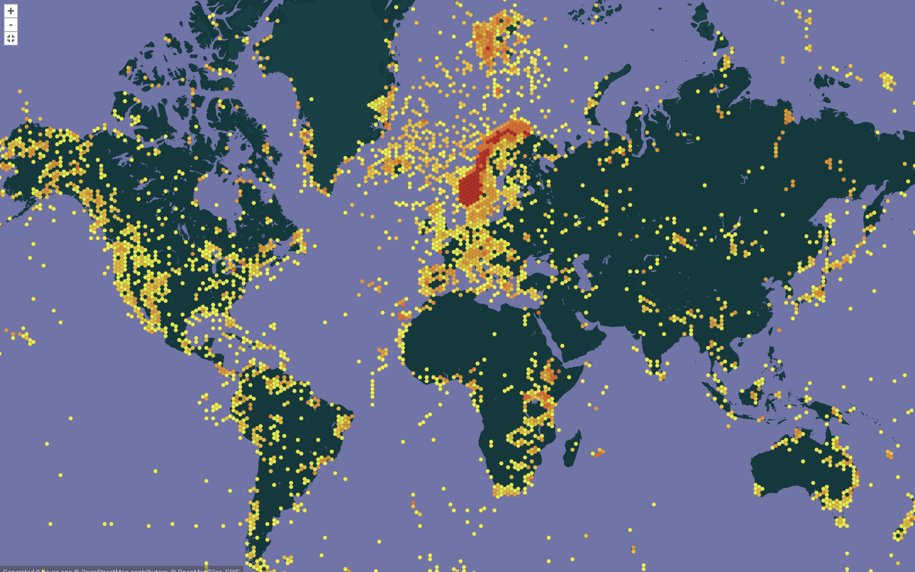
Data publishing from UiO
Researchers and students from the University of Oslo publish 4 651 363 species occurrence data in GBIF (map updated 2023-05-15)
Notes:
Researchers and students from the University of Oslo publish 4 651 363 species occurrence data in GBIF (updated 2023-05-15)
map updated 2023-05-15
https://www.gbif.org/publisher/f314b0b0-e3dc-11d9-8d81-b8a03c50a862/metrics
https://www.gbif.org/occurrence/map?has_coordinate=true&has_geospatial_issue=false&publishing_org=f314b0b0-e3dc-11d9-8d81-b8a03c50a862

Slide 9
GBIF Norway end-users: GBIF-mediated biodiversity data
GBIF provides anyone, anywhere, open access to data about all types of life on Earth.
Researchers and students from Norway has published 483 peer-reviewed papers citing the reuse of GBIF-mediated data.
(18 papers so far in 2023; 106 in 2022)
Notes:
https://www.gbif.org/resource/search?contentType=literature&countriesOfResearcher=NO&peerReview=true
https://www.gbif.org/resource/search?contentType=literature&year=2023,2023&countriesOfResearcher=NO&peerReview=true
(are we able to make a breakdown for UiO researchers...?????)
Researchers and students from UiO reuse and cites ???? GBIF-mediated data ....????

Slide 10
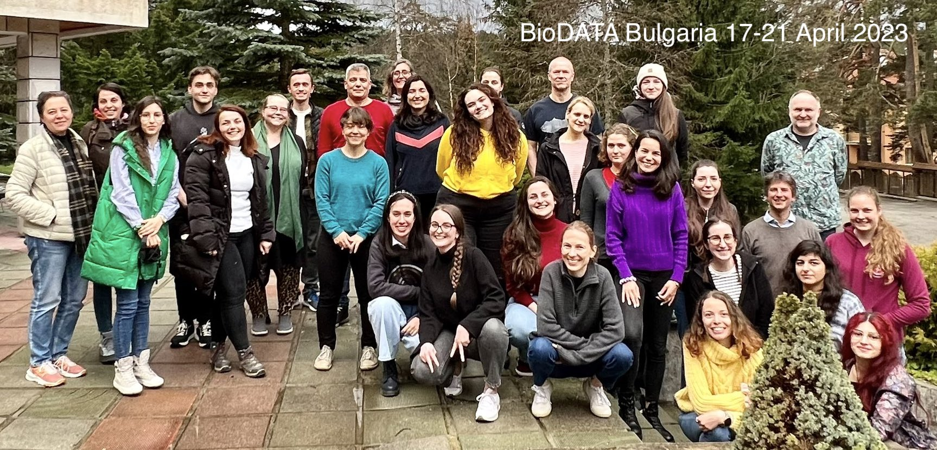
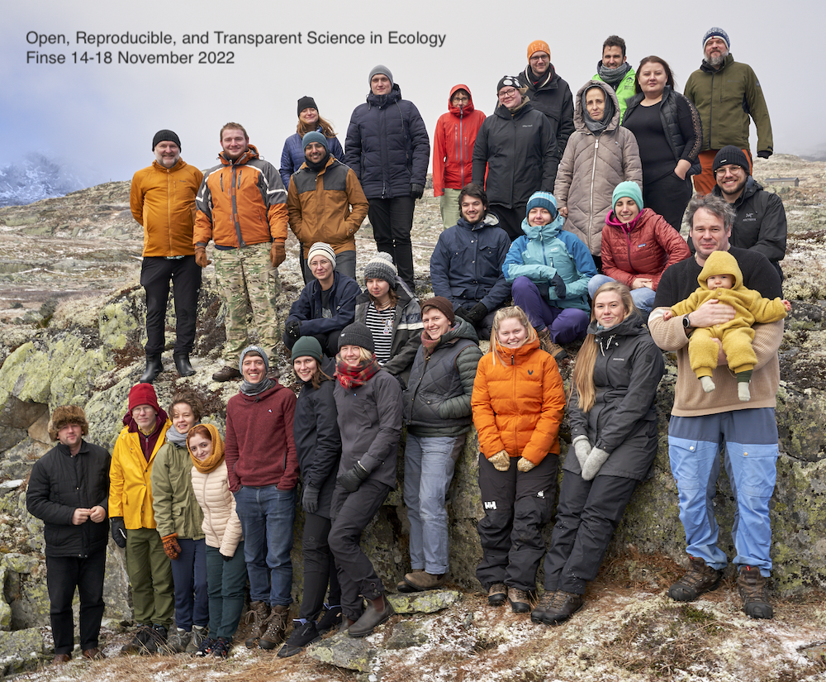
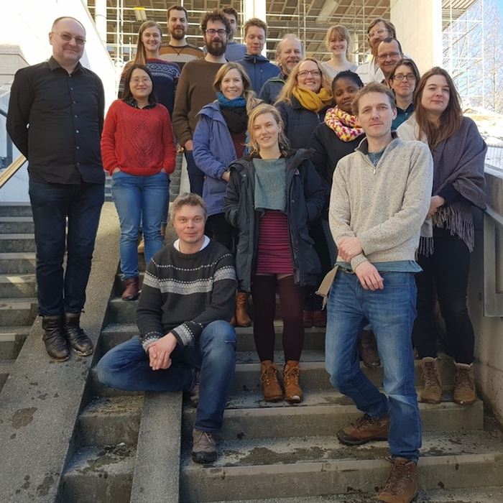
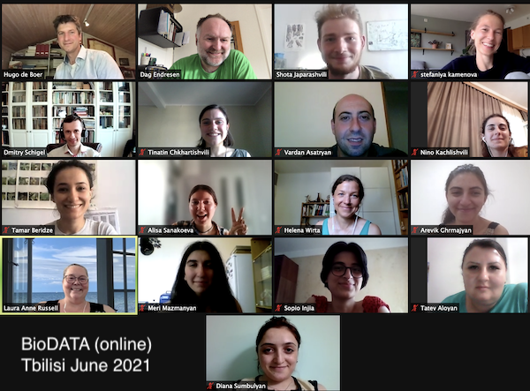
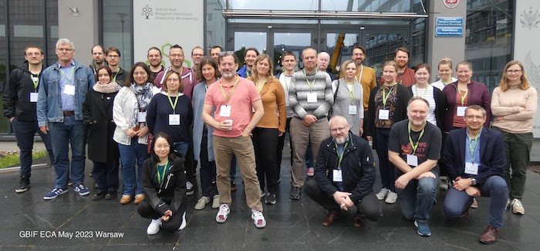
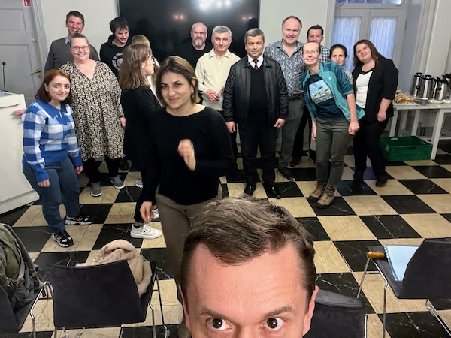
Student courses, researcher training and workshops
Marine biodiversity data mobilisation for Nansen Legacy (Tromsø Nov 2022, Oslo Sept 2023, …)
Data publication workshops (Bergen Feb 2023, …)
Open Science cources (Finse Nov 2022, Dovre Nov 2023)
BioDATA data mobilisation (2018-2022)
BioDATA DNA sequence data (2022-2025)
BioMedData ELIXIR data management (2020-2024)
GBIF CESP Tajikistan mentoring (2022)
GBIF CESP OpenPSD proivate sector (2020)
GBIF CESP Bireme EU reporting (2017-2018)

Slide 11
Biodiversity Digital Twin (biodt.eu)
GBIF and GBIF Norway (UiO) participate in the Horizon Europe development of digital twins for biodiversity (2022-2025).
Including a digital twin for the crop wild relative genepool of grasspea (Lathyrus).
Including a digital twin for DNA-detected biodiversity in poorly known habitats.
Including identifying biodiversity infrastructure (ESFRI roadmap, EOSC) collaboration models.
Notes:
https://biodt.eu/use-cases

Slide 12
Hvorfor GBIF Norge som UiO kjernefasilitet – ønsket gjevinst
Ytterligere økt anvendelse fra hele UiO (bedre integrert i hele UiO).
Økt gjenbruk av forskningsdata (artsdata) produsert ved hele UiO.
Tverfaglig utveksling av kompetanse, redusere duplisering av ressurser
→ økt komplementaritet mellom forskningsinfrastrukturer der UiO deltar.
UiO Forskningsstrategi (inkludere biodiversitetsinformatikk):
Veikart UiO → Veikart Norge → ESFRI
UiO IT: Avanserte tjenester for IT i forskning:
Artsdata, datapublisering, FAIR data, data science

Slide 13
UiO kjernefasilitet - definisjon
Kjernefasiliteter er forskningsinfrastruktur som godkjennes av fagrådet om den oppfyller følgende krav:
Gjør tilgjengelig, eller bidrar med analyser fra, særlig avansert og kostbart vitenskapelig utstyr som ikke finnes allment tilgjengelig i forskningsmiljøene, og legitimeres i stor grad av etterspørsel og brukermasse utenfor eier av fasiliteten. → Artsdata fra vitenskapelige samlinger, naturhistorie
Krever spisskompetent personell for drift og service; spesialkompetansen må dokumenteres for eksempel gjennom dette personellets forskningsaktivitet. → datarøkter, data steward
Kan unntaksvis være rene kompetanseplattformer (spesialkompetanse uten avansert kostbart utstyr) når etterspørsel etter kompetansen er utstrakt og særskilt viktig for forskningsaktiviteten – et eksempel på dette er for tiden Computational Life Science. → biodiversitetsinformatikk
Har påtatt seg en forpliktelse til å tilby avanserte/ høyspesialiserte analyser uten automatisk å ha krav om medforfatterskap (men dette kan vurderes etter Vancouver-reglene når bidraget innebærer videreutvikling utover standard analyseoppsett). → #CiteTheDOI avanserte tjenester for datasitering
Nasjonal forskningsinfrastruktur defineres automatisk som kjernefasilitet. → har NFR INFRA status
Kjernefasiliteten er vurdert å fylle et behov utfra Fagrådets vurderinger.
Notes:
https://www.uio.no/for-ansatte/nettverk-moter/fellesadm/forskningsinfrastruktur/kjernefasiliteter/godkjenningsordning-for-kjernefasiliteter.html

Slide 14
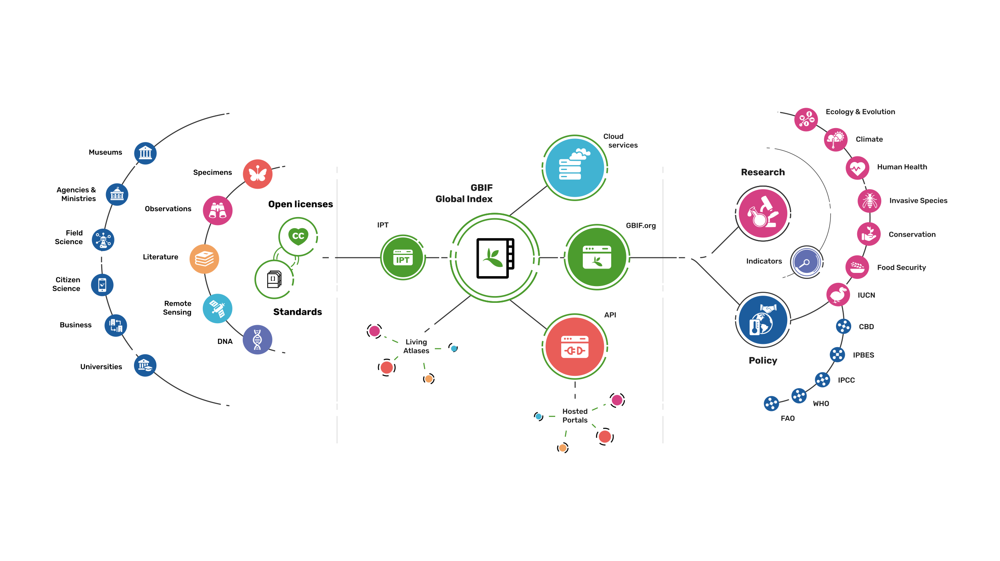
Providing biodiversity Evidence for research and policy

Slide 15
GBIF Norway node story
…so far
(2004-2025)
GBIF ECA Nodes Meeting in Warsaw Poland May 2023
Notes:
GBIF Regional ECA Nodes meeting, Warsaw, May 2023
GBIF Norway, UiO Natural History Museum in Oslo, University in Oslo | www.gbif.no
Photo: ForBio/GBIF training at Baikal lake September 2018, CC-BY Dag Endresen

Slide 16
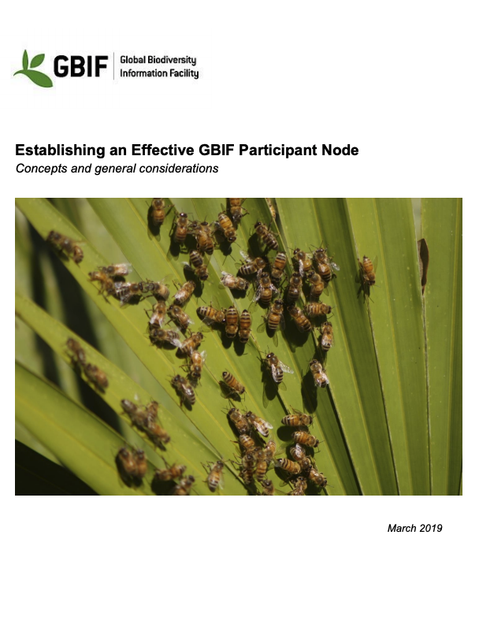
GBIF Participant Node
Participant Node (min 4 roles)
Node Manager (coordination)
IT developer (informatics)
Data scientist (science support)
Biodiversity informatics officer

Slide 17
Research Council of Norway (RCN)
UiO Natural History Museum (NHMO)
Norwegian Biodiversity Information Centre (NBIC)
Norway joined GBIF as voting member in February 2004.
Mandate from the Ministry of Science (KD).
Funded through the Research Council of Norway (RCN-INFRA).
Node hosted by the UiO Natural History Museum since 2005.
Node staff at NHMO (since 2005) & NBIC (since 2018) & more since 2021 (distributed node Oslo, Trondheim, Bergen, Tromsø).
Project funding through 5 project periods (2005-2025).
Node data publishing services are well integrated in operational national decision-making systems.

Slide 18
Node budget (2005 - 2025)
Overall investment (21 years, 83 MNOK = 8 M€)
2005-2007 (1,9 MNOK/year = 194 000 €/year)
2008-2011 (3,0 MNOK/year = 317 000 €/year)
2012-2016 (4,0 MNOK/year = 421 000 €/year)
2017-2020 (3,7 MNOK/year = 382 000 €/year)
2021-2025 (6,2 MNOK/year = 533 000 €/year)

Slide 19
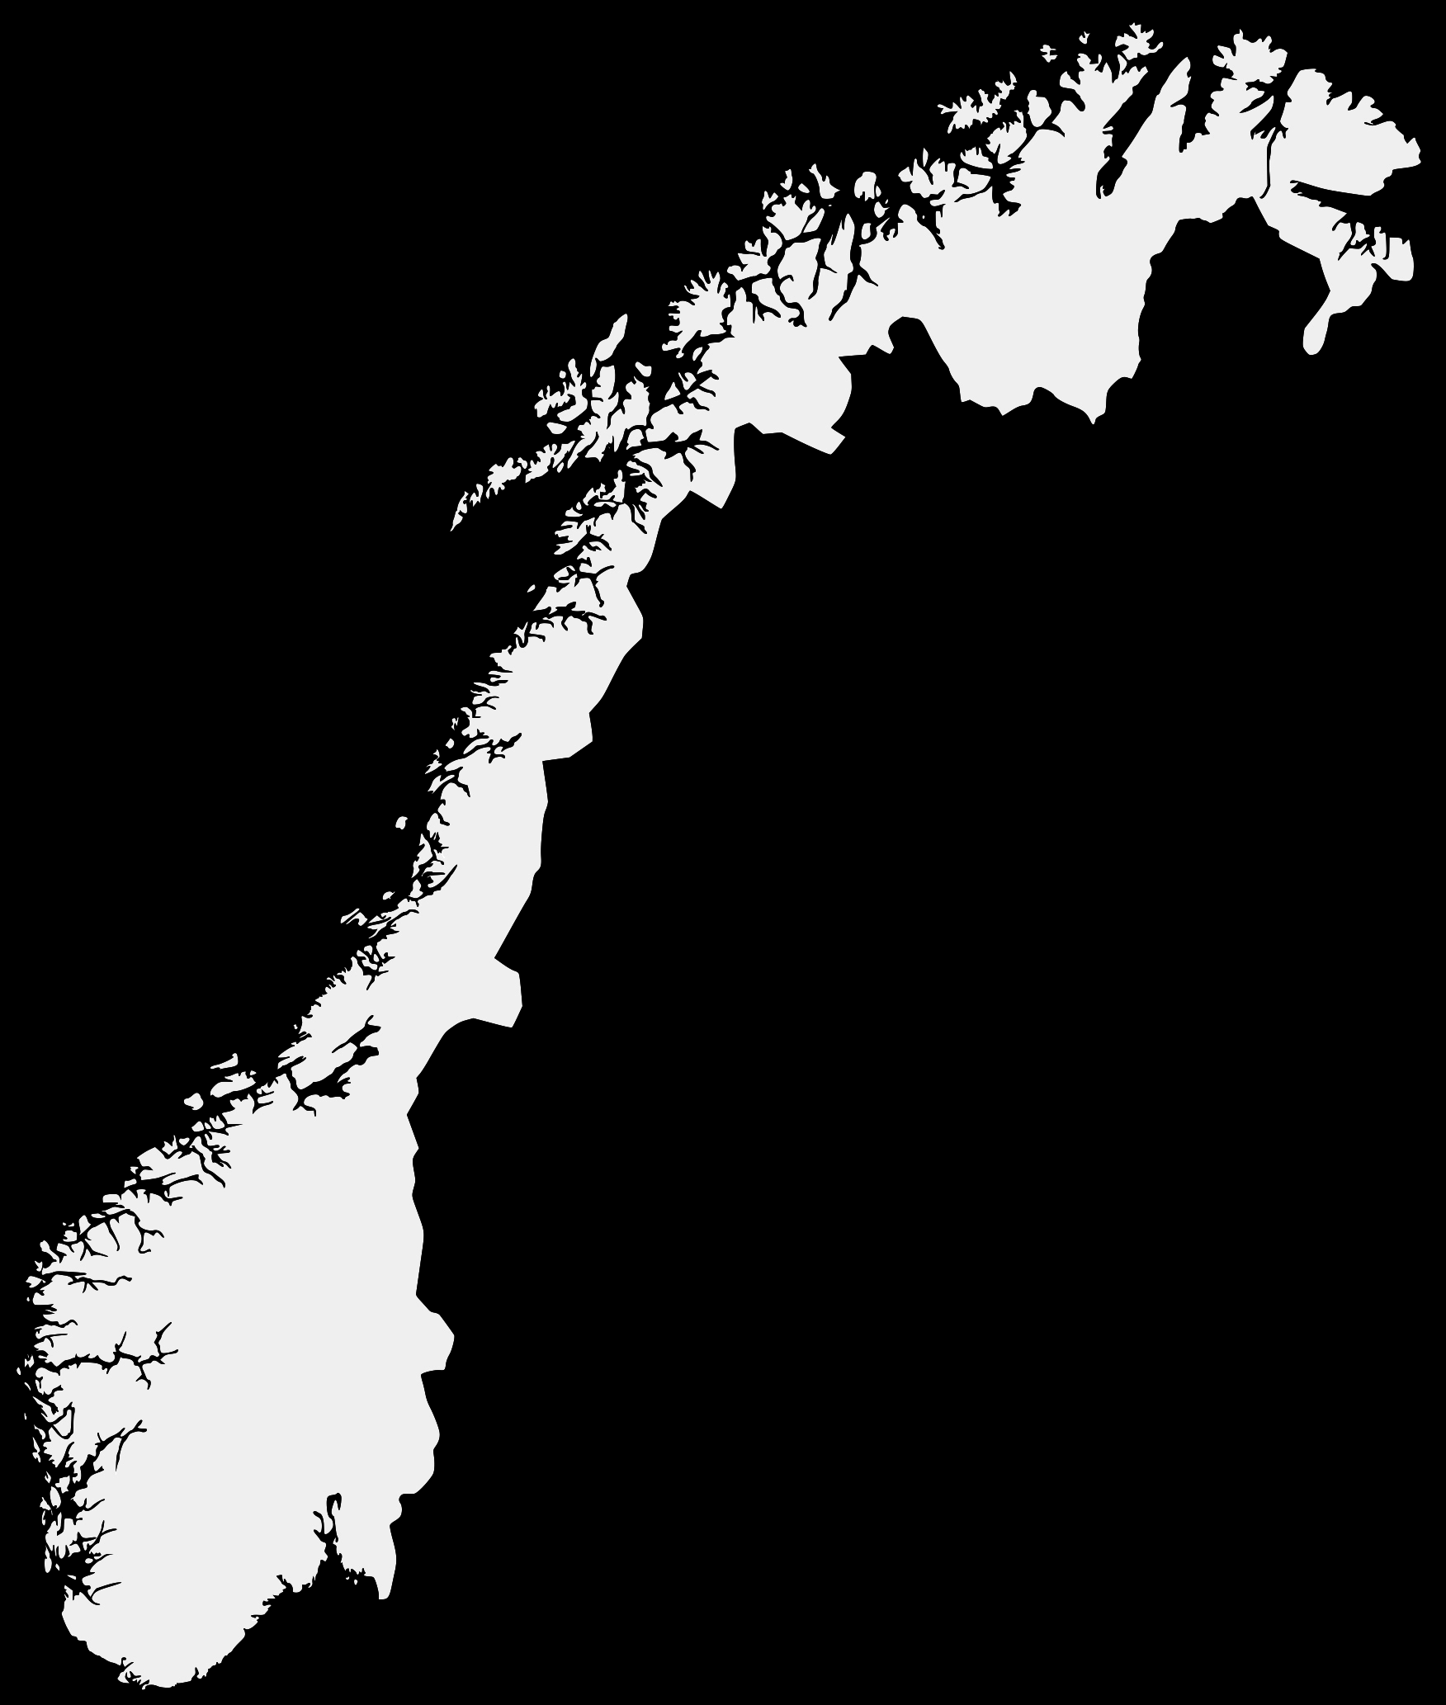
Distributed Node Consortium
Tromsø
formalized sharing of Node responsibilities
Oslo (node host)
University of Oslo
Trondheim
Norwegian University of Science and Technology
Norwegian Biodiversity Information Centre
Norwegian Institute of Nature Research
Bergen
University of Bergen
Tromsø
UiT The Arctic University of Norway
Trondheim
Bergen
Oslo
Notes:
University

Slide 20
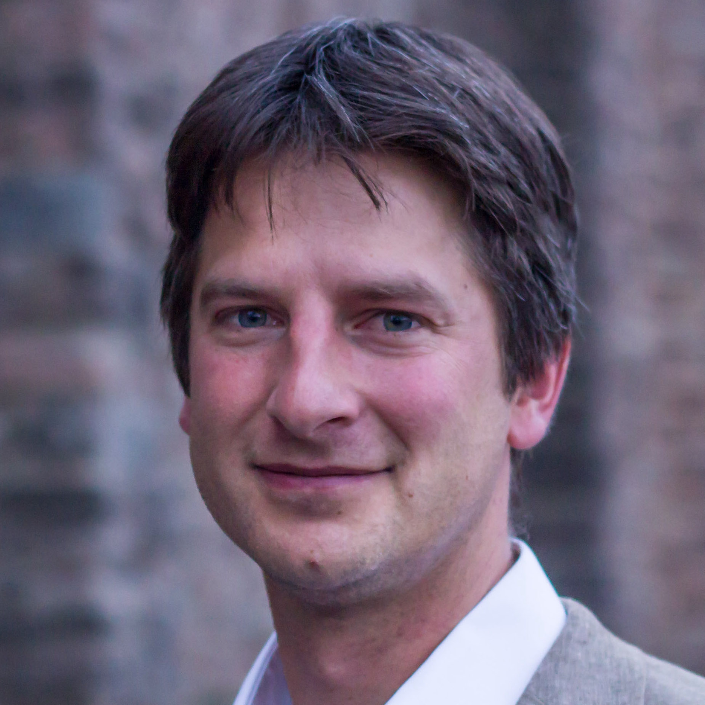
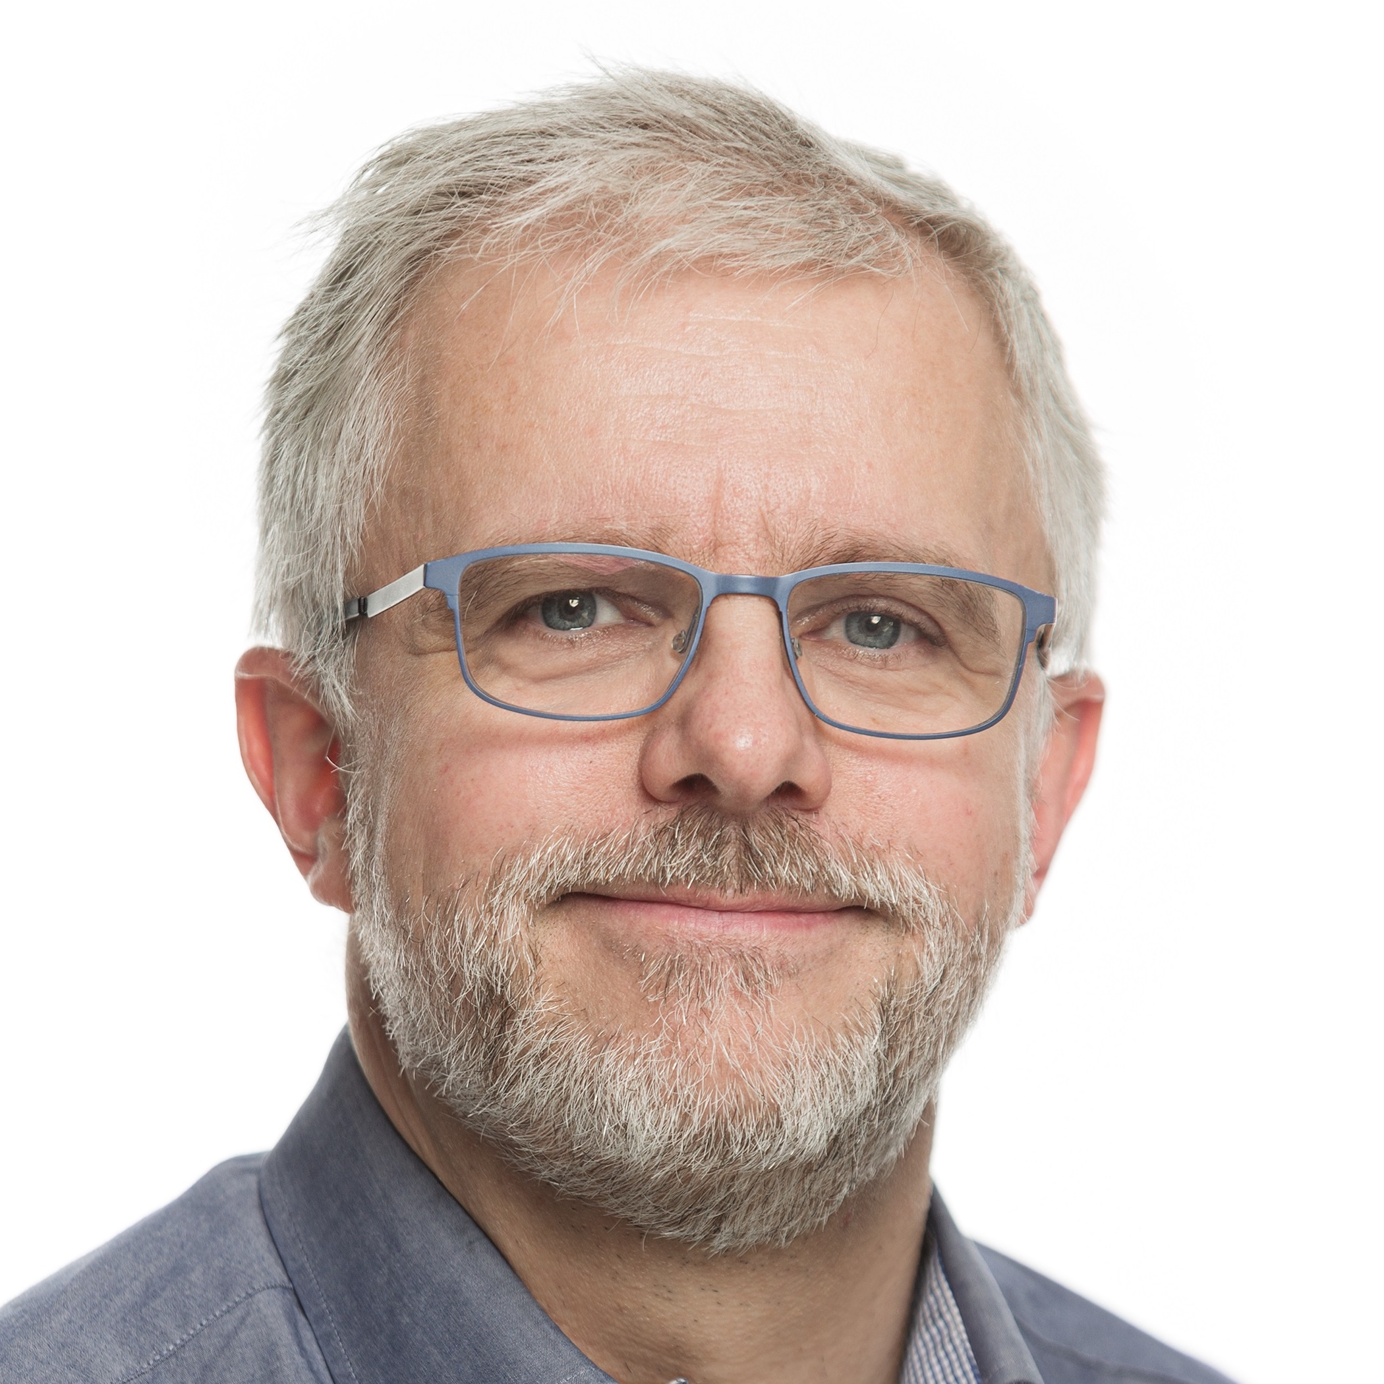
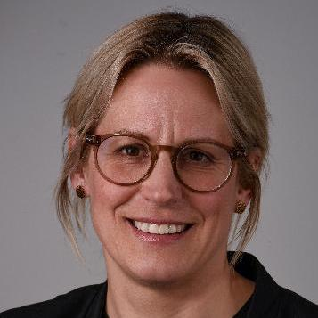
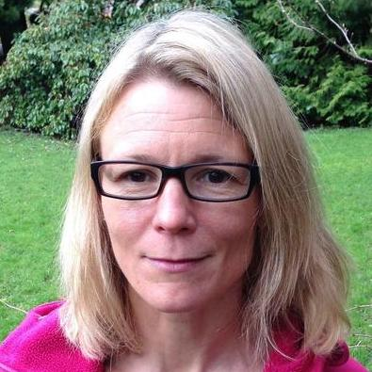
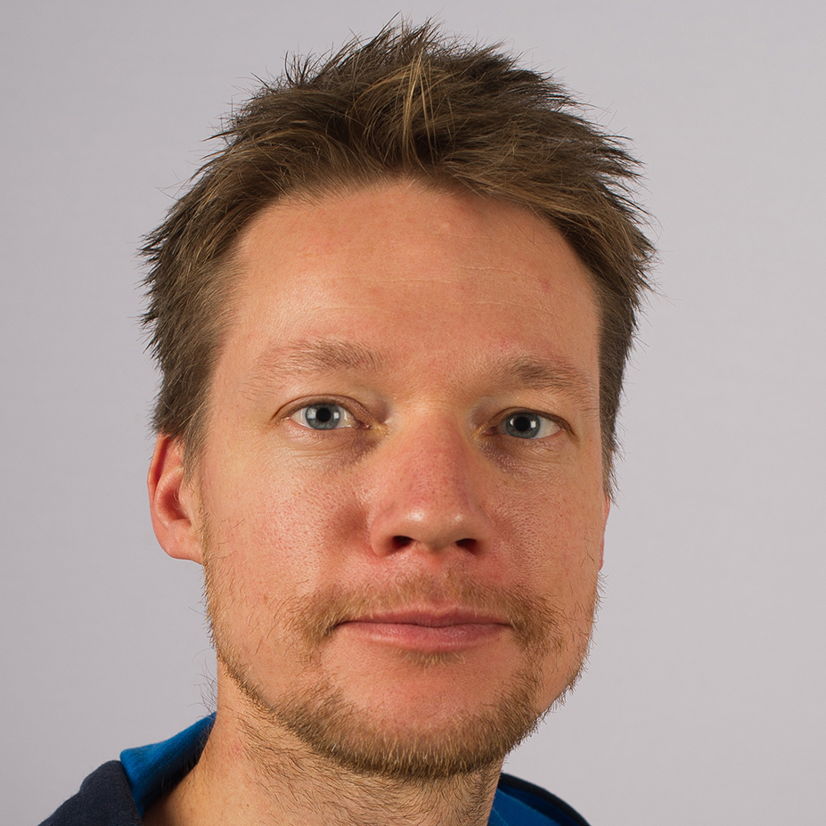
Node board
Hugo de Boer, UiO, Oslo – Head of delegation
Arild Lindgaard, NBIC, Trondheim
Ingrid E. Mathisen, NTNU, Trondheim
Geir Rudolfsen, UiT, Tromsø
Jenny Smedmark, UiB, Bergen
Erlend Birkeland, NINA, Trondheim
Appox. 2 (virtual) node board meeting each year
Notes:
Research Council of Norway -- Christian Wexels Riser (since 2017)

Slide 21
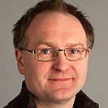
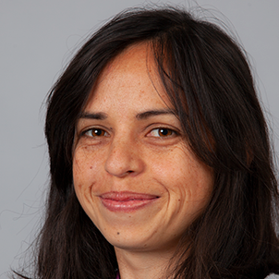
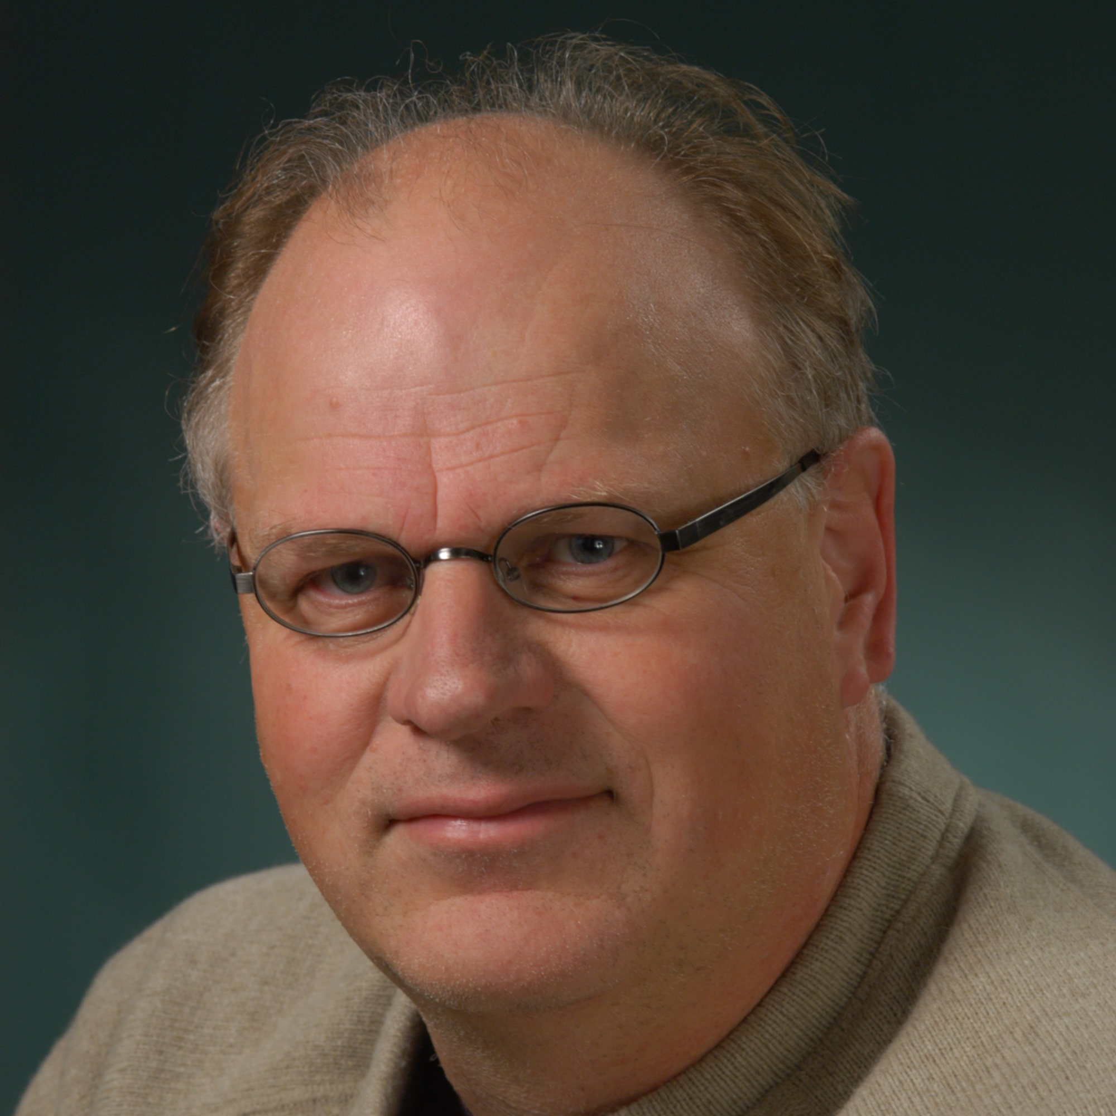
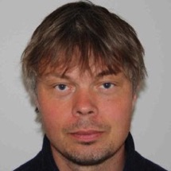
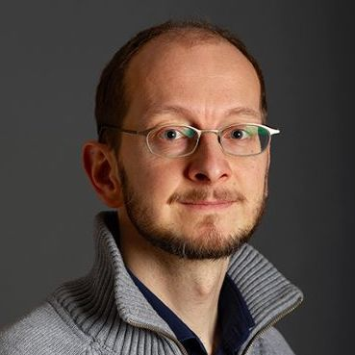
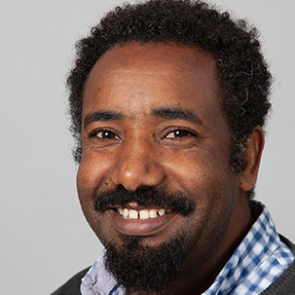
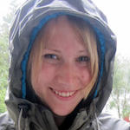
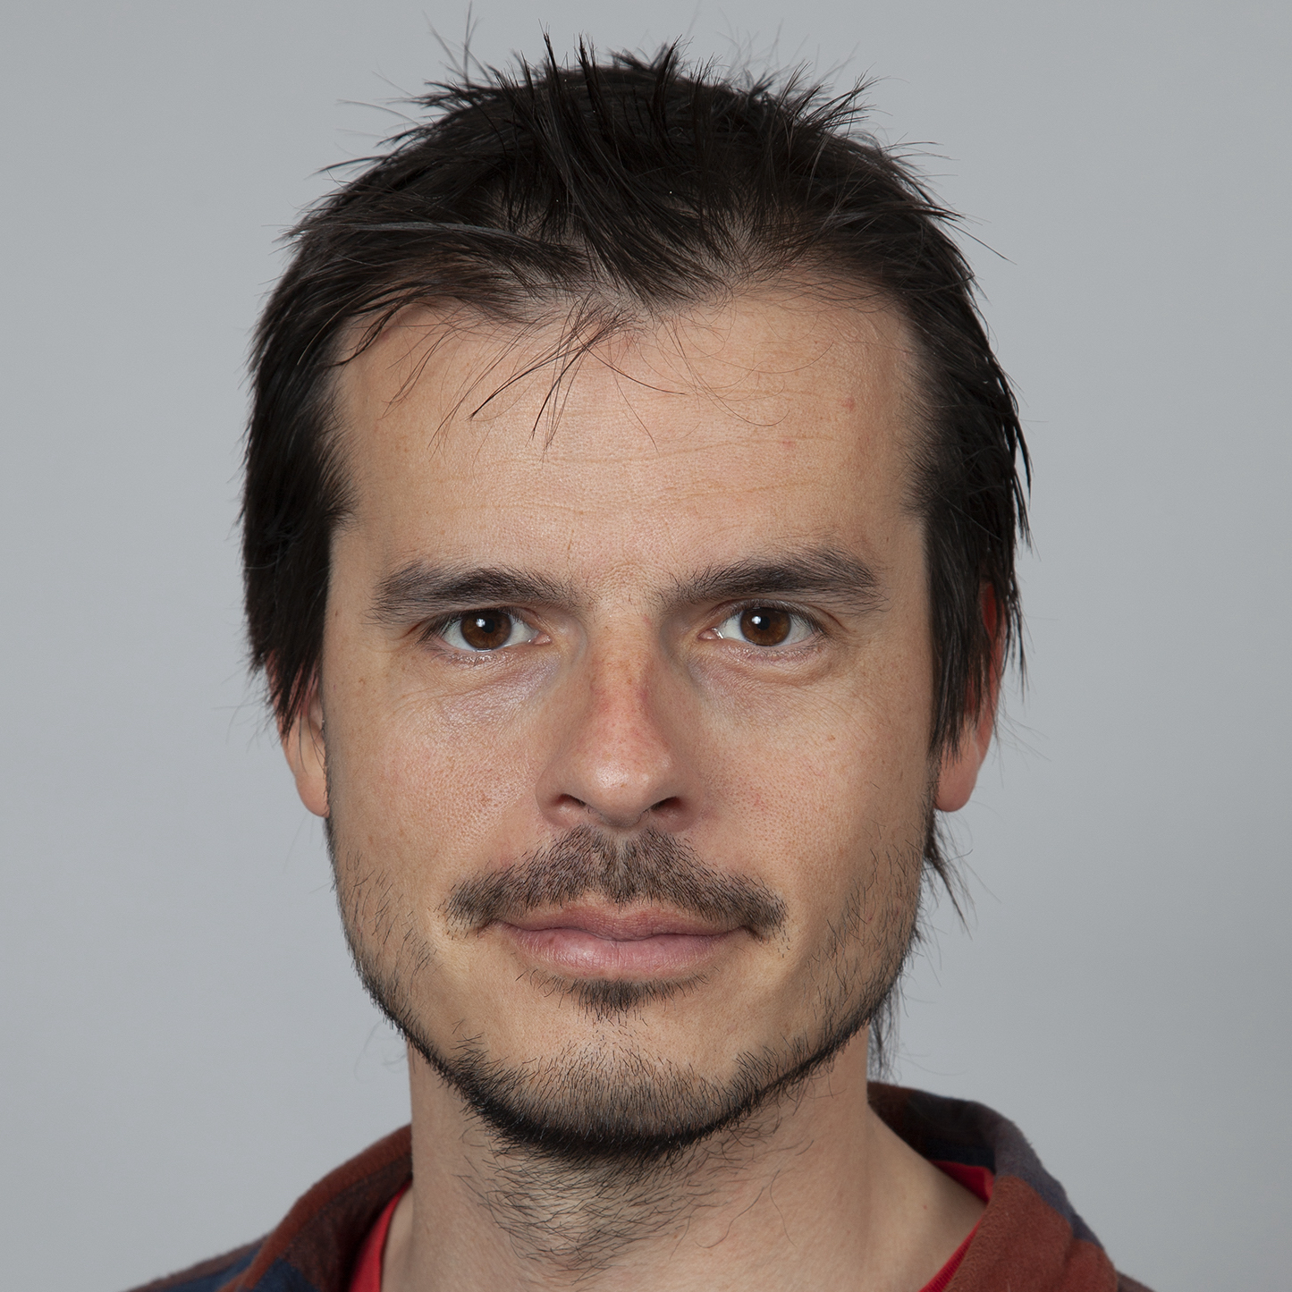
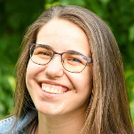
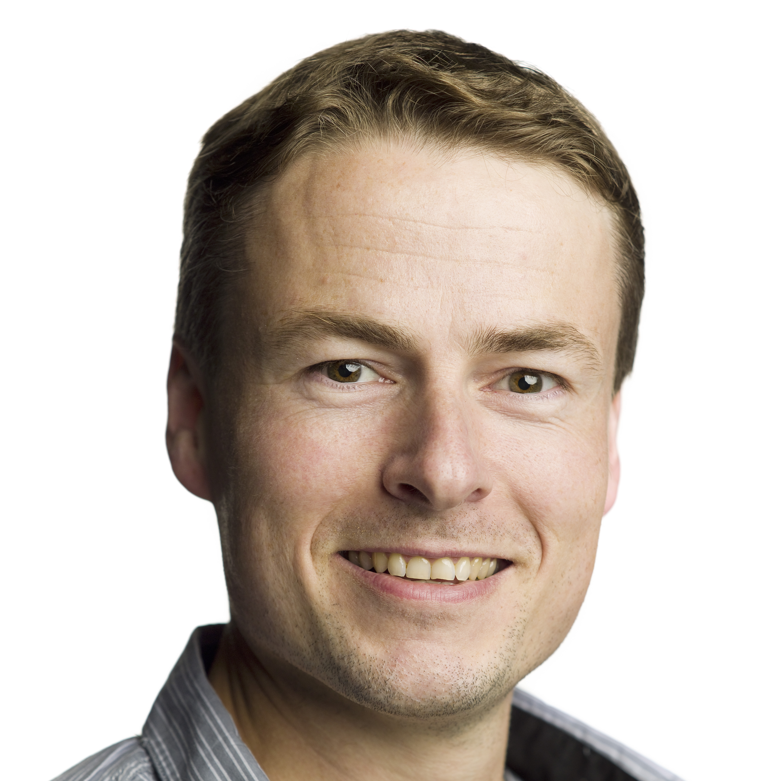
Node staff
Dag Endresen, UiO Oslo – Node manager
Rukaya Johaadien, UiO Oslo – Data manager
Vidar Bakken, UiO Oslo – Data mobilization
Michal Torma, UiO Oslo – Data steward
Erik Kusch, UiO Oslo – BioDT
Desalegn Gelete, UiO, Oslo – BioDT
Knut Hovstad, NBIC, Trondheim – Data mobilization
Stein Hoem, NBIC, Trondheim – IT Manager
Anders Finstad, NTNU, Trondheim – Science
Caitlin Mandeville, NTNU, Trondheim – Data use
Beatrice Maria Trascau, NTNU, Trondheim
Andreas Altenburger, UiT, Tromsø – Marine data
Katrine Kongshavn, UiB, Bergen – Marine data
Erlend Birkeland, NINA, Trondheim – Living Norway
Roald Vang, NINA, Trondheim – IT Manager
Regular bi-weekly (virtual) node meetings

Slide 22
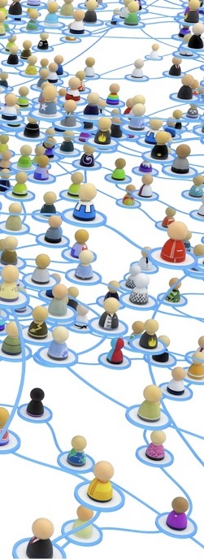
Some Key node collaboration projects
Biodiversity Digital Twin – BioDT (Horizon Europe, 2022-2025)
GBIF CESP mentoring (with Tajikistan) (2022)
BioDATA DNA barcode data (with South Africa [and Russia]) (2021-2024)
BioMedData – FAIR data management (lead by ELIXIR, 2020-2025)
DiSSCo Prepare (ESFRI preparatory phase) (2020-2023)
GBIF CESP OpenPSD (Private-sector data mobilization) (2019-2021)
BioDATA biodiversity data skills (Caucasus and Central Asia) (2018-2022)
GBIF CESP Bireme (EU Directorate reporting) (2017-2018)
Marine data mobilization (Nansen Legacy, OBIS, etc) (recent years)

Slide 23
Dag Endresen
GBIF Nodeleder for Norge
UiO Naturhistorisk museum
Forskningsgruppe for Maskin-lesbar Natur (MaNa)

Slide 24
EXTRA slides
Some extra slides included here to present some of the biodiversity research data infrastructures the Norwegian GBIF node has collaboration with…

Slide 25
Biodiversity research infrastructure in Norway
GBIF ECA Nodes Meeting in Warsaw Poland May 2023
Notes:
GBIF Regional ECA Nodes meeting, Warsaw, May 2023
GBIF Norway, UiO Natural History Museum in Oslo, University in Oslo | www.gbif.no
Photo: ForBio/GBIF training at Baikal lake September 2018, CC-BY Dag Endresen

Slide 26
Landscape –national biori nodes
Global Biodiversity Information Facility – Norway (since 2004)
DiSSCo Norway (since 2019) – under development
Revita – Digitization of museum specimens (since 2007)
ForBio – Research School in Biosystematics (since 2010)
BioDATA – biodiversity information skills (since 2018)
Living Norway Ecological Data Network (since 2020)
eLTER Norway (since 2022) – ecological data (under development)
Norwegian Barcode of Life network - NorBOL (since 2012)
ELIXIR Norway (since 2014) – Molecular biodiversity WG
Nature Biobank / DNA Bank – proposed (under development)
GEO BON, GEOSS representatives in Norway
Nordic e-Infrastructure Collaboration (NeIC)

Slide 27
Norwegian Biodiversity Information Centre

Slide 28
DiSSCo Norway (RCN & ESFRI infrastructure)
Distributed System of Scientific Collections – DiSSCo RI
DiSSCo Prepare (ESFRI) (2020-2023)
DiSSCo Norway consortium MoU signed (by the 4 university museums)
Aligned and/or integrated GBIF Norway with DiSSCo Norway

Slide 29
Distributed DiSSCo Node Consortium
Tromsø
formalized sharing of Node responsibilities
Oslo
University of Oslo, Natural History Museum
Tromsø
UiT The Arctic University Museum of Norway
Trondheim
Norwegian University of Science and Technology, University Museum
Bergen
UiB, University Museum of Bergen
Trondheim
Bergen
Oslo
Notes:
University

Slide 30
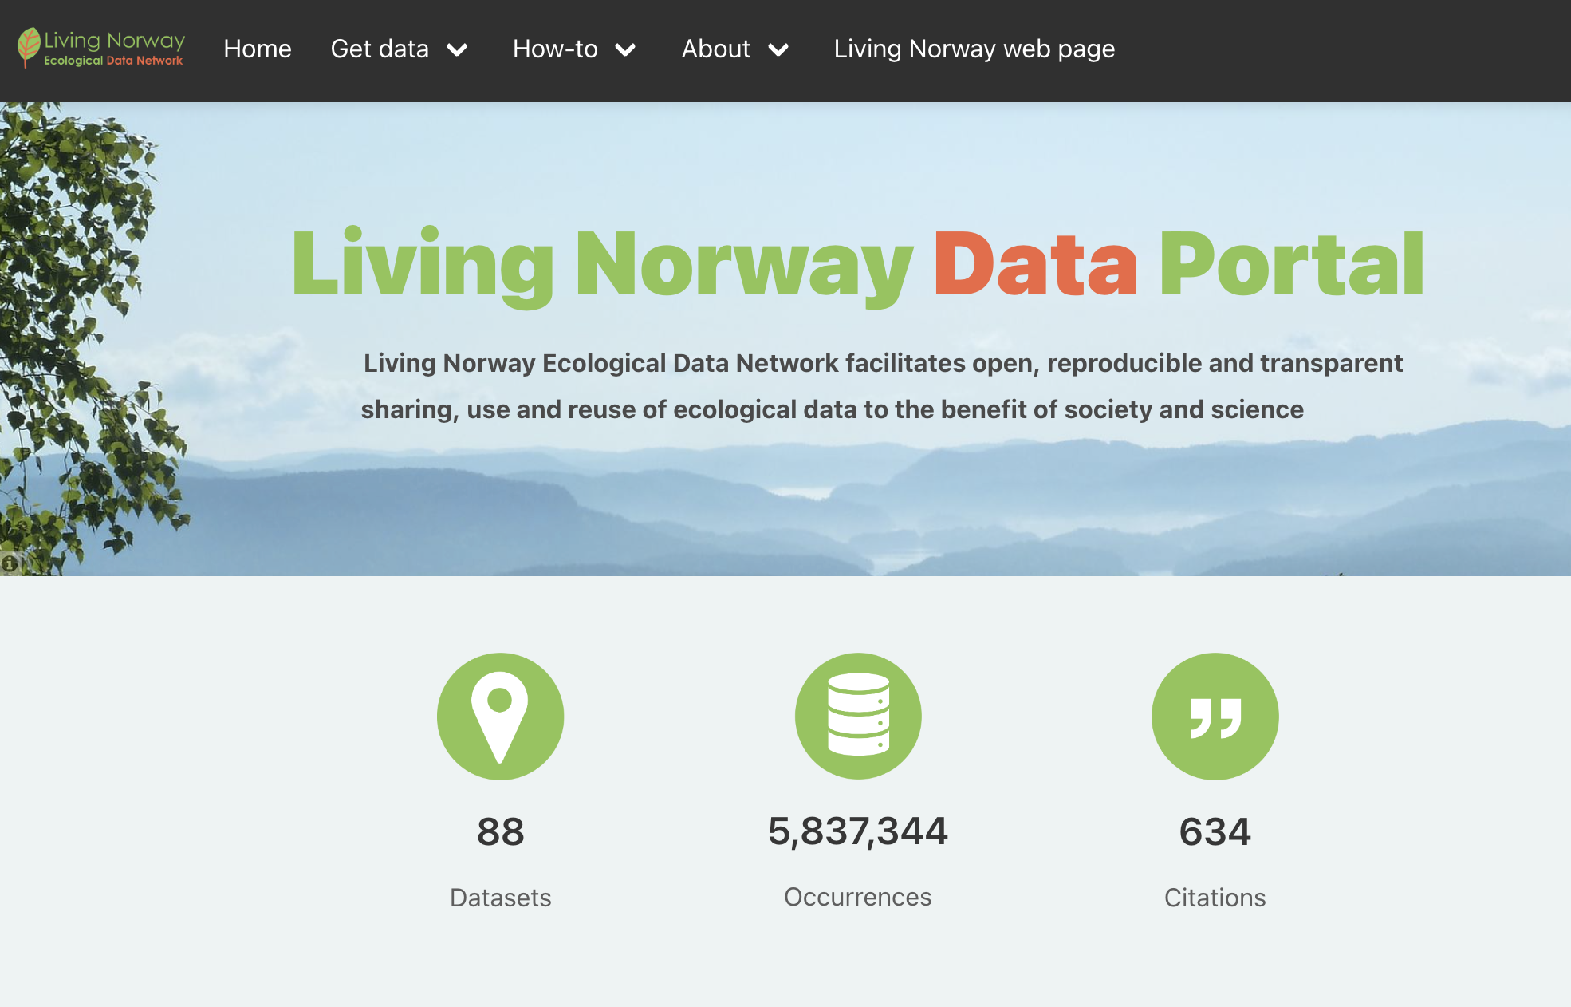
Data mobilization
Institute sector
Ecology & Observation data
NINA coordination
Distributed infrastructure
Consortium (8 institutions)
GBIF Hosted Portal
Annual colloquium meetings
Open Science courses
Notes:
Figure: Main data flow of Living Norway (black arrows) with datasources (blue boxes) sorted according to technical components (green boxes) and components of associated or integrated infrastructure (grey boxes). References to tasks responsible for implementing and operating technical components listed in Table 1 are given in brackets.

Slide 31
Living Norway Ecological Data Network
Tromsø
Trondheim
Norwegian Institute of Nature Research (NINA)
Norwegian University of Science and Technology
Norwegian Biodiversity Information Centre
Bergen
University of Bergen
Oslo
University of Oslo
Norwegian University of Life Sciences
Norwegian Institute of Bioeconomy Research
Norwegian Institute for Water Research
Trondheim
Bergen
Oslo
Notes:
University

Slide 32
Nature Biobank (RCN infrastructure)
Nature biobank of digitized material samples in silico
Distributed infrastructure
Builds on museum collections, DNA barcoding, genome sequencing and DiSSCo RI
Proposed – not funded (yet)

Slide 33
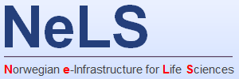
ELIXIR Norway
National node of ELIXIR
Distributed infrastructure
supporting life science research and its translation to medicine, environment, the bioindustries and society
Molecular biodiversity working group

Slide 34
ELIXIR Norway – BioMedData (2020 – 2024)

Slide 35
Marine data research data infrastructures

Slide 36
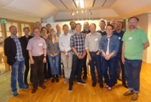
NordForsk – NEiC – Nordic eInfrastructure collaboration
DeepDive (2017 - 2019) Nordic-Baltic Collaboration on e-Infrastructures for Biodiversity Informatics
Nordic Lifewatch cooperation (NordForsk report 2014)
Notes:
https://neic.no/news/2015/08/31/new-ideas-to-develop-e-infrastructure-for-nordic-biodiversity/
https://neic.no/deepdive/
Nordic LifeWatch report 2014 https://www.duo.uio.no/handle/10852/50260, http://urn.nb.no/URN:NBN:no-53904

